Slide 1
Anesthetic Considerations for Necrotizing Enterocolitis
Updated 9/2019
Monica Williams, MD
Johns Hopkins School of Medicine

Slide 2
Disclosures
No relevant financial relationships

Slide 3
Learning Objectives:
The learner will be able to identify key features of NEC
The learner will be able to describe the pathophysiology of NEC
The learner will be able to describe implications of NEC on anesthetic preparation

Slide 4
Background Information
Necrotizing enterocolitis (NEC) is the most common gastrointestinal emergency in neonatal intensive care units.
True incidence is unknown, but in US proven NEC occurs in 1-3 per 1000 live births.
Globally, the reported incidence varies from 2-7% across NICUs.
Over 90% of cases are associated with very low birth weight neonates (<1500 g) born <32 weeks.
Outcomes
Mortality rates range from 15-30%
Mortality is inversely related to gestational age and birth weight.

Slide 5
Backgroung information continued
NEC in Preterm Infants
Incidence of NEC increases in very low birth weight (VLBW) infants (<1500g) and infants born at <32 week gestation.
Rates of NEC increased 5-fold for infants <1000g and <28 weeks.
NEC in Term Infants
10-15% of NEC cases occur in term infants
Studies demonstrate increased incidence in infants receiving non-human milk and have pre-existing illness
Associated conditions: sepsis, congenital heart disease, perinatal hypoxia, and fetal growth restriction.

Slide 6
Clinical Presentation
NEC can present with both GI and systemic signs.
Most common presentation:
Sudden change in feeding tolerance
Abdominal distension and tenderness
Lethargy
Respiratory distress
Temperature instability (sudden variation and inability to maintain normothermia)
Signs of hemodynamic instability
Timing of presentation
Onset of symptoms varies and may be inversely related to gestational age.
Median age of onset of NEC
GA less than 26 weeks – 23 days
GA greater than 31 weeks – 11 days

Slide 7
Making the Diagnosis
Radiologic findings:
Plain x-rays may demonstrate free intraperitoneal air, dilated loops of bowel, ascites, and pneumatosis intestinalis.
Ultrasound of abdomen can demonstrate absence of mesenteric blood flow.
Contrast enemas are NOT recommended and may cause more harm
Laboratory findings (not diagnostic on their own)
Thrombocytopenia
Metabolic acidosis
Coagulopathy
Persistantly high levels of C-reactive protein

Slide 8
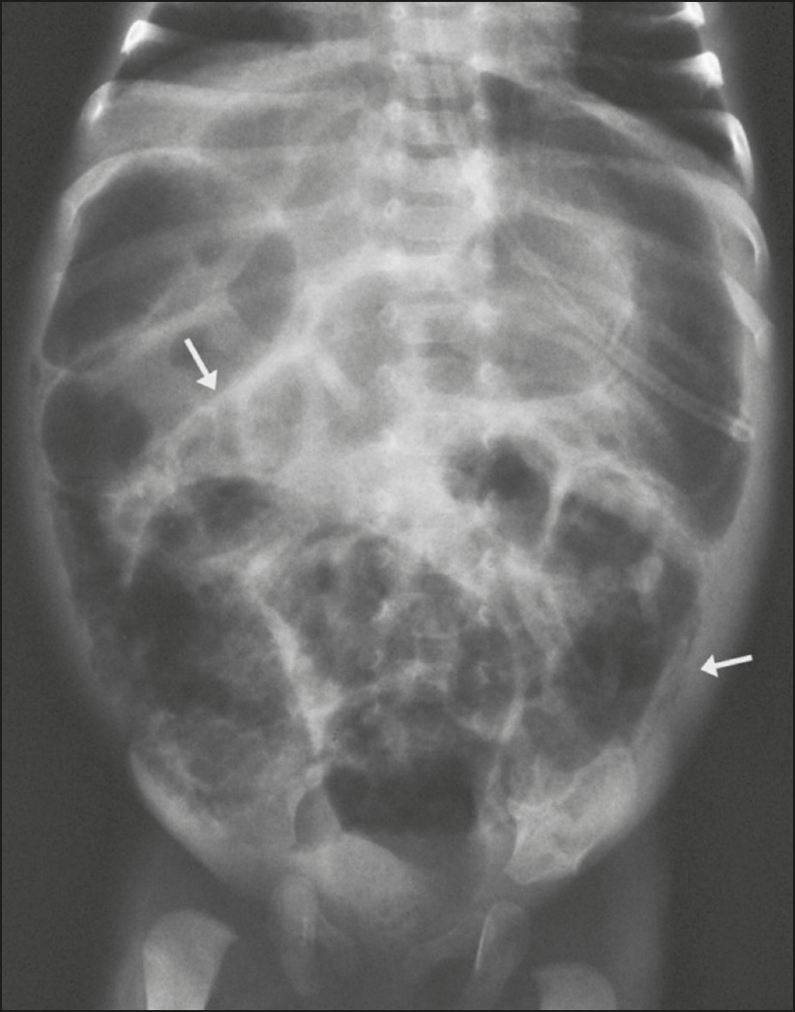
Abdominal Imaging in NEC
Abdominal x-ray of neonate with NEC demonstrating dilated loops of bowels and arrows indicating pneumatosis
Santos IG, et al. Radiologia Brasileria 2018.
Notes:
Santos, Isabela Gusson Galdino dos, Mezzacappa, Maria Aparecida, & Alvares, Beatriz Regina. (2018). Radiological findings associated with the death of newborns with necrotizing enterocolitis. Radiologia Brasileira, 51(3), 166-171. https://dx.doi.org/10.1590/0100-3984.2017.0040. Open Access distributed under Creative Common Attribution License.

Slide 9
Making the diagnosis
Diagnosis | Signs | Symptoms | Treatment
Suspected NEC | Abdominal distension and feeding intolerance, heme-positive stool | Normal X-rays or mild dilation, no signs of pneumatosis or portal vein gas. | Close observation, consider bowel decompression and holding feeds. Consider blood cultures, broad spectrum antibiotics.
Medical NEC | Same as above but grossly bloody stools | X-rays show dilated loops of bowel. Pneumatosis +/- portal vein gas. | Bowel decompression and hold feedings for 7-10 days. Close monitoring, blood cultures, antibiotics.
Surgical NEC | Abdominal distension | Free intraperitoneal air on abdominal x-rays | Exploratory laparotomy with resection if necessary
Surgical NEC | Abdominal distension | Persistant ileus | Placement of drain

Slide 10
Pathophysiology of NEC
Probably multifactorial, but not completely understood
Preterm infants are predisposed because of immature motility, defenses, absorption and an excessive inflammatory response to luminal microbial stimuli.
Based on timing of NEC (at least 8-10 days post partum), inappropriate microbial colonization may also be an important factor.
Hypoxia-ischemia may also contribute by modulating microvascular tone
A combination of these factors can lead to intestinal necrosis.

Slide 11
Pathophysiology continued
Fetal hypoxia and perinatal asphyxia
Reduce intestinal motility
Watershed areas of ileum and colon are sensitive and are the most commonly affected bowel segments
Umbilical artery catheters
Can reduce mesenteric blood flow
If NEC is suspected, remove catheter
Predisposing factors for NEC
Prematurity
Immature immune system
Infection

Slide 12
Medical Management of NEC
Bowel rest
Bowel decompression
Broad spectrum antibiotics
Supportive care for hemodynamics, and ventilator support for respiratory compromise

Slide 13
Surgical Management
Surgical intervention is necessary when there is bowel perforation, gangrenous bowel, and pneumoperitoneum.
Usually the surgery involves resection of the gangrenous bowel, and enterostomy formation.
If extremely unstable, can place a peritoneal drain to temporize and optimize care before transporting to an operating room.

Slide 14
Anesthetic Management (Pre-Op)
Try to optimize pre-operatively if time allows, and try to correct hypovolemia, metabolic acidosis, coagulopathy, and hypocalcemia.
Patients may present on vasopressors, and/or extremely acidotic. Be sure to check labs and ensure blood is available for transfusion.
Ensure adequate venous access – at least 2 peripheral IVs or 1 peripheral and a central access line.

Slide 15
Anesthetic Management
Standard ASA monitoring plus peripheral arterial line
Again, ensure adequate venous access
In addition to large volume of IV fluids, may need inotropic support (dopamine, epinephrine, or vasopressin)
For intermittent bolus dosing, 1mcg/kg/dose of epinephrine can help temporize
If possible, follow urine output and look for at least 0.5mL/kg/hr
Replace blood loss with blood and fresh frozen plasma

Slide 16
Anesthetic Management Cont
Usually these neonates are very sick and already intubated, but if not, an awake intubation or rapid sequence intubation is preferred
Avoid nitrous oxide to prevent further bowel distension
For maintenance, use air/oxygen mixture to maintain SpO2 around 90%
Notes:
Remember that for neonates, using higher FiO2 is not ideal because of risk of retinopathy of prematurity which can lead to vision loss.

Slide 17
Anesthetic Management
Aggressively avoid hypothermia
Very warm OR temperature
Radiant heat lamps
Warming blankets
Warm IV fluids
Wrap head and extremities in plastic
Warm and humidify gases
Notes:
Heat loss occurs in patients mainly via radiant heat loss, which is the difference between the patient and that of the environment. For premature infants, the recommended room temperature is 29 degrees Celsius.

Slide 18
Post-operatively
Expect to continue ventilation in the NICU
Transport in warmed isolette with full monitoring
Expect a prolonged ileus and consider central line for TPN and continued inotrope support until sepsis is controlled.
Infants that initially respond to medical management or a drain may still eventually need surgical management.
Acute complications include infections, disseminated intravascular coagulation, and further metabolic or cardiovascular compromise.
Notes:
About 50% of patients that initially respond to drain placement continue on to need a laparotomy, but there is no difference in mortality between the two procedures.
Late complications include strictures, intestinal failure, recurrent NEC, and adhesion ileus.

Slide 19
Conclusions:
Have a high suspicion for NEC – especially for the low birth weight preterm infants.
Not every patient with NEC will need a laparotomy, a drain or medical management are options for the correct patient population.
Intraoperatively, expect dramatically high fluid requirements, and consider inotropic support.
Worry about hypothermia, and aggressively try to prevent.
Continue ventilation and cardiovascular support post-operatively

Slide 20
References:
Pierro A. The surgical management of necrotizing enterocolitis. Early Hum Dev. 2005 Jan; 81(1): 79-85.
Sodhi P, Fiset P. Necrotizing enterocolitis. Continuing education in Anaethesia. 2012; 12 (1): 1-4.
Kliegman R. Neonatal necrotizing enterocolitis: bridging the basic science with the clinical disease. J pediatric 1990: 117: 833-835.
Hillier S. Neonatal anesthesia. Semin Pediatr Surg. 2004 Aug; 13 (3): 142-151.
Kim JH. Neonatal necrotizing enterocolitis: Clinical features and diagnosis. UpToDate. Updated June 21, 2019, from https://www.uptodate.com/contents/neonatal-necrotizing-enterocolitis-management#H7
Neu J. Necrotizing Enterocolitis. N Engl J Med. 2011 Jan 20; 364: 255-64.

