Slide 1
COVID-19: Strategies for Preventing Transmission With Limited Resources
Andrew Infosino, MD
Department of Anesthesia and Perioperative Care
University of California San Francisco

Slide 2
Disclosures
No relevant financial relationships

Slide 3
Disclaimer
Many of the strategies discussed in this presentation have not been adequately studied or approved by regulatory authorities such as the United States Food and Drug Administration (FDA). In some cases, the FDA has issued an emergency use authorization (e.g. extended use of N95s due to the extreme worldwide shortage), which can be rescinded at any time.
A discussion of these strategies in this presentation does not indicate an endorsement by SPA.

Slide 4
Learning Objectives:
Recognize the value of educating health care workers and the public on strategies for preventing transmission
Promote handwashing/alcohol based hand-sanitizer usage and face mask usage in public and in health care settings
Identify options for decreasing the potential for transmission by utilizing face masks, face shields, and intubation boxes/barriers
Describe options for dealing with limited supplies of N95 masks

Slide 5
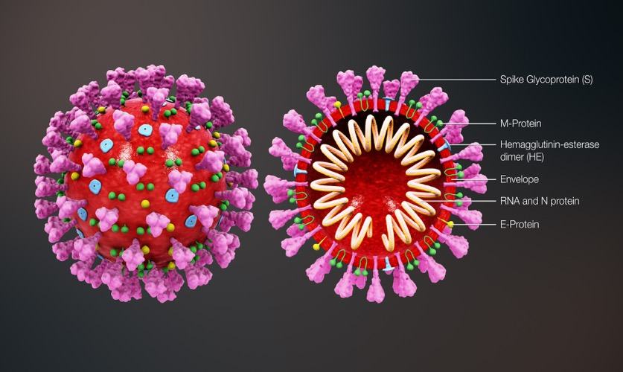
COVID-19: Worldwide Pandemic
Disease: Covid-19 (COronaVIrus Disease - 2019)
Virus: SARS-CoV-2 (Severe Acute Respiratory Syndrome CoronaVirus 2)
https://commons.wikimedia.org/wiki/File:3D_medical_animation_coronavirus_structure.jpg

Slide 6
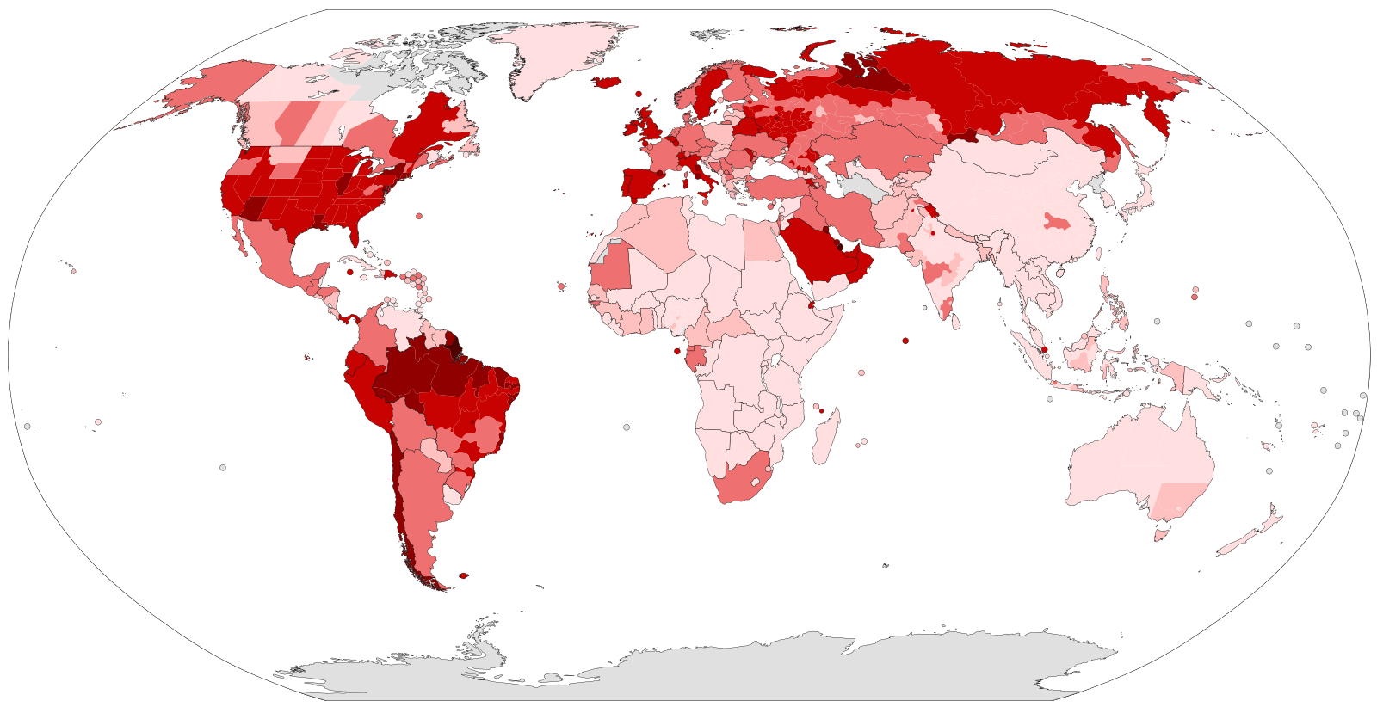
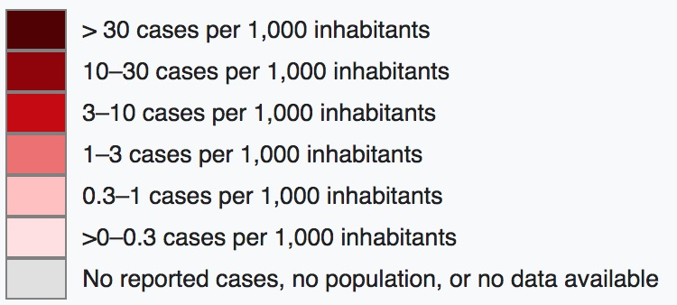
COVID-19: Worldwide Pandemic
Map of the COVID-19 verified number of infected per capita as of 30 June 2020.
Notes:
Map of the COVID-19 verified number of infected per capita as of 30 June 2020. Since this is a rapidly evolving situation, new cases may not be immediately represented visually. Refer to the primary article 2019–20 coronavirus pandemic or the World Health Organization's situation reports for most recent reported case information.Every country larger than 3 million km² or with a bigger population than 200 million people has been split up into its first level administrative division for better visualization of the spread of the epidemic.
https://en.wikipedia.org/wiki/File:COVID-19_Outbreak_World_Map_per_Capita.svg
Wikipedia 5/2/20. Licensed under the Creative Commons Attribution 4.0 International license.

Slide 7
COVID-19: Worldwide Pandemic
SARS-CoV-2 is extremely contagious with over 10 million infections in over 200 countries*
To date, there is no vaccine and no effective treatment leaving prevention of infection and decreasing transmission as the most rational approaches
*As of June 30, 2020

Slide 8
COVID-19: Worldwide Pandemic
Strategies for decreasing transmission of COVID-19
Hand washing
Face masks and face shields
Social or physical isolation
Testing, contact tracing and isolating individuals with COVID-19

Slide 9
COVID-19: Decreasing Transmission
Governmental Public Health Responsibility:*
Testing, tracking and isolating individuals with COVID-19
Promoting social or physical isolation
  Banning travel, closing borders
  Preventing public gatherings and events
  Closing schools and non-essential businesses
  Shelter-in-place orders
Encouraging face mask usage
*Not the focus of this presentation

Slide 10
COVID-19: Decreasing Transmission
Our Responsibility:
Educating ourselves, our colleagues and the public about the best approaches to decreasing transmission
Leading by example:
  Encourage hand washing
  Utilize personal protective equipment (PPE): gowns, gloves, face masks and face shields
  Consider barriers to block respiratory droplets during intubation/extubation

Slide 11

COVID-19: Decreasing Transmission
WHO Hand Hygiene for All Global Initiative:*
Hand washing with soap and water can help stop the spread of COVID-19:
Image by Annalise Batista from Pixabay, Pixabay License Free for commercial use. No attribution required
Notes:
https://www.who.int/water_sanitation_health/sanitation-waste/sanitation/hand-hygiene-for-all/en/
Hand Hygiene for All Global Initiative
A call to action for all of society to achieve universal hand hygiene and stop the spread of COVID-19

Slide 12

COVID-19: Decreasing Transmission
If soap and water are not available use alcohol based hand sanitizer
Pixabay License. Free for commercial use. No attribution required
Notes:
Pixabay License Free for commercial use
No attribution required

Slide 13

COVID-19: Decreasing Transmission
Alcohol based hand sanitizer
Final concentration of alcohol needs to be at least 60% to be effective
Can be formulated locally
Glycerol (Glycerin) or aloe vera gel: counteract the effects of alcohol on the skin and add viscosity
Essential oil can be added for color/smell
Pixabay License. Free for commercial use. No attribution required
https://www.healthline.com/health/how-to-make-hand-sanitizer#ingredients
https://www.tomsguide.com/news/how-to-make-hand-sanitizer-ingredients-for-making-it-at-home

Slide 14
Alcohol Based Hand Sanitizer:
WHO Recipe*:
Ethanol 96%
or + Hydrogen peroxide 3% + Glycerol 98%
Isopropyl alcohol 99.8%
Recipe is for 10 liter production
Alcohol is active antibacterial and anti-viral ingredient
Hydrogen peroxide is added to kill any spores
Glycerol (glycerin) is added as an emollient
Production cost worldwide is approximately $0.40 - $0.50 per 100 ml including local production costs and dispenser
*https://www.who.int/gpsc/5may/Guide_to_Local_Production.pdf

Slide 15
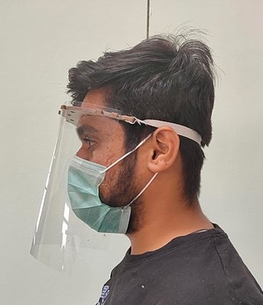
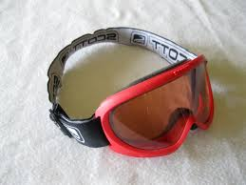
COVID-19: Decreasing Transmission
Utilizing face shields can minimize respiratory droplets contaminating eyes or face
Many designs can be 3D printed and are available on the internet
3D printed plastic clips can be affixed to a standard protective ballcap and used to hold a protective face shield in place¹
Ski goggles have also been utilized as eye protection and can be washed and reused
https://en.m.wikipedia.org/wiki/File:Face_shield_4.jpg
https://commons.wikimedia.org/wiki/File:Scott_Ski_goggles.jpg
¹https://johndeerejournal.com/2020/04/john-deere-innovations-enhance-employees-safety/
Notes:
https://en.m.wikipedia.org/wiki/File:Face_shield_4.jpg
https://commons.wikimedia.org/wiki/File:Scott_Ski_goggles.jpg

Slide 16
COVID-19: Decreasing Transmission
Decreasing the potential of respiratory droplets contaminating health care workers during intubation, extubation or transport
Use of video-laryngoscopy to distance the practitioner from the patient during intubation
Clear acrylic boxes to enclose the patient’s head
Clear plastic draped over a frame made from plastic PVC pipe
Notes:
https://commons.wikimedia.org/wiki/File:COVID-19_Intubation_Safety_Box,_personal_protective_equipment_(PPE)_produced_by_Ascalon_Studios,_Inc.jpg

Slide 17
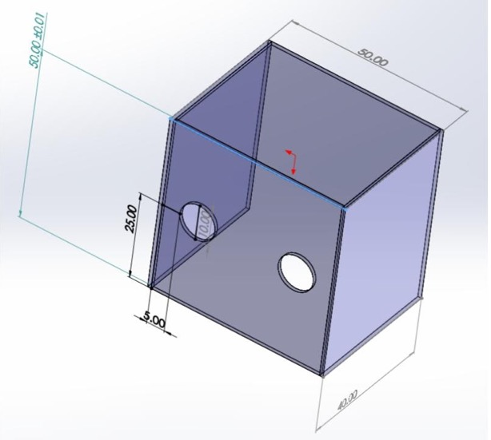
Decreasing Transmission
Clear acrylic boxes: may help prevent transmission, but no verified evidence of their efficacy
Acrylic or transparent polycarbonate sheets
Holes for arm insertion
Reusable: disinfect with 70% alcohol or diluted bleach solution
Cost: < $100
May be problematic during emergency situations, difficult airways or emesis
https://sites.google.com/view/aerosolbox/design?authuser=0
Notes:
Creative Commons Attribution-NonCommercial 4.0 International License
https://sites.google.com/view/aerosolbox/design?authuser=0
Designed by Dr. Hsien Yung Lai
https://commons.wikimedia.org/wiki/File:COVID-19_Intubation_Safety_Box,_personal_protective_equipment_(PPE)_produced_by_Ascalon_Studios,_Inc.jpg

Slide 18
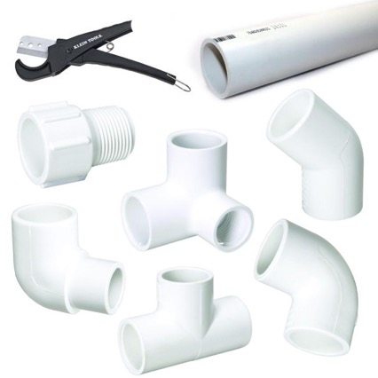
Decreasing Transmission
Plastic drapes suspended over a PVC frame
Intubation frame from PVC pipe:
  Easy to make/assemble
  Can be customized to size of patient
Frame is reusable: disinfect with 70% alcohol or diluted bleach solution
Cost: < $20
Instructional videos widely available on YouTube
https://www.youtube.com/watch?v=sv9jPYiAY38
https://www.youtube.com/watch?v=8tgfqOgK7ns
https://www.flickr.com/photos/16863012@N06/9719477800
Notes:
https://www.flickr.com/photos/16863012@N06/9719477800
By It's Great To Be Home
Attribution-NonCommercial 2.0 Generic (CC BY-NC 2.0)

Slide 19
Approaches/Barriers During Intubation:
Method | Cost
Video Laryngoscopy | $$$$$
Acrylic Boxes | $$
PVC pipe Frame with clear plastic drapes | $

Slide 20
COVID-19: Decreasing Transmission
Wearing face masks or facial coverings can decrease the spread of SARS-CoV-2
Encourage the public to wear face masks whenever they leave their homes
Establish policies so that everyone in hospitals and health care facilities (including patients) wear face masks whenever possible
Promote the local manufacture of face masks

Slide 21
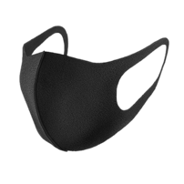
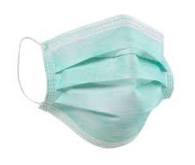
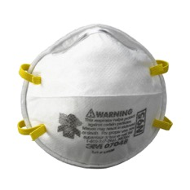
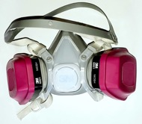
Types of Face Masks
Cloth surgical masks
Cloth masks with replaceable filters
Surgical Masks
N95 Masks: Filters 95% of particles > 0.3 microns
P99 or P100
Notes:
Black cloth face mask:
Image category: Medical mask
Format: PNG image with alpha (transparent)
License: Creative Commons 4.0 BY-NC
Facemask
License: Creative Commons 4.0 BY-NC for surgical mask
N95
https://www.flickr.com/photos/dreamsspatial/25004624788
Attribution 2.0 Generic (CC BY 2.0)
P100
https://commons.wikimedia.org/wiki/File:P100_ovm_respirator.jpg

Slide 22

Homemade Cloth Masks
Cloth masks are easy to make with a sewing machine
2-3 layers of fabric are recommended
Higher thread count fabrics filter virus better
Adding pleats allows the mask to conform better to the curve of the face
Patterns and information on choosing the best fabric are available online
  https://threadsmonthly.com/free-fabric-face-mask-sewing-patterns/ l
  https://sarahmaker.com/how-to-sew-a-surgical-face-mask-for-hospitals-free-pattern/
  https://www.thesprucecrafts.com/diy-face-masks-4800726
  https://www.allfreesewing.com/Accessories-to-Sew/Patterns-for-Face-Masks
PNG License: Creative Commons 4.0 BY-NC

Slide 23
Homemade Cloth Masks With Filters
Cloth mask is made with a pocket to hold a replaceable filter which increases the ability to filter small viral sized particles
Many materials can be used as a filter including coffee filters, paper towels, Halyard 600 cloth, air filters, etc. but very limited scientific testing
Masks can be washed and a new filter can be inserted
https://ithinksew.com/Products/Details/2781
http://www.arkansasfashion.org/instructions-for-contoured-face-mask-with-filter-pocket/
https://www.healthline.com/health/how-to-make-a-face-mask-with-filter
https://jennifermaker.com/diy-face-mask-filter-materials/
https://www.youtube.com/watch?v=9ljLYHedxyU
https://www.youtube.com/watch?v=Eg9fOot-CAQ

Slide 24
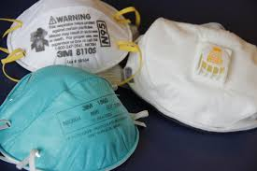
N95 Masks: Classification
The letter indicates the filter's ability when exposed to oils
  N: Not resistant to oil
  R: Somewhat resistant to oil
  P: Strongly resistant to oil
The number indicates the percentage of 0.3 micron particles blocked: most common are 95, 99 or 100
https://pixnio.com/science/medical-science/face-masks-or-respirators
https://www.osha.gov/

Slide 25
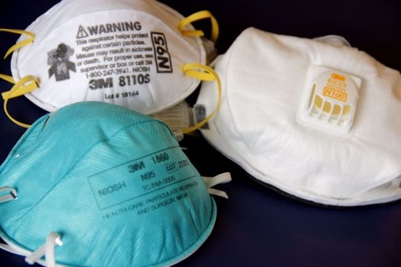
N95 Masks: How Are They Made?
Filtration layer traps particles:
  Tangle of melt-blown synthetic threads < 1 micron thick
  Electrostatic charges from polarized material
https://pixnio.com/science/medical-science/face-masks-or-respirators
Prefiltration layer: non-woven fabric that is molded to create shape
Inner and outer surfaces are nonwoven fabric made of spun bond polypropylene threads 15-35 microns thick
All photos and videos on Pexels can be downloaded and used for free.
Notes:
https://pixnio.com/science/medical-science/face-masks-or-respirators
PIXNIO - Image usage: Image is in public domain, not copyrighted, no rights reserved, free for any use. You can use picture for any personal and commercial use without the prior written permission and without fee or obligation.

Slide 26
N95: International Equivalents
Country | Classification | Certification
USA | N95 | NIOSH-42CFR84
Australia, New Zealand | P2 | AS/NZA 1716:2012
Brazil | PFF2 | ABNT/NBR 13698:2011
China | KN95 | GB2626-2006; GB 2626-2019
European Union | FFP2 | EN 149-2001
Japan | DS | JMHLW-Notification 214, 2018
Korea | KF94 | KMOEL - 2017-64
Mexico | P95 | NOM-116-2009
Russia | FFP2 | GOST R 12.4.191-2011
Taiwan | D2 | CNS 14755
Notes:
3M
OSHA news release April 3,2020

Slide 27
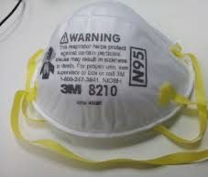
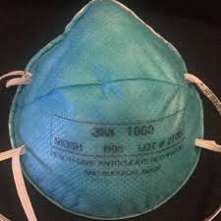
N95 Masks: Industrial vs Medical
Industrial:
  E.g. 3M 8210 or 8110S
  N95 filtration rating
  Not fluid resistant
Medical:
  E.g. 3M 1860 or 1860S
  N95 filtration rating
  fluid resistant
https://en.wikipedia.org/wiki/N95_mask#/media/File:3M_N95_Particulate_Respirator.JPG
https://en.wikipediaorg/wiki/N95_mask#/media/File:Surgical_N95.jpeg
Notes:
https://en.wikipedia.org/wiki/N95_mask#/media/File:Surgical_N95.jpeg (green)
https://en.wikipedia.org/wiki/N95_mask#/media/File:3M_N95_Particulate_Respirator.JPG (white)

Slide 28
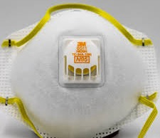
N95 Masks: Exhalation Valves
Exhalation occurs via valve
Easier to breath through (minimal resistance on exhalation)
Reduces heat/moisture build up in mask
https://creativecommons.org/licenses/by-nc-nd/2.0/
Protects the wearer, not others
Not recommended for medical use
Notes:
For N95 valved Mask
Attribution-NonCommercial-NoDerivs 2.0 Generic (CC BY-NC-ND)
https://creativecommons.org/licenses/by-nc-nd/2.0/
You are free to Share — copy and redistribute the material in any medium or format
.

Slide 29
N95 Shortages:
Potential Solutions
Extended use of the same mask: disposable surgical mask worn over N95 can protect it from secretions
Industrial N95 as substitute: not fluid resistant
N99, P99, P100 industrial masks/respirators: adequate protection, but difficult to breathe through
“Creative” make your own face masks approximating the filtering ability of traditional N95s
All of the above listed potential solutions may not provide adequate protection against SARS-CoV-2, have not been adequately studied and have not been approved by the FDA

Slide 30
Make Your Own ”N95s”
Many organizations have suggested approaches for making an “N95” equivalent face mask when N95s are not available
Anesthesia Facemask Respirator with HEPA filter¹
Halyard Fabric Sew-Your-Own²
3D printable respirators³
All of the above potential solutions may not provide adequate protection against SARS-CoV-2, have not been adequately studied and have not been approved by the FDA
Notes:
¹https://www.childrenshospital.org/research/departments-divisions-programs/departments/surgery/surgical-innovation-fellowship
²https://anest.ufl.edu/clinical-divisions/mask-alternative/
³https://medeng.jpl.nasa.gov/covid-19/respirators/

Slide 31
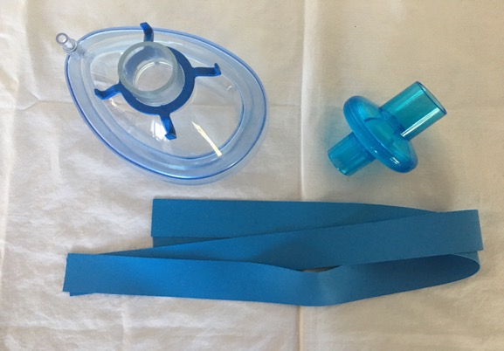
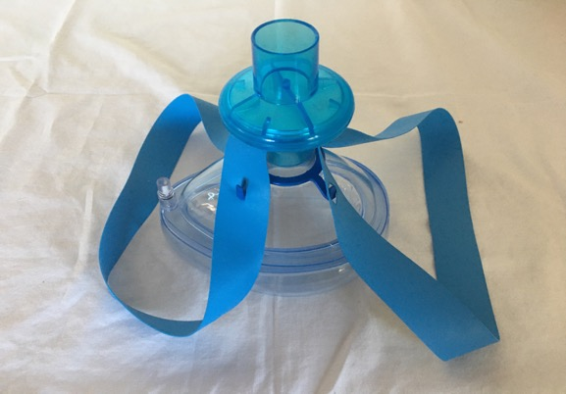
“Creative” Make Your Own N95: Anesthesia Facemask Respirator
Easily made from anesthesia facemask, HEPA filter and elastic straps such as tourniquets
Mask can be washed and reused after replacing filter
Can be difficult to breathe through HEPA filter (P100) for extended periods
→
https://www.childrenshospital.org/research/departments-divisions-programs/departments/surgery/surgical-innovation-fellowship
Notes:
Photos by author
HEPA (High efficiency particulate Air) filter is equivalent to a P100 filter (Used in PAPR)

Slide 32
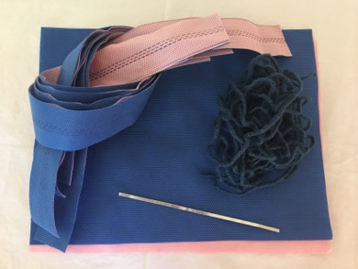
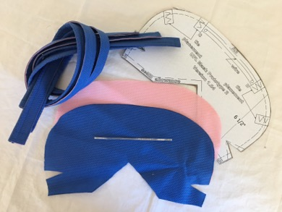
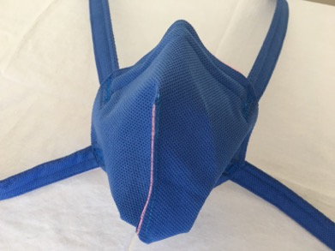
“Creative” Make Your Own N95: Halyard Fabric Sew-Your-Own
Easily made with a sewing machine from 2 layers of Halyard H600 medical fabric and 16G wire for nose piece
Prototypes, patterns and instructional videos available online
→
→
https://anest.ufl.edu/clinical-divisions/mask-alternative/
Notes:
Photos by author

Slide 33
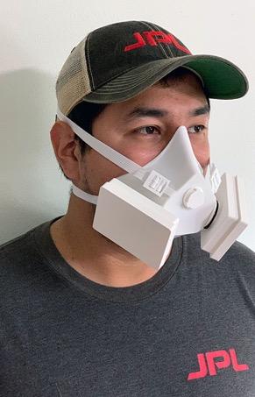
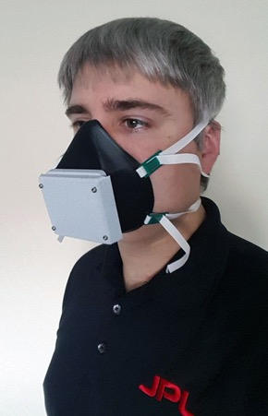
3D Printable Respirators
For example: NASA Jet Propulsion Laboratory California Institute of Technology has designed 4 COVID-19 respirators and released their designs as open source
Designed to meet or exceed N95 performance
Multiple designs for different situational needs (high performance, mass production, comfort)
Compatible with commercial and custom cartridge filters
Science driven designs and testing
https://medeng.jpl.nasa.gov/covid-19/respirators/
Notes:
Images labeled for non-commercial reuse

Slide 34
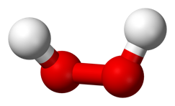

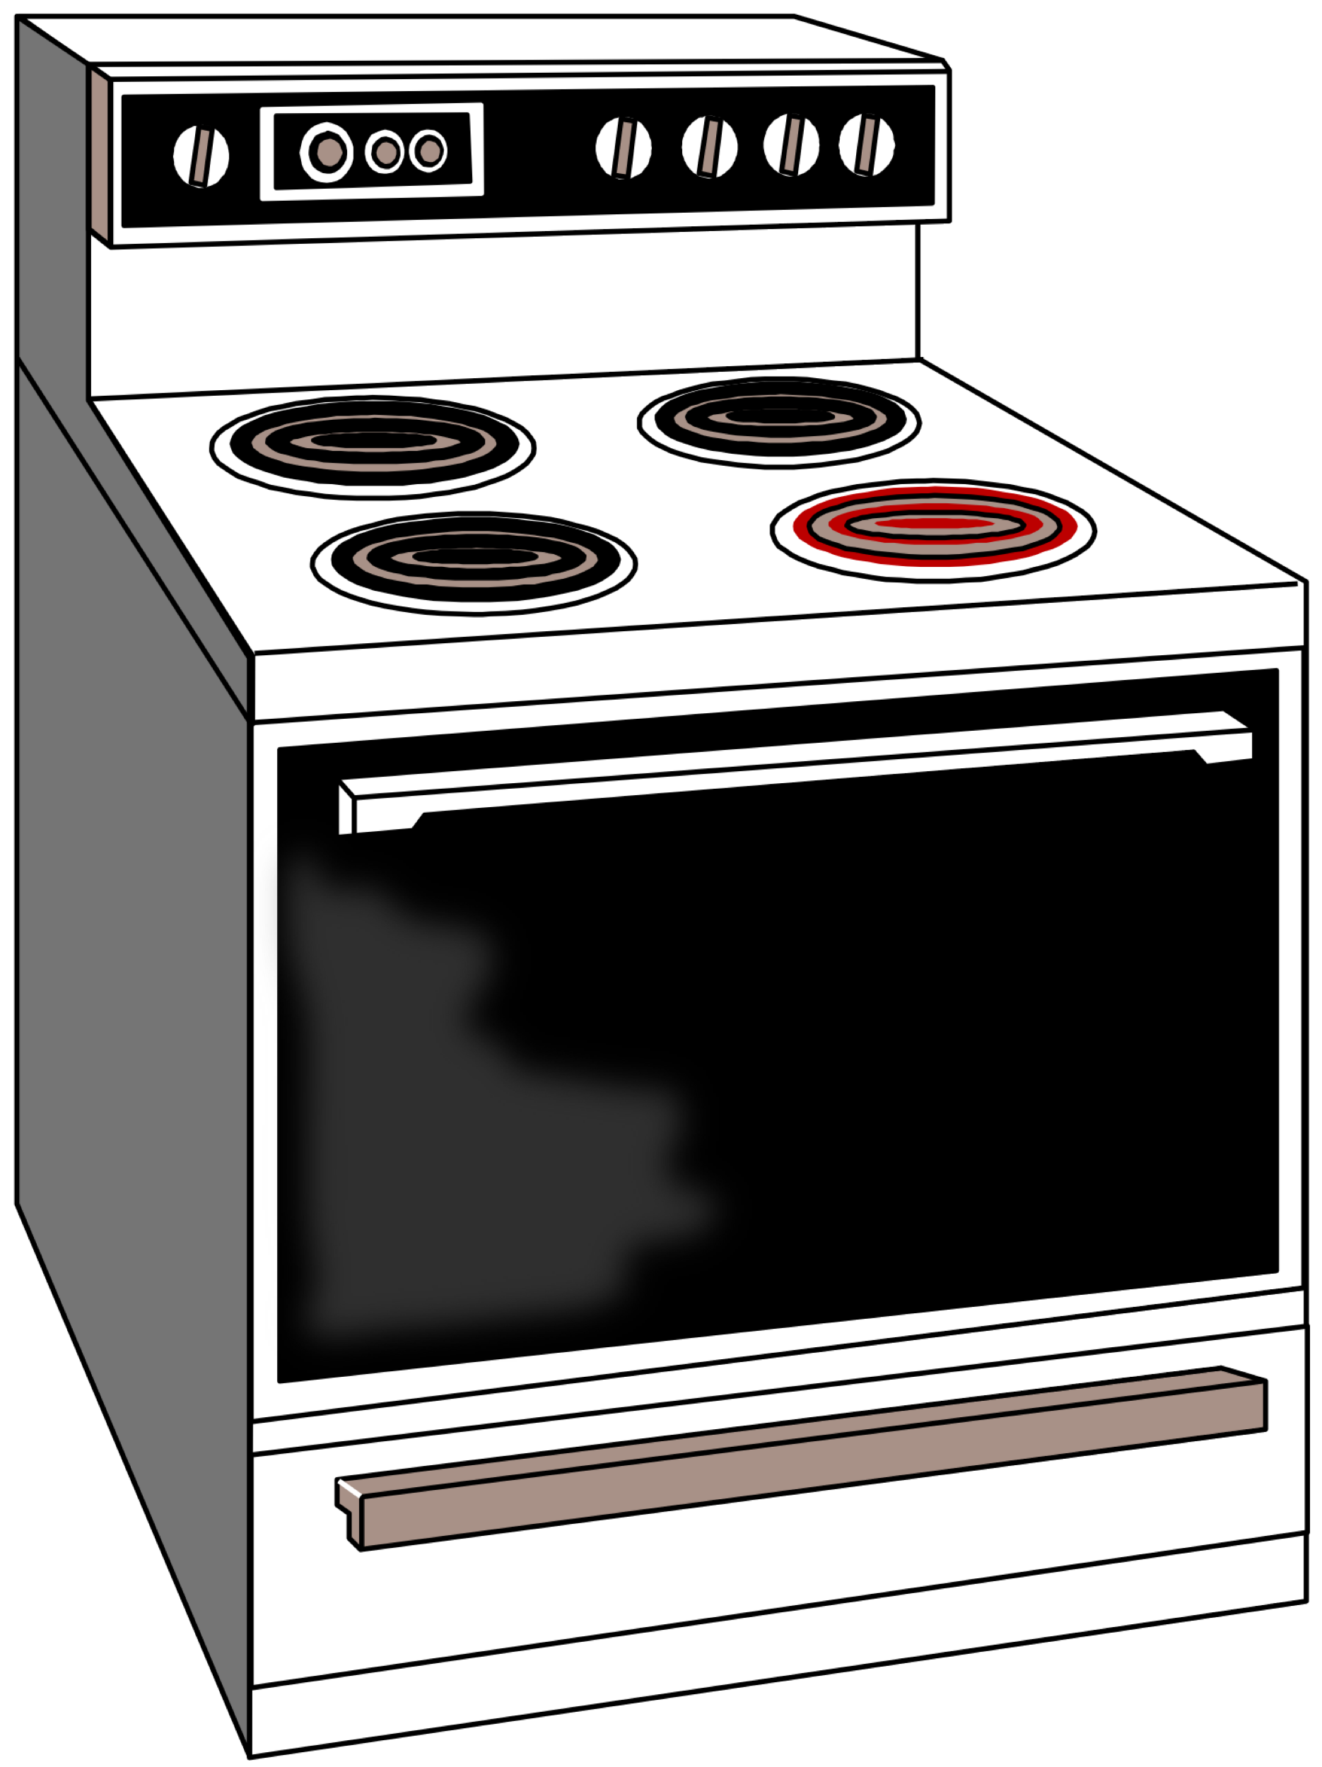
N95 Mask Decontamination:
Rotation Method
H₂O₂ Vaporization Protocol
UV-C Protocol
Dry Heat Protocol
Moist Heat Protocol
All of these methods have not been adequately studied or scientifically validated
https://en.m.wikipedia.org/wiki/File:Hydrogen-peroxide-3D-balls.png
https://commons.wikimedia.org/wiki/File:Germicidal_Lamp_1.jpg
https://commons.wikimedia.org/wiki/File:Stove.svg

Slide 35
N95 Mask Decontamination: Rotation Method
SARS-CoV-2 on N95 surface is slowly inactivated over time
Acquire a set of 5-7 N95s; label with user, date and number
Store each N95 separately at room temperature for 6-7 days between use in a clean and breathable container
Use face shield/2nd surgical mask to protect N95 from soiling
Perform a user seal check before each use.
Discard mask if damaged or soiled
https://www.n95decon.org/
n95deconfactsheet_timev1.0
Notes:
Storage at room temperature (22°C, 40– 65% humidity) for 7 days is expected to significantly reduce risk of exposure to SARS-CoV-2 via a re-used N95. Room temperature conditions are not expected to reduce mask integrity. This approach does NOT decontaminate against bacterial and mold co-infection risks
There is an urgent need for more experimentation to provide clearer guidance The time to reduce infection risk is expected to be extremely sensitive to initial viral load, N95 FFR material, storage temperature , and humidity See www.n95decon.org/time for more information.
Best practice is the use of new N95s. Decontamination approaches do not solve the PPE shortage crisis and should be considered only as an emergency practice with unknown efficacy and safety.

Slide 36
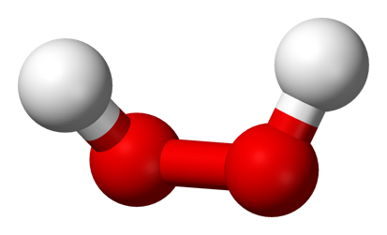
N-95 Mask Decontamination
Hydrogen Peroxide Vaporization Protocol
H₂O₂ inactivates SARS-CoV-2 on N95 masks
H₂O₂ systems differ (e.g. Bioquell, Battelle, SteraMist, Steris, Halosil, Curis)
  Microdroplets or vaporized H₂O₂
  Varying cycle times
  Different concentrations (ppm)
Allows for up to 5-20 cycles without degradation of fit or filtration efficiency
https://en.m.wikipedia.org/wiki/File:Hydrogen-peroxide-3D-balls.png
https://www.n95decon.org/
2020-04-23_N95DECON_HydrogenPeroxide_factsheet_v2.0_final

Slide 37
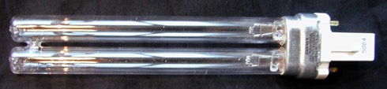
N-95 Mask Decontamination
UV-C Protocol
Dose of 1 - 1.2 J/cm of UV-C inactivates viruses similar to SARS-CoV-2 on N95 masks
Elastic straps require additional chemical disinfection
Shadows can block UV-C rays & can leave parts of N95 contaminated
Allows for up to 10-20 cycles without significant degradation of fit or filtration efficiency
https://commons.wikimedia.org/wiki/File:Germicidal_Lamp_1.jpg
https://www.n95decon.org/
2020-04-23_N95DECON_UV-C_Fact_Sheet_V2.0_FINAL

Slide 38
N-95 Mask Decontamination
Dry or Moist Heat Protocols
Careful temperature and humidity control are critical
Viral inactivation, Not sterilization: Prevent cross-contamination and return to original user
Target temperature range of 70 - 85°C
  Temperature too low: reduced viral inactivation
  Temperature too high: risk of mask damage
https://www.n95decon.org/
Fischer et al. doi:10.1101/2020.04.11.200620

Slide 39
N-95 Mask Decontamination
Dry Heat Protocol
70°C dry heat for 60 minutes inactivates SARS-CoV-2 (e.g. convection oven)
Masks must be isolated during processing, labeled and returned to original user
Method does NOT inactivate all bacterial or mold spores
Excessive heating or multiple thermal cycles may damage fit and filtration efficiency
Not been validated by FDA
https://www.n95decon.org/
2020-04-23_N95DECON_Heat_factsheet_v2.0_final
https://commons.wikimedia.org/wiki/File:Stove.svg

Slide 40
N-95 Mask Decontamination
Moist Heat Protocol
Heat: convection oven for 40 minutes at 85˚C
Humidity: 500 μL of water added to a 6 x 6 cm two-ply paper towel to create 60-85% humidity
N95 masks placed separately in covered polypropylene containers (e.g. Ziploc medium square)
Tested for 5 cycles without significant degradation of fit or filtration efficiency (Only 3M 1860, 1870 and 8210 tested)
https://commons.wikimedia.org/wiki/File:Stove.svg
Notes:
A Scalable Method of Applying Heat and Humidity for Decontamination of
N95 Respirators During the COVID-19 Crisis
Loic Anderegg,1, 2, Cole Meisenhelder,1 Chiu Oan Ngooi,3 Lei
Liao,4 Wang Xiao,4 Steven Chu,5, 6 Yi Cui,7, 8 and John M. Doyle1, 2

Slide 41
N-95 Mask Decontamination:
Unsuitable Methods
Soapy water: degrades filtration^{1,2}
Alcohol: degrades filtration^{1,2,3}
Bleach immersion: degrades filtration and residual fumes can cause health risks to wearer^{3,4,5,6}
Overnight storage: COVID-19 can remain active on surfaces for up to 3 days^{7,8}
https://www.n95decon.org/
200408_N95DECON_cautionsheet_v1.2_final (April 8, 2020)
Notes:
1. Tsai, 2020
2. Viscusi et al., 2007
3. Lin et al., 2017
4. Heimbuch et al., 2014
5. Viscusi et al., 2009;
6. Salter et al., 2010;
7. van Doremalen, et al., 2020;
8. Chin et al., 2020

Slide 42
N-95 Mask Decontamination:
Method | Cost | Specialized Equipment | FDA EUA*
Rotation | $ | - | -
Dry Heat | $$ | + | -
Moist Heat | $$ | + | -
UV-C | $$$$$ | +++++ | +
H₂O₂ Vaporization | $$$$$ | +++++ | -
*Emergency Use Authorization as of 6/2020

Slide 43
Strategies for Preventing COVID-19 Transmission With Limited Resources: Conclusions
Promote hand washing and alcohol based hand sanitizer use by the public and health care personnel
Support basic public health measures including social isolation, increased testing, contact tracing and quarantining/isolating infected individuals
Facemasks: encourage use by everyone in public and in health care facilities
N95 Masks: consider reuse, extended use, industrial substitutes and decontamination methods

