Slide 1
Anesthetic Considerations for Pediatric Patients With
Sickle Cell Disease
Updated 10/2017
Andrew Infosino, MD
UCSF Department of Anesthesia
And Perioperative Care

Slide 2
What is Sickle Cell Disease?
Heterogenous group of inherited disorders of the β hemoglobin molecule.
Clinical Manifestations include:
Chronic hemolytic anemia
Intermittent vaso-occclusive crises
Marked variability in severity from individual to individual
Average life expectancy in the developed world is 40-60 years

Slide 3
The Hemoglobin Molecule
Transports oxygen from the lungs and carries to the tissues via the RBCs where it is released
Hemoglobin molecules are tetramers
  4 globin chains
  4 heme groups consisting of an iron ion in a heterocyclic porphyin ring
  4 oxygen molecules can be bound by each hemoglobin molecule

Slide 4
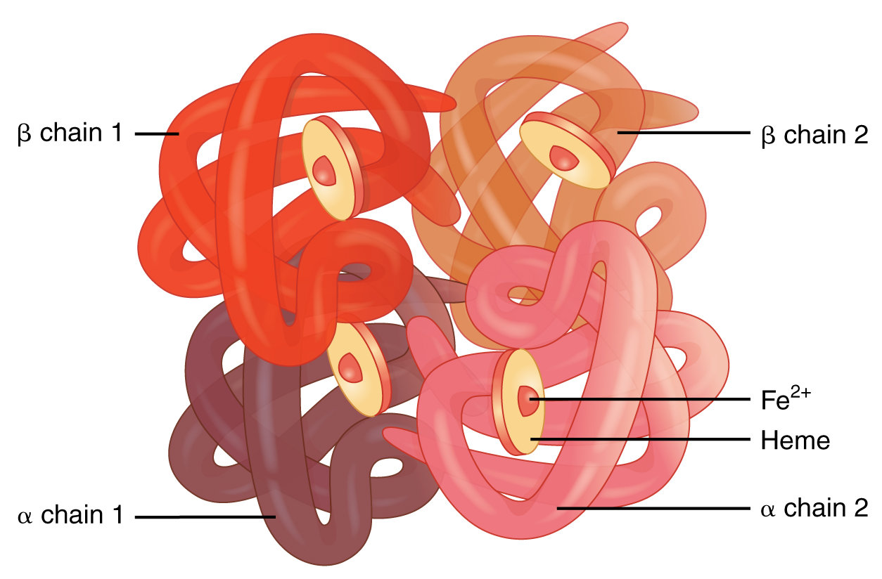
The Hemoglobin Molecule
Image: OpenStax College [CC BY 3.0 (http://creativecommons.org/licenses/by/3.0)], via Wikimedia Commons

Slide 5
Normal Hemoglobin in RBCs
Hemoglobin also carries carbon dioxide, but not at the iron binding positions, but in the globin chains
Hemoglobin also transports nitric oxide on specific thiol groups in the globin protein. Nitric oxide is released to peripheral tissues when oxygen is released leading to increased vasodilation

Slide 6
Normal Hemoglobin in RBCs
Hemoglobin can also competitively bind other molecules such as carbon monoxide, cyanide, sulfur monoxide sulfide and hydrogen sulfide inhibiting oxygen binding and preventing delivery of oxygen to the tissues

Slide 7
Normal Hemoglobin
Once beyond infancy:
96-98% of hemoglobin is HbA:
  (2 α globin chains and 2 β globin chains)
1.5 – 3.2% of hemoglobin is HbA₂:
  (2 α globin chains and 2 δ globin chains)
0.5-0.8% of hemoglobin is HbF:
  (2 α globin chains and 2 γ globin chains)

Slide 8
Hemoglobin in Sickle Cell Patients
Hemoglobin S is hemoglobin with
  2 normal α globin chains
  2 abnormal β globin chains
Single point mutation on chromosome 11 replaces adenine with thymine
Glutamic acid becomes valine

Slide 9
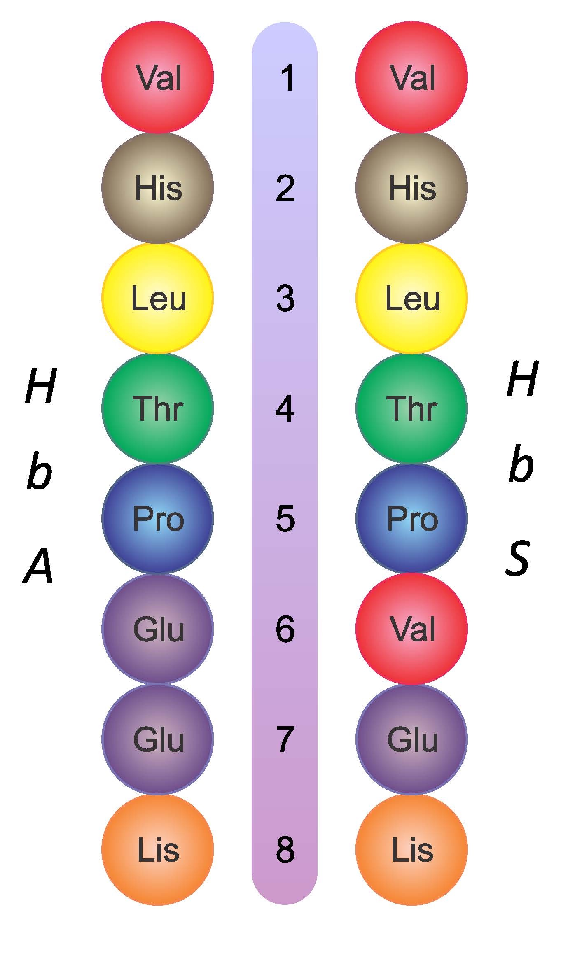
Hemoglobin in Sickle Cell Patients
The adenine to thiamine point mutation causes a nonpolar hydrophobic valine to replace the negatively charged hydrophilic glutamic acid at position 6 on the β chain
Image: Jsan92 (Own work) [GFDL (http://www.gnu.org/copyleft/fdl.html) or CC BY-SA 3.0 (http://creativecommons.org/licenses/by-sa/3.0)], via Wikimedia Commons

Slide 10
Hemoglobin in Sickle Cell Patients
Loss of negative charge destabilizes the oxygenated hemoglobin resulting in accelerated denaturation and breakdown
Results in hemolytic anemia
RBC membranes exposed to oxidant potential of intracellular iron (normally iron is contained within hydrophobic globin pocket)
Damaged RBC membranes lead to RBC dehydration and increased RBC sickling

Slide 11
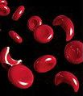
Hemoglobin in Sickle Cell Patients
Damaged RBC membranes lead to RBC dehydration and increased RBC sickling
Image: United States, National Human Genome Research Institute, website at genome.gov (http://www.genome.gov/25520257) [Public domain], via Wikimedia Commons

Slide 12
Hemoglobin S and Sickling
Conformational change during deoygenation allows a hydrophobic bond to form between β^{S}-6 valine of one tetramer and the β^{S}-85 phenylalanine and β^{S}-88 leucine on an adjacent tetramer
Results in polymerization which distorts the shape of red blood cell
The “sickling” causes increased viscosity and occlusion in the microvasculature

Slide 13
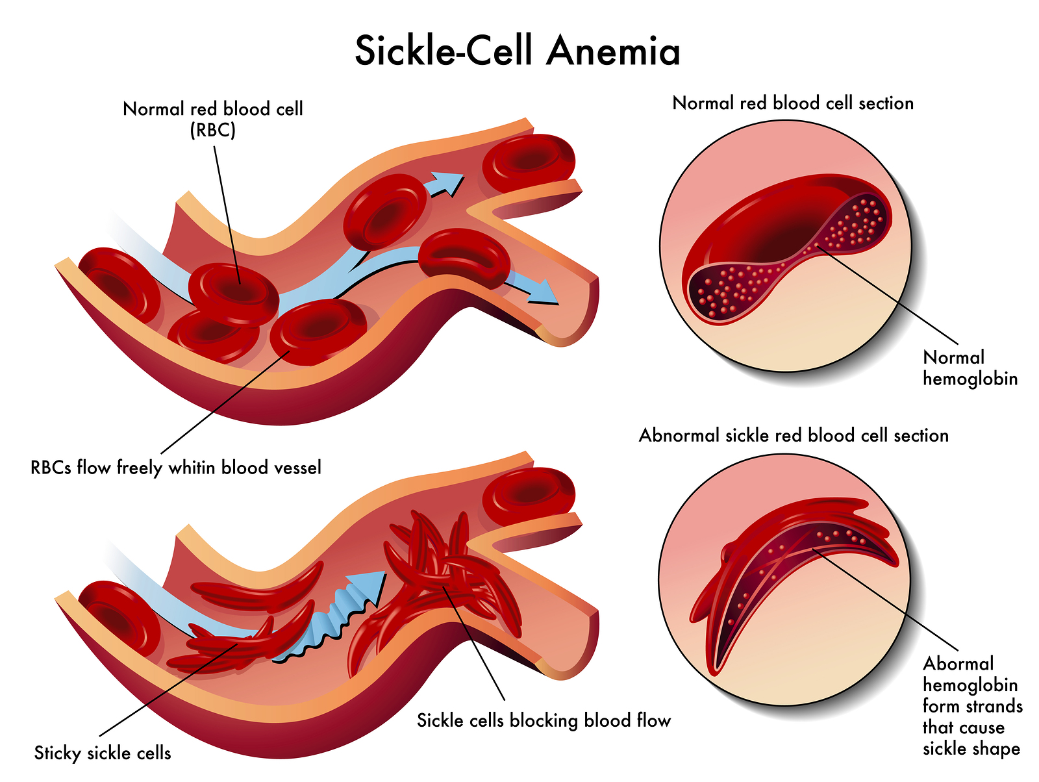
Hemoglobin S and Sickling
Image: Diana grib (Own work) [CC BY-SA 4.0 (http://creativecommons.org/licenses/by-sa/4.0)], via Wikimedia Commons

Slide 14
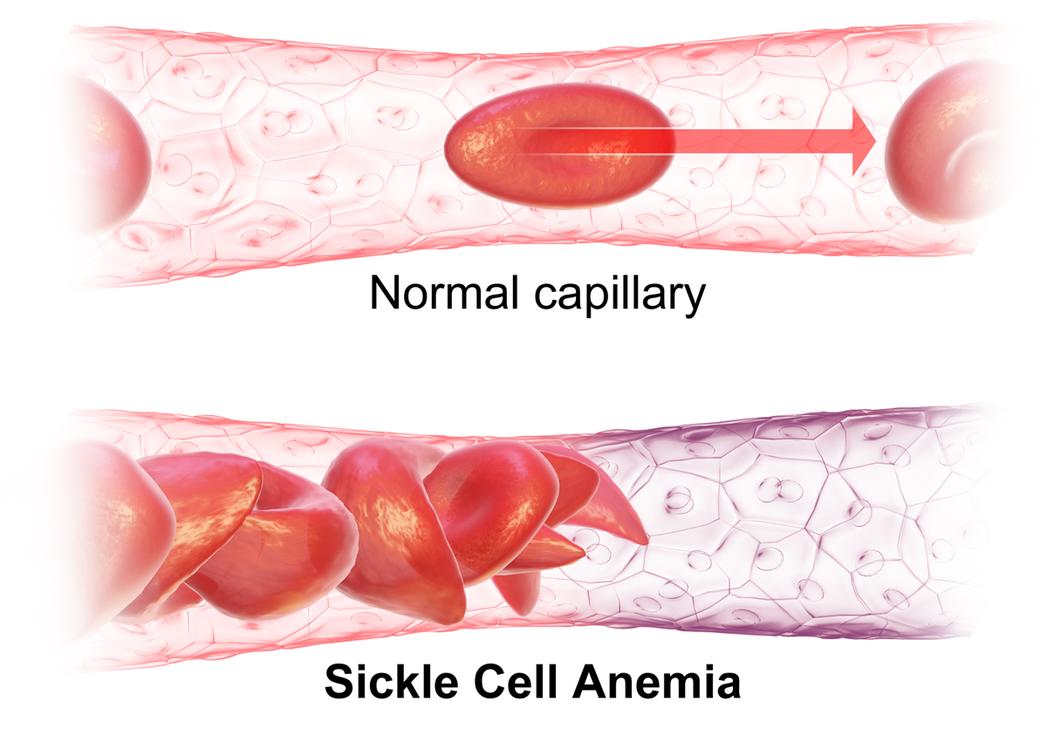
Hemoglobin S
Sickled RBCs with damaged cell membranes have increased adherence to the vascular endothelium
Produces increased shear and oxidant stress to endothelium
Image: BruceBlaus (Own work) [CC BY-SA 4.0 (http://creativecommons.org/licenses/by-sa/4.0)], via Wikimedia Commons

Slide 15
Hemoglobin S
The presence of sickled cells causes chronic vascular inflammation
Up-regulation of endothelial cell adhesion molecules
Increased leukocyte count
Activated coagulation pathways
Increased cytokines
Impaired nitric oxide signaling pathways

Slide 16
Hemoglobin S
Sickled red blood cells have a shorter life expectancy than normal red blood cells
Normal red blood cells last for 90-120 days
Sickled red blood cells last for only 10-20 days
Bone marrow cannot keep up with the increased rate of destruction

Slide 17
Hemoglobin S and NO
NO is normally delivered from pulmonary vascular bed to peripheral tissues bound to intracellular hemoglobin. Decreased oxygen tension in peripheral tissues causes an allosteric structural transformation of the hemoglobin molecule releasing bioavailable NO and causing vasodilation
In SCD, the hemolysis results in free plasma heme complexes which scavenge NO and diminish delivery of NO and oxygen to the peripheral tissues

Slide 18
Sickle Cell Disease Inheritance
Autosomal recessive inheritance pattern
Clinical disease occurs in patients homozygous for HbS gene: HbSS
A person who receives a gene for sickle cell disease from one parent and a normal gene from the other has a condition called "sickle cell trait"

Slide 19
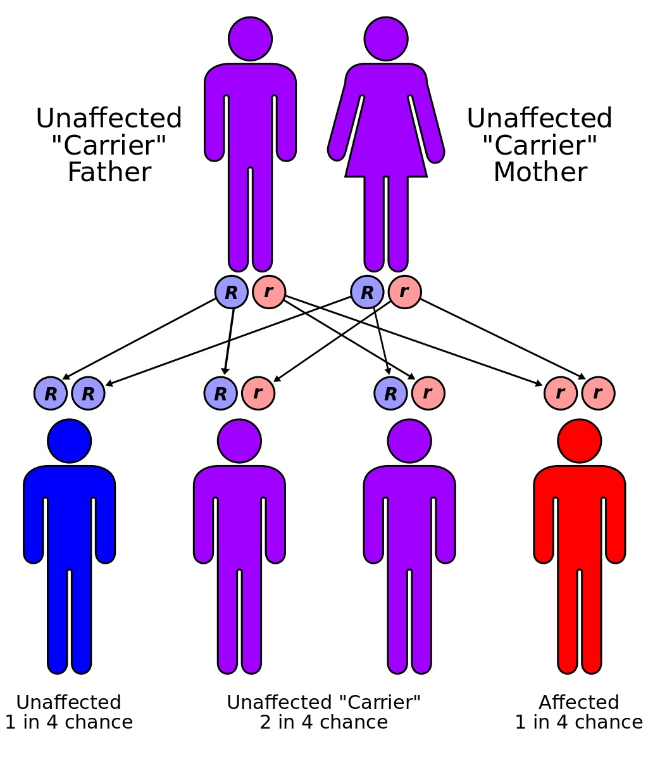
Two Heterozygous Carrier Parents
25% chance of producing a normal child (HbAA)
50% chance of producing a heterozygous carrier child (HbAS)
25% chance of producing a child with sickle cell disease (HbSS)
Image: Cburnett (Own work in Inkscape) [GFDL (http://www.gnu.org/copyleft/fdl.html) or CC-BY-SA-3.0 (http://creativecommons.org/licenses/by-sa/3.0/)], via Wikimedia Commons

Slide 20
Vaso-occlusive Crises
Vaso-occlusive crises are intermittent, recurrent, acute episodes of severe pain.
Triggers include:
  Infection
  Surgical stress
  Hypoxia
  Altitude

Slide 21
Acute Vaso-occlusive Crises
Sickled red blood cells adhere to vascular endothelium and cause microvascular occlusion, ischemia, infarction and pain
Inflammation of endothelium with release of IL-1, IL-6 and TNF
Platelet activation and aggregation
Fibrin deposition on damaged endothelium
Up-regulation of cell adhesion molecules
Decreased production and increased scavenging of nitric oxide
Activation of coagulation system

Slide 22
Pathophysiology of Sickle Cell Disease
Fully oxygenated HbSS blood is more viscous than fully oxygenated HbAA blood at the same hematocrit (less deformable RBCs)
The viscosity of HbSS blood increases more rapidly with increasing hematocrit than HbAA blood
  HbAA blood: An increase of Hct from 30% to 60% increases viscosity x2
  HbSS blood: An increase of Hct from 30% to 60% increases viscosity x50

Slide 23
Types of Acute Sickle Cell Crises
Acute chest syndrome
Cerebral Vascular Accident or Stroke
Ischemia/Pain
Priapism
Splenic sequestration crisis
Aplastic crisis
Hyper-hemolytic crisis

Slide 24
SCD: Central Nervous System
Transient ischemic attacks
Silent Infarcts
Cerebrovascular accidents including intra-cerebral hemorrhages
Seizures

Slide 25
SCD: Hematology
Hemolytic crises from accelerated RBC death
Aplastic crises with suppression of normal erythropoiesis which usually resolve in 7-10 daysTransient ischemic attacks
Associated with infections from EBV, parvovirus B19, Pneumococci, Salmonella and Streptococci

Slide 26
SCD: Cardiovascular
Cardiomegaly from chronic anemia
Left ventricular hypertrophy and congestive heart failure
Right ventricular hypertrophy from chronic hypoxia

Slide 27
SCD: Respiratory System
Micro-infarctions resulting in progressive pulmonary fibrosis and restrictive lung disease
Acute chest syndrome: Combination of infarction, infection, pulmonary sequestration and fat embolism

Slide 28
SCD: Gastrointestinal System
Repeated splenic micro-infarcts render patient functionally asplenic
Acute cholecystitis from bile stones from hemolysis often require cholecystectomy
Acute abdominal pain from vaso-occlusive crisis

Slide 29
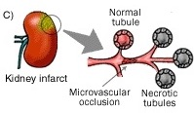
SCD: Genitourinary System
Micro-infarcts in medulla of kidney
Inability to concentrate urine can lead to dehydration
Renal failure from progressive glomerular fibrosis
Hematuria
Priapism
Image: National Center for Biotechnology Information (US) (http://www.ncbi.nlm.nih.gov/books/NBK22238/) [Public domain], via Wikimedia Commons

Slide 30
SCD: Bones, Extremities & Growth
Increased bone marrow activity in bones starves the growth plates of nutrients resulting in decreased growth
Bone pain from vaso-occlusion in medulla of bones
Avascular necrosis of the femoral head
Increased incidence of osteomyelitis often due to Salmonella or Staphylococci

Slide 31
SCD: Presentation
Striking diversity in presentation, progression of disease and severity of symptoms
About 30% of HgbSS patients have rapidly progressive disease with widespread vascular damage, organ failure and death
About 60% have less severe disease
About 10% are relatively asymptomatic

Slide 32
SCD: Presentation
Diversity in presentation, progression of disease and severity of symptoms due to:
Increased expression of Hemoglobin F which ameliorates the disease
Haplotype variation
Coinheritance of α-thalassemia
Polymorphisms at cellular and physiologic levels

Slide 33
SCD: Presentation
Increased production of Hemoglobin F:
Normal production of HgbF is 1% after infancy
African haplotypes express HgbF up to 15%
Asian haplotypes express HgbF from 8-30%

Slide 34
Preoperative Anesthetic Management
History and Physical Exam
Document the number and frequency of crises
  No active infections
  No acute pain crisis
Consult with patient’s hematologist
  Baseline hematocrit
  Baseline percentage of hemoglobin S
  Preoperative transfusion recommendations

Slide 35
Preoperative Anesthetic Management
Labs: Baseline Values should be obtained and compared to historical values
  Hemoglobin/hematocrit
  Hemoglobin electrophoresis for percentage of hemoglobin S

Slide 36
SCD: Historical Approaches to Preoperative Transfusion
Simple transfusion to raise the hemoglobin to >10 g/dl
Simple transfusion for high risk patients
  History of frequent sickle crises
  History of frequent acute chest syndrome crises
  Complex surgical procedures with significant blood loss
Exchange transfusion to lower the HbS to <30% and raise the hemoglobin to >10 g/dl

Slide 37
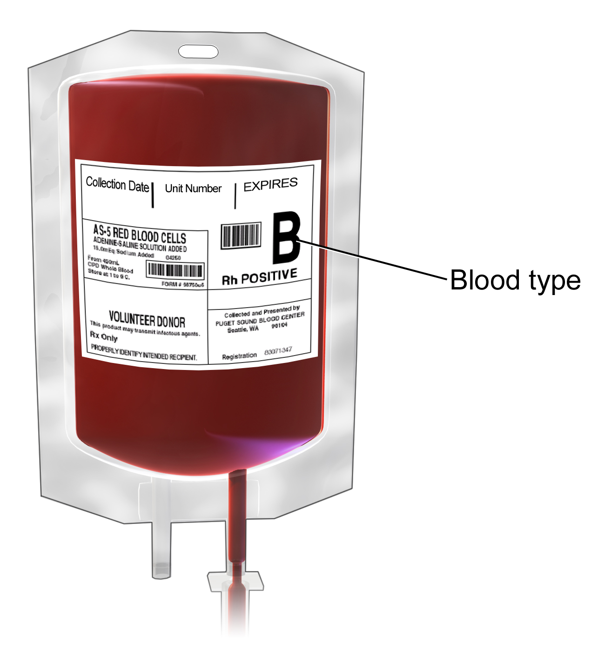
SCD: Changes in Transfusion Practice
HIV and Hepatitis transmission from blood transfusions prompted a re-examination of transfusion practices in sickle cell patients
Image: BruceBlaus. Blausen.com staff (2014). "Medical gallery of Blausen Medical 2014". WikiJournal of Medicine 1 (2). DOI: 10.15347/wjm/2014.010. ISSN 2002-4436. (Own work) [CC BY 3.0 (http://creativecommons.org/licenses/by/3.0)], via Wikimedia Commons

Slide 38
SCD: Current Preoperative Transfusion Practices
Exchange transfusions no longer recommended
Low risk patients and low risk procedures (short duration, minimal fluid shifts, no significant blood loss): Preoperative transfusion not recommended
High risk patients and/or high risk procedures: Simple transfusion with hemoglobin goal of between 9 – 11 g/dl (over-transfusion increases blood viscosity)

Slide 39
SCD: Preoperative Management
Schedule as first case of the day to minimize NPO time
Consider IV fluid bolus of 10 to 15 ml/kg after starting IV and before induction
Notify Blood Bank and send type and cross as soon as possible: May be more difficult to obtain compatible blood because of frequent transfusions and antibody formation

Slide 40
SCD: Goals of Intraoperative Management
Avoid hypotension
Avoid hypoxemia
Avoid hypothermia
Avoid hypovolemia

Slide 41
SCD: Intraoperative Management
Keep operating room and patient warm
Maintain FiO₂ of at least 40 - 50%
Use pneumatic compression devices to help minimize vascular stasis in the lower extremities
Antibiotic prophylaxis

Slide 42
SCD: Intraoperative Management
Regional anesthesia has been safely used in sickle cell patients and may be beneficial in patients with opioid tolerance
Tourniquets have been used in patients with SCD, but extremity should be carefully ex-sanguinated prior to inflation

Slide 43
Postoperative Management
The majority of perioperative complications occur during the postoperative period and include:
Painful crises
Acute chest syndrome
Stroke

Slide 44
Postoperative Management
Minimize postoperative complications with:
Postoperative oxygen therapy
Postoperative hydration
Postoperative pulse-oximetry monitoring
Postoperative pain control

Slide 45
Managing Chronic Pain in Sickle Cell Patients
Challenging intravascular access from multiple intravenous lines in the past
Pain: High tolerance to opioids
Opioid dependance
Involve the Chronic Pain Team. Use multimodal pain management. Consider PCAs, epidurals, PCEAs, fentanyl patches, NSAIDs and acetaminophen

Slide 46
References:
Marchant WA, Walker I. Anaesthetic Management of the Child with Sickle Cell Disease. Paediatric Anaesthesia 2003; 13:473-489.
Firth PG, Head CA. Sickle Cell Disease and Anesthesia. Anesthesiology 2004; 101:766-785.
https://en.wikipedia.org/wiki/Sickle-cell_disease.

