Slide 1
Congenital Cardiac Disease
A Guide to Evaluation, Treatment and Anesthetic Management
Updated 11/2017
Les Garson M.D. Associate Clinical Professor UCI Department of Anesthesiology and Perioperative Care
J. Matthew Kynes, MD Assistant Professor Monroe Carell, Jr Children’s Hospital at Vanderbilt

Slide 2
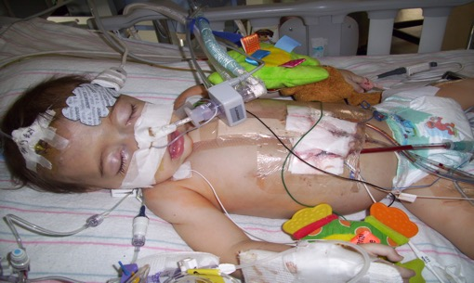
Congenital Heart Disease
Congenital heart disease (CHD) occurs in 1/125 live births.
Most common birth defect
Occurs during the 1st 8 weeks of fetal development
Majority have no known cause

Slide 3
Congenital Heart Disease
Epidemiology of CHD
Incidence - 8/1000 live births
- 3-4/100 still born
- 2/100 premature infants excluding PDA
- 10-25/100 aborted fetuses
Most congenital defects are well tolerated during fetal life.
Etiology - Unknown in most cases
- Genetic factors
-Single gene defect
-Chromosomal abnormality.
- Environmental factors
- Gender differences in type of CHD

Slide 4
Relative Frequency of Congenital Heart Lesions
Lesions | % of all Lesions
- Ventricular septal defect | 25-30
- Atrial septal defect (Secundum) | 6-8
- Patent ductus arteriosus | 6-8
- Coarctation of aorta | 5-7
- Tetralogy of Fallot | 5-7
- Pulomnary Valve Sterosis | 5-7
- Aortic Valve Stenosis | 4-7
- d-Transposition of great arteries | 3-5
- Hypoplastic left ventricle | 1-3

Slide 5
Relative Frequency of Congenital Heart Lesions (cont.)
Lesions | % of all Lesions
- Hypoplastic right ventricle | 1-3
- Truncus arteriosus | 1-2
- Total anomalous PVR | 1-2
- Tricuspid atresia | 1-2
- Single ventricle | 1-2
- Double-outlet right ventricle | 1-2
- Others | 5-10

Slide 6
Factors Contributing to CHD
85 to 90 % of cases, there is no identifiable cause for the heart defect  generally considered to be caused by multifactorial inheritance.
Factors are usually both genetic and environmental, where a combination of genes from both parents, in addition to unknown environmental factors, produce the trait or condition.
Maternal Factors:
seizure disorders w/ intake of anti-seizure medications
intake of lithium for depression
uncontrolled IDDM
lupus
German measles (rubella) – 1st trimester of pregnancy

Slide 7
Factors Contributing to CHD
Family History:
risk increases when either parent has CHD, or when another sibling was born w/ CHD
If you have had one child with CHD, the chance that another child will be born with CHD ranges from 1.5 to 5 %, depending on the type of CHD in the first child.
If you have had two children with CHD, then the risk  to 5 to 10 %, to have another child with CHD.
If the mother has CHD, the risk for a child to be born with CHD ranges from 2.5 to 18 percent, with an average risk of 6.7 percent.
Chromosome abnormalities:
5 to 8 % of all babies with CHD have a chromosome abnormality
includes Down syndrome, trisomy 18 and trisomy 13, Turner’s syndrome, Cri-du-chat syndrome

Slide 8
Illustration from Anatomy & Physiology, Connexions Web site. http://cnx.org/content/col11496/1.6/, Jun 19, 2013.

Slide 9
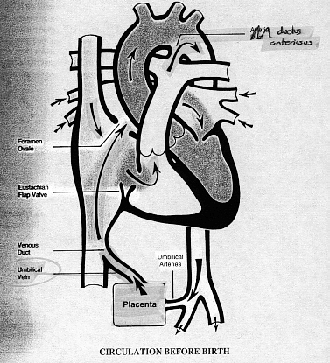
Fetal circulation
Blood flows from the placenta…
→ IVC
→ RA
→ through the FO
→ LA
→ LV
→ ascending aorta
→ head & upper extremities
→ returns via the SVC

Slide 10
Fetal circulation:
From the SVC…
→ RA
→ RV
→ pulmonary artery
→ through the PDA
→ descending aorta
→ lower extremities
and placenta

Slide 11
Fetal circulation:
Only a very small amount of blood is directed through the right and left pulmonary arteries to the lungs.

Slide 12
Blood circulation after birth
The transformation from fetal to neonatal circulation involves two major changes:
A marked increase in systemic resistance.
- caused by loss of the low-resistance placenta.
A marked decrease in pulmonary resistance.
- caused by pulmonary artery dilation with the neonate’s first breaths.

Slide 13
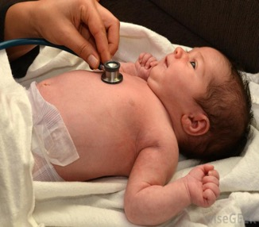
Examination for CHD
Clues for Evaluation of an Infant with suspected CHD
1. On History and Physical Examination (color)
Acyanotic
Cyanotic
2. Auscultation
3. Chest roentgenogram
Normal
Increased/Plethora Pulmonary blood flow
Decreased/Oligemia

Slide 15
Acyanotic Congenital Heart Defects
Pink Baby (L → R shunt)
L → R shunts cause CHF and pulmonary hypertension
This leads to RV enlargement, RV failure
These babies present with CHF and respiratory distress.
They are not typically cyanotic
Examples: Patent Ductus Arteriosus (PDA)
Ventricular Septal Defect (VSD)
Atrial Septal Defect (ASD)
Coarctation of the Aorta

Slide 16
Acyanotic Heart Defect
Move blood from arterial …to…venous system
A Cyanotic
Increased in pulmonary
blood flow
1. ASD
2. VSD
3. AVC
4. PDA
Obstruction of blood flow from
ventricle
Pulmonary stenosis
Aortic stenosis
3.Coarctation of the Aorta

Slide 17
Defects with increased pulmonary blood flow
ASD (Atrial septal defect )
PDA ( patent ductus arteriosus)
VSD (ventricular septal defect )
AVC (Atrioventricular canal defect )

Slide 18
Acyanotic CHD
Clinical Diagnosis
CXR - Right. V & A enlargement
Large pulmonary artery
↑ pulmonary vascularity
ECG - volume overload
right axis deviation
minor right ventricular conduction delay
Echocardiography
Catheterization
Prognosis--Well tolerated
Complications
Pulm. Hypertension, Eisenmenger syndrome
Treatment
Surgery for all symptomatic ASD or asymptomatic patients with shunt ratio > 2:1

Slide 19
Atrial Septal Defect (ASD)
An opening in the atrial septum
An atrial septal defect allows oxygenated (red) blood to pass from the left atrium, through the opening in the septum, and then mix with unoxygenated (blue) blood in the right atrium
During fetal heart development  the partitioning process does not occur completely, leaving an opening in the atrial septum
occur in 4-10% of all infants w/ CHD
EFFECTS: When blood passes through the ASD from the left atrium to the right atrium  a larger volume of blood than normal must be handled by the right side of the heart  extra blood then passes through the pulmonary artery into the lungs  pulmonary hypertension and pulmonary congestion

Slide 20
Capac M. Atrial_septal_defect-en.png. Own work. Accessed commons.wikimedia.org

Slide 21
Atrial Septal Defect (ASD)
Signs and Symptoms:
child tires easily when playing
infant tires easily when feeding
fatigue
sweating
tachypnea, tachycardia
shortness of breath, crackles
poor growth
murmur
Diagnostic tests:
CXR – enlarged heart
ECG
2D echo – show pattern of blood flow through the septal opening, det. how large the opening
Cardiac catheterization

Slide 22
Atrial Septal Defect (ASD)
20% of atrial septal defects will close spontaneously in the first year of life.
Atrial septal defects may close spontaneously as a child grows
Usually, an ASD will be repaired if it has not closed on its own by the time the child starts school - to prevent lung problems that will develop from long-time exposure to extra blood flow
Pulmonary arteries become thickened and obstructed due to increased flow, from left to right for many years (pulmonary vascular obstructive disease)

Slide 23
Treatment
Medical management
digoxin - helps strengthen the heart muscle, enabling it to pump more efficiently
diuretics – relieve pulmonary congestion
Infection control - prophylactic antibiotics to prevent bacterial endocarditis before dental procedures and other invasive procedures
Surgical repair - the patient is placed on cardiopulmonary bypass and the right atrium is then opened to allow access to the atrial septum below
- defect may be closed with stitches or a special patch
- the material utilized for patch closure of ASDs may be the patient’s own pericardium, commercially available bovine pericardium, or synthetic material (Gore-Tex, Dacron)

Slide 24
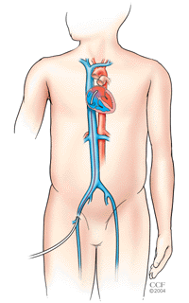
Transcatheter management
This technique involves implantation of one of several devices (basically single or double wire frames covered by fabric) using cardiac catheterization
Cardiac catheterization - involves slowly moving a catheter (a long, thin, flexible, hollow tube) into the heart. The catheter is initially inserted into a large vein through a small incision made usually in the inner thigh (groin area) and then is advanced into the heart

Slide 25
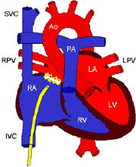
Transcatheter management
An ASD closure device is moved through the catheter to the heart and specifically to the location of the heart wall defect
Within a few days, the body’s own tissue will begin to grow over the device. By 3 to 6 months, the device is completely covered by heart tissue and at that point becomes a part of the wall of the patient’s heart

Slide 26
ASD: Anesthetic considerations
Air bubbles precautions
High incidence of perioperative arrhythmias
Inhalation induction is usually well tolerated
Usually suitable for fast discharge
Endocarditis prophylaxis for the first 6 months post surgery
Atrial fibrillation flutter post surgery
4% <11yo
59% >41yo
Persistent RV dilation or pulmonary hypertension if late repair

Slide 27
PDA (Patent Ductus Arteriosus)
Failed to closed at birth, blood will shunt from the aorta to the pulmonary artery.
Complete closure occurs usually by 3 months
More common in girls than boys

Slide 28
Source: http://www.nhlbi.nih.gov/health/dci/Diseases/pda/pda_what.html. PD-USGov-HHS-NIH

Slide 29
PDA (Patent Ductus Arteriosus)
Can cause…
1. Reduced glomerular filtration rate.
2. Impaired platelet aggregation
3. Decreased GI & CNS blood flow

Slide 30
Patent Ductus Arteriosus (PDA)
Characterized by a connection between the aorta and the pulmonary artery
All babies are born with a ductus arteriosus
As the baby takes the first breath, the blood vessels in the lungs open up, and blood begins to flow  the ductus arteriosus is not needed to bypass the lungs
Most babies have a closed ductus arteriosus by 72 hours after birth
In some babies, however, the ductus arteriosus remains open (patent)
The opening between the aorta and the pulmonary artery allows oxygenated blood to pass back through the blood vessels in the lungs.
PDA occurs in 6-11 % of all children with CHD

Slide 31
PDA (Patent Ductus Arteriosus)
Treatment…
Cath at age of (6m to 1y) or surgical intervention by thoracotomy
If no treatment …
CHF
Infected Endocarditis

Slide 32
PDA (Patent Ductus Arteriosus)
Medical Management
Indomethacin IV (prostaglandin inhibitor) may help close a PDA.
works by stimulating the muscles inside the PDA to constrict, thereby closing the connection
Digoxin
Diuretics
Adequate nutrition
premature infants or those infants with a large PDA may become tired when feeding, and are not able to eat enough to gain weight
high-calorie formula or breast milk Special nutritional supplements may be added to formula or pumped breast milk that increase the number of calories in each ounce, thereby allowing your baby to drink less and still consume enough calories to grow properly.

Slide 33
PDA: Treatment
Medical
Treatment of CHF and pulmonary edema
Indomethacin trial in preterm infants
Interventional cardiology
Surgical
Preterm infants and neonates who fail medical therapy
Older asymptomatic children (age 2-4 years)
Surgical options:
PDA ligation via posterolateral thoracotomy
VATS
BruceBlaus. Own work. 11 July 2017. Accessed commons.wikimedia.org

Slide 34
PDA: Anesthetic considerations
Pre and post-ductal pulse oximetry to detect ligation of the wrong vessel
Upper and lower extremity blood pressure monitoring to determine pressure gradient
Upon ligation increase in diastolic pressure
In older children lung isolation may be requested
Preterm infants:
Often done bedside = off-site anesthesia
Reduced monitoring options, poor access to patient
All emergency drugs, vasoactive medications and blood must be immediately available
ETT position should be checked and carefully secured
Surgical exposure and retraction = functional single lung ventilation
Post PDA:
Endocarditis prophylaxis during the first 6 months
Recurrent laryngeal nerve injury
Pulmonary HTN and heart failure if late repair

Slide 35
Ventricular Septal Defect
Most common CHD (20-25%)
Close spontaneously 30-40% within the first year
Pathophysiology:
Left to right shunt
Pulmonary over-circulation
Congestive heart failure
Poor cardiac output
Associated anomalies: trisomy 13, 18, 21
Signs and symptoms:
Small VSD: asymptomatic
Infants with large VSD: CHF at 6-8 weeks
Holosystolic murmur, systolic thrill at the LSB
BruceBlaus. Own work. 3 August 2017 Accessed commons.wikimedia.org

Slide 36
VSD: Treatment
Medical:
ACE inhibitors (decrease Left to Right shunt in cases with increased SVR)
Diuretics
Digoxin
Interventional cardiology
Surgical
Infants with CHF and FTT not responding to medical treatment
Large left to right shunt: Qp/Qs>2:1
Elective repair to asymptomatic children around 2 years of age
Procedures:
For infants unable to tolerate CPB: PA banding
Definitive: direct patch closure via and arterial approach or a ventriculotomy

Slide 37
VSD: Anesthetic considerations
Small VSD with no obvious CHF:
Careful inhalation induction is possible, be aware to reduced cardiac reserve
Large VSD with or without CHF:
IV induction is preferred
High FiO₂ and low PaCO₂ decrease PVR and will increase left to right shunt
Risk for shunt reversal with increase PVR or hypotension
Patient with repaired VSD:
Endocarditis prophylaxis for the first 6 months
Dysrhythmias and conduction defects:
RBBB, ventricular arrhythmias, AV block
Ventricular dysfunction (ventriculotomy)
Pulmonary hypertension if late repair

Slide 38
AVC ( Atrioventricular Canal Defect)
Low atrial septal defect continuous with high ventricular defect and distortion of the mitral and tricuspid valve
**Assessment: Echo …important for surgical planning as sometimes need a new valve
**Treatment …after surgery give antibiotic and anticoagulant

Slide 39
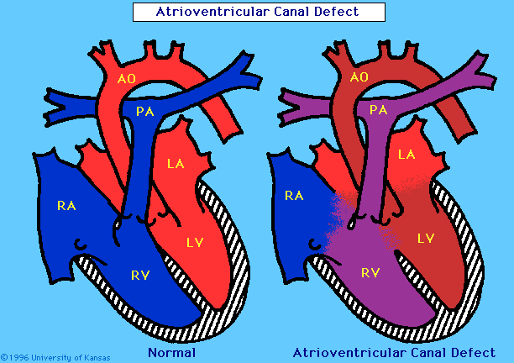

Slide 40
Obstruction of blood flow from ventricle
1.Pulmonary stenosis
2.Aortic stenosis
3.Coarctation of the Aorta

Slide 41
Pulmonary Stenosis
4 types:
Valvular
Infundibular
Supra-valvular
Peripheral
Pathophysiology:
Right outlet obstruction → Pressure work
↓ Right ventricular hypertrophy
Dake~commonswiki. 16 July 2006. commons.wikimedia.org

Slide 42
Pulmonary Stenosis
Diagnosis
Clinical
CXR - Right ventricular hypertrophy, reduced pulmonary blood flow
ECG
Echocardiography
Prognosis
Good in mild to moderate
Complications
CHF in severe PS
Treatment
Valvular PS → balloon valvuloplasty
Surgical repair

Slide 43
Aortic Stenosis
Valvular - the commonest
Supra-valvular
Subvalvular (subaortic)
BruceBlaus. Own work. 22 October 2013 Accessed commons.wikimedia.org

Slide 44
Aortic Stenosis
Clinical Manifestation
Mild stenosis
- Normal pulse & apical impulse
- Systolic ejection murmur
- Normal to enlarged heart size
Critical stenosis
- Left ventricular failure
- pulmonary edema, cardiomegaly
- Weak peripheral pulses
- Weak systolic murmur
- Paradoxical split 2nd heart sound

Slide 45
Aortic Stenosis
Diagnosis
Clinical
CXR
ECG
Echocardiography
Graded exercise testing
Prognosis is good for mild to moderate
Treatment
Balloon valvuloplasty
Surgical

Slide 46
Coarctation of Aorta
Infants
Congestive heart failure
Pulmonary over circulation and edema if large VSD
Often ductal dependent
Tachypnea, FTT, hepatomegaly, metabolic acidosis, poor perfusions
Child/adolescent
HTN and murmur
Often asymptomatic
Occasionally exercise induced claudication or headaches
Decreased lower extremities pulse
Systolic pressure gradient upper and lower extremity

Slide 48
Coarctation of Aorta
Diagnosis
Clinical
CXR - cardiomegaly and pulmonary congestion, notching of ribs
ECG
Echocardiography
Prognosis – Untreated cases succumb by 20-40 years
Complications
CVA
Aneurysms
Treatment
Medical - IV PGE₁ in neonatal age
Surgery

Slide 49
CoA: Anesthetic considerations
Check for associated anomalies
Infants with CHF: careful IV induction, narcotic based
Arterial line in the right arm
Additional BP monitoring and pulse oximetry in lower extremities
During cross clamping:
Volatile agents and short active vasodilators
Lower extremity pressure (through collaterals) >45mmHg
De-clamping: vasoactive drugs available
Postoperative phase: HTN and postcoarctectomy syndrome: abdominal pain, vomiting
Post repair:
Persistent HTN
Myocardial hypertrophy (diastolic dysfunction, premature coronary artery disease
Risk for re-coarctation

Slide 50
Cyanotic Congenital Heart Defects
Blue Baby (R → L shunt)
R → L shunts cause hypoxia and central cyanosis.
Venous blood is shunted from the R to the L side of the heart w/o passing through the lungs to be oxygenated
Unoxygenated blood circulates in arteries  cyanosis
Examples:
Tetralogy of Fallot (TOF)
Transposition of the Great Arteries (TGA)
Truncus Arteriosus (TA)
Tricuspid Atresia

Slide 51
Cyanotic Heart Defect
Cyanotic
Decreased pulmonary
blood flow
Mixed blood flow
(Single Ventricle)

Slide 52
Tetralogy of Fallot
National Heart Lung and Blood Institute (NIH). Accessed commons.wikimedia.org

Slide 53
Heilman J. Own work. 2 June 2011. Accessed commons.wikimedia.org
Notes:
This is an CXR of a child with tetralogy of Fallot with a characteristic “boot shaped” heart

Slide 54
Tetralogy of Fallot (TOF)
EFFECTS
If the right ventricle obstruction is severe, or if the pressure in the lungs is high  a large amount of oxygen-poor (blue) blood passes through the VSD, mixes with the oxygen-rich (red) blood in the left ventricle, and is pumped to the body  cyanosis
The more blood that goes through the VSD, the less blood that goes through the pulmonary artery to the lungs  decreased oxygenated blood to the left side of the heart
Soon, nearly all the blood in the left ventricle is oxygen-poor (blue)
This is an emergency situation, as the body will not have enough oxygen to meet its needs

Slide 55
TOF: Signs and Symptoms
Wide range…
Severely cyanotic newborn to a “pink Tet” with CHF
Pansystolic murmur at the left upper sternal border
Cyanosis and hypoxemia: SaO₂ 70-90%
Decreased exercise tolerance, dyspnea on exertion, easy fatigability
Squatting increase SVR and arterial oxygenation
Polycythemia
Risk of spontaneous thrombosis and ischemic strokes
Hypercyanotic (Tet) spells
Occurs in 20-30% of patients
Peak incidence at 2-3 months

Slide 56
“Tet-Spells” treatment
Knee chest position or abdominal compression
Supplemental oxygen
Sedation
Morphine: 0.1 mg/kg IM/SC
Ketamine 1-2 mg/kg IV/IM
Volume expansion: 10-20ml/kg crystalloids
Phenylephrine 0.5-2mcg/kg
Propranolol 0.1mg/kg IV
Esmolol 50-300mcg/kg/min + loading dose 100-500mcg/kg IV

Slide 57
TOF: Surgical treatment
Historically multi stage approach
Palliation with shunt in infancy, full repair later in life
More recently elective one stage repair at 3-4 months
Palliation: Modified Blalock-Taussig shunt
Gore-Tex shunt from subclavian artery to PA
Definitive repair: depends on morphology
Patch closure of VSD
Excision of RVOT muscle bundles
Ventriculotomy versus atrial approach
Transannular or infundibular patch
Complex repair with extra cardiac conduit for TOF with pulmonary atresia

Slide 58
TOF: Anesthesia Considerations
Polycythemia
Avoid dehydration and long fasting period
Endocarditis prophylaxis
Careful removal of all air bubbles from IV lines
Phenylephrine, propanol, esmolol
Induction:
Ketamine or etomidate
Careful inhalation induction (likely delayed induction because of the right-to-left shunt)
Hemodynamic goals:
Maintain SVR and preload
Avoid tachycardia
Avoid increase in right ventricular outlet pressure
Postoperative problems:
Right ventricular dysfunction
Pulmonary regurgitation
Complete heart block
Junctional ectopic tachycardia

Slide 59
Defects of Mixed Blood Flow and Single Ventricle Physiology
Transposition of the Great Arteries
Truncus Arteriosus
Ebstein’s Anomaly
Total pulmonary venous return
Single Ventricle
Hypo-plastic left Heart Syndrome

Slide 60
Transposition of the Great Arteries
Parallel circulation
Fatal if no inter-circulatory mixing via ASD, VSD or PDA
Right ventricle support systemic circulation
Right ventricle failure
Left ventricle supports low pulmonary pressure
Left ventricle reconditioning
BruceBlaus. Own work. 3 Aug 2017. Accessed commons.wikimedia.org

Slide 61
TGA: Treatment
Cardiac catheterization
Balloon atrial septostomy: to increase mixing at atrial level

Slide 62
TGA: Arterial switch (Jatene)
Within first week of life
Switch of great vessels just above the ventricles
Problems: coronary artery kinking, stenosis, ischemia
The native pulmonary valve becomes the neoaortic valve

Slide 63
TGA: Anesthesia Considerations
Usually neonates in first week of life
Induction: High dose opioids
Carful maintenance of cardiac output and adequate mixing
Balancing PVR and SVR
Post CPB myocardial dysfunction
Poor LV function (deconditioned LV)
Poor myocardial protection
Coronary mal-transfer
Coronary air
Post operative problems:
Arrhythmias
Poor LV function
Poorly compliant LV
Residual ASD/VSD

Slide 64
Truncus Arteriosus
The aorta and pulmonary artery start as a single blood vessel, which eventually divides and becomes two separate arteries
Truncus arteriosus occurs when the single great vessel fails to separate completely, leaving a connection between the aorta and pulmonary artery
Usually accompanied by a ventricular septal defect
EFFECTS:
Oxygen-poor (blue) and oxygen-rich (red) blood mix back and forth through the ventricular septal defect
This mixed blood then flows through the common truncal vessel. Some of it will flow to pulmonary artery and on to the lungs, and some of the mixed blood will go into the aortic branch and to the body
The mixed blood that goes to the body does not have as much oxygen as normal, and will cause varying degrees of cyanosis

Slide 65
Truncus Arteriosus
Degree of cyanosis and CHF Depends on PVR/SVR ratio
Risk of pulmonary over-circulation when PVR drop
Early development of pulmonary vascular obstructive disease
Not ductal dependent
Often truncal valve regurgitation
Additional volume load on ventricles leads to CHF
Often wide pulse pressure and bounding pulses
Centers for Disease Control and Prevention. Accessed commons.wikimedia.org

Slide 66
Truncus Arteriosus: Surgical solution
Often done during the first week of life
Definitive repair
Patch closure of VSD
Detachment of the PA’s from truncus
Valved homograft to establish RV-PA continuity
Inspection of truncal valve, possible repair

Slide 67
TA: Anesthetic Considerations
Very sick neonate, often intubated with inotropic support
Careful balancing of PVR/SVR
Post bypass:
Inotropic support
Rate dependent cardiac output
Consideration in patients with repaired truncus:
Homograft stenosis or calcification ➡️ right ventricle dysfunction
Valvular insufficiency

Slide 68
Ebstein’s anomaly
Apical displacement of the septal and posterior tricuspid valve leaflets
Atrialization of the right ventricle
Variable degree of malformation and displacement of the anterior leaflet.

Slide 70
Ebstein’s Anomaly: Treatment
Medical
PGE1 to maintain ductal patency
CHF and antiarrhythmic therapy
Cardiac catheterization
Radiofrequency ablation of SVT locus
Surgical
Total ventricular repair (cone procedure)
Staged repair to Fontan palliation
Heart transplant

Slide 71
Ebstein’s Anomaly: Anesthesia Considerations
Delayed onset of pharmacologic effects
Pooling and dilution in RA
Risk for paradoxical air embolism
Right ventricular depression leads to increase RA pressure and cyanosis
Supraventricular arrhythmias
Goals
Maintaining RV contractility
RV afterload reduction

Slide 72
Total Pulmonary Venous Return
Pulmonary vein return to the right atrium or the superior vena cava instead of the left atrium
Treatment
-Give PGE₁, catheterization, and surgical treatment options

Slide 73
Single Ventricle Defects
Tricuspid atresia (with or without TGA, PS)
Double inlet left ventricle (with or without TGA)
Unbalanced complete AV canal
Pulmonary atresia with intact ventricular septum
Hypoplastic left heart syndrome
Double outlet right ventricle
Heterotaxy syndromes (situs ambiguous)

Slide 75
Hypoplastic Left Heart Syndrome
1% of all CHD
High mortality
7 years survival 50-60%
12% associated defects
Parallel circulation
Staged repair
Norwood/Sano within 1st week
Bidirectional Glenn at 3-6 months
Modified Fontan at 18-24 months
Centers for Disease Control and Prevention. Accessed commons.wikimedia.org

Slide 76
Stage I (Norwood)
Hypoplastic Left Heart Syndrome
Components:
Creation of neoaorta
Atrial septoplasty
Modified Blalock-Taussig shunt
PDA ligation
Goals
Provide systemic perfusion
Preserve function of single ventricle
Allow normal maturation of pulmonary vasculature

Slide 77
Stage II: Bidirectional Glenn
Hypoplastic Left Heart Syndrome
At 3-6 months
Pulmonary blood flow via SVC-RPA anastomosis
Ligation of shunt
Venous return via IVC mixes with fully saturated blood in single ventricle
SaO₂ 80-85% but with reduced volume overload
Ventricular remodeling
Preservation of ventricular function

Slide 78
Stage III: Fontan
Hypoplastic Left Heart Syndrome
IVC blood flow connected to pulmonary artery via intra- or extra-cardiac conduit
Separation of pulmonary and systemic circulating
Single ventricle provides kinetic energy for systemic blood flow
Pulmonary blood flow dependent on pressure gradient across the lungs
RupertMillard. Diagram_of_the_human_heart_(cropped).svg. Accessed commons.wikimedia.org

Slide 79
Fontan: Anesthesia Considerations
Avoid long NPO
Rehydration if sepsis, fever or nausea/vomiting, trauma
Limit inflation pressure for laparoscopy
Often benefit from low dose of inotropic support
Arrhythmia risk, non-sinus rhythm poorly tolerated
Open fenestration
Sudden cyanosis with increase in PVR
Minimize AW pressure
Avoid hypoventilation, hypoxia, hypercapnia
Minimal PEEP
Low RR and long inspiratory time

Slide 80
Fontan: Long Term Problems
Arrhythmias: 20% of 10y post-op
Thromboembolism: increase risk for stroke, DVT and clots
Protein losing enteropathy
Plastic bronchitis
Lymph fluid builds in the airways and forms rubbery or caulk-like plugs
Decrease exercise tolerance
Suboptimal increase in CO (fixed pulmonary blood flow and SV)
Open fenestration
Possible desaturation with R-L shunt if PVR increase

Slide 81
General Principles for Preoperative Assessment
Knowledge of the underlying lesion and type of circulation? Are changes in SVR/PVR likely to be of significant importance? Are the oxygen saturations what is to be expected?
Evidence of long-term complications and other features that put children into a high-risk category
3. Evidence of recent upper or lower respiratory tract infections: this may cause changes in airway reactivity and PVR which may be poorly tolerated in children with reduced pulmonary compliance or PHT and particularly those with a Glenn or Fontan circulation
4. Venous access: may be problematic and alter the choice of anaesthetic technique
5. Routine drug therapy: most cardiac medications should be continued before operation. Some anesthesiologists prefer to omit ACE inhibitors based on adult literature, but evidence in children is lacking. Cardiac medications are not associated with electrolyte disturbances so routine preoperative blood testing is unnecessary. Aspirin should be continued to prevent shunt thrombosis, and children on warfarin need admission for monitoring and establishment on i.v. heparin
6. Sedative premedication: commonly used to avoid distress, minimize oxygen consumption, and may also reduce the amount of induction agent so minimizing reductions in SVR
7. Endocarditis prophylaxis: national guidelines must be followed

Slide 82
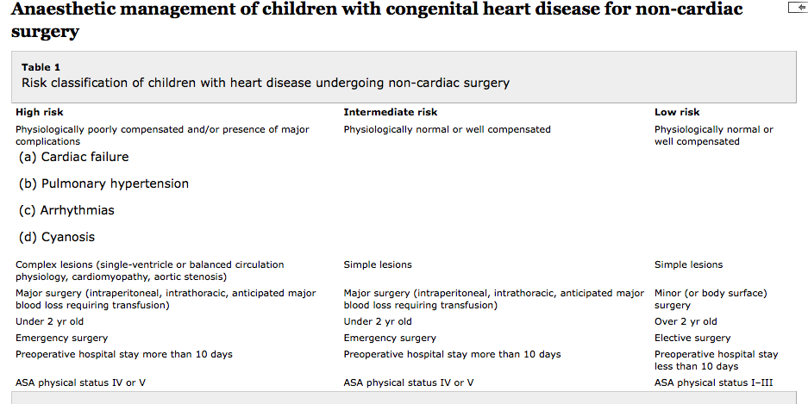

Slide 83
Manipulation of SVR
INCREASE
Sympathetic stimulation
Pain and agitation
Epinephrine
Dopamine
Norepinephrine
Phenylephrine
Ketamine
Negative intrathoracic pressure
Hypothermia
DECREASE
Adequate sedation and analgesia
Vasodilators
Milrinone
Dobutamine
Nitroprusside
ACE inhibitors
Angiotensin II receptor blockers (ARB)
Positive pressure ventilation
Fever
Sepsis

Slide 84
Manipulation of PVR
INCREASE
PEEP
High PIP
Atelectasis
Low FiO₂
Acidosis
Hypercapnia
Increased HCT
Pain, agitation
Epinephrine, dopamine
Direct surgical manipulation
Vasoconstrictors: phenylephrine
DECREASE
No PEEP
Low AW pressure
Normal FRC
High FiO₂
Alkalosis
Hypocapnia
Low HCT
Blunted surgical response
NO
Vasodilators (Milrinone, prostacyclin)

Slide 85
Cases
1. 6 month old with an unrepaired VSD presenting for emergency surgery for a scrotal swelling.
Physiology: compensated (on examination in moderate cardiac failure, on diuretics but feeding well and gaining weight)
Lesion: simple. Awaiting VSD repair next month
Risk category: intermediate (physiologically well-compensated, simple lesion, minor surgery, but less than 2 yr old, emergency surgery)
Management: depends on local anaesthesia and surgical expertise—if local hospital routinely performs surgery on children under 2 yr then safe to undertake locally. Otherwise, consider discussion with and transfer to specialist centre
Anaesthesia considerations: slow cautious gas or IV induction, beware of possibility of poor cardiac reserve. Avoid high inspired oxygen concentration in order to minimize left-to-right shunt and maximize systemic perfusion. May require higher ventilator pressures than expected because of pulmonary edema. Avoid air bubbles in venous lines because of the risk of paradoxical embolus. Endocarditis prophylaxis unnecessary

Slide 86
Cases
2. 6 year old with a repaired tetralogy of Fallot presenting for dental extractions due to dental caries
Physiology: compensated (on examination good exercise tolerance, no signs of right heart failure. ECG shows RBBB and no ventricular ectopy)
Lesion: simple
Risk category: low (physiologically well compensated, simple lesion, minor surgery, over 2 yr old, elective surgery)
Management: perform procedure in local hospital. If ventricular ectopy present on ECG—consider to be high risk and seek cardiology advice. May need to postpone surgery or transfer to specialist center as high risk of life-threatening arrhythmias
Anaesthesia considerations: gas or IV induction. No need for endocarditis prophylaxis.

Slide 87
Cases
3. 8 year old with a Fontan circulation presenting for emergency surgery for reduction and fixation of a supracondylar fracture with neurovascular compromise
Physiology: may be well-compensated working single-ventricle circulation
Lesion: complex single ventricle
Risk category: high (physiologically well compensated, but complex single-ventricle lesion, emergency surgery)
Management: discuss with specialist centre paediatric cardiac anaesthetist. Transfer to specialist centre risks limb loss so may not be possible. Needs discussion on individual basis to balance risk of loss of limb vs loss of life if local hospital anaesthetist does not understand complex single-ventricle physiology.
Anaesthesia considerations: gas or IV induction, consider spontaneous ventilation as this aids PBF but must avoid hypoxia, hypercarbia and atelectasis which increase PVR and compromise PBF. Full stomach may require rapid sequence intubation and positive pressure ventilation (PPV). If using PPV avoid high pressures, high PEEP, and long inspiratory times all of which compromise PBF. Slight head-up position aids venous return and PBF as does raising the legs. Endocarditis prophylaxis unnecessary.

