Slide 1
Neonatal Cardiovascular Physiology
Greg Latham, MD
Associate Professor
Seattle Children’s Hospital
gregory.latham@seattlechildrens.org
Updated 4/2017

Slide 2
Disclosures
No disclosures to report

Slide 3
Objectives
Review prenatal and postnatal formation of the cardiovascular system
Review the fetal, transitional, and persistent fetal circulations
Review the relevant impact of oxygen on newborn resuscitation

Slide 4
Embryologic formation of the cardiovascular system

Slide 5
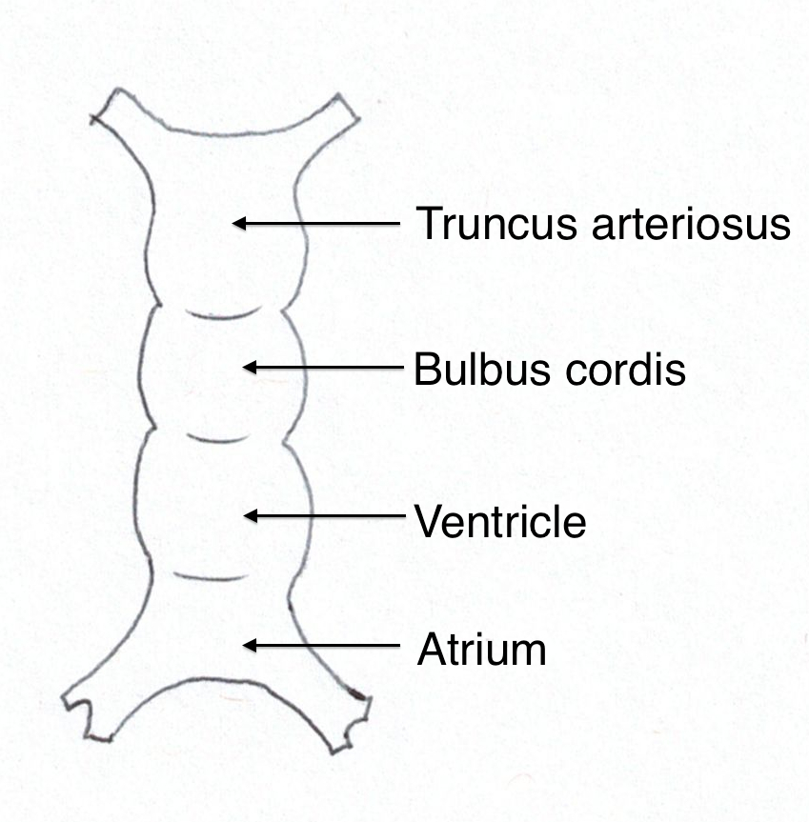
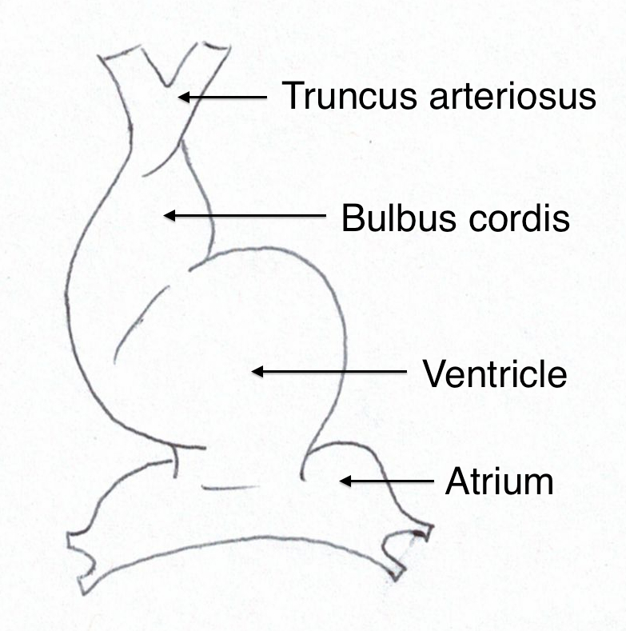
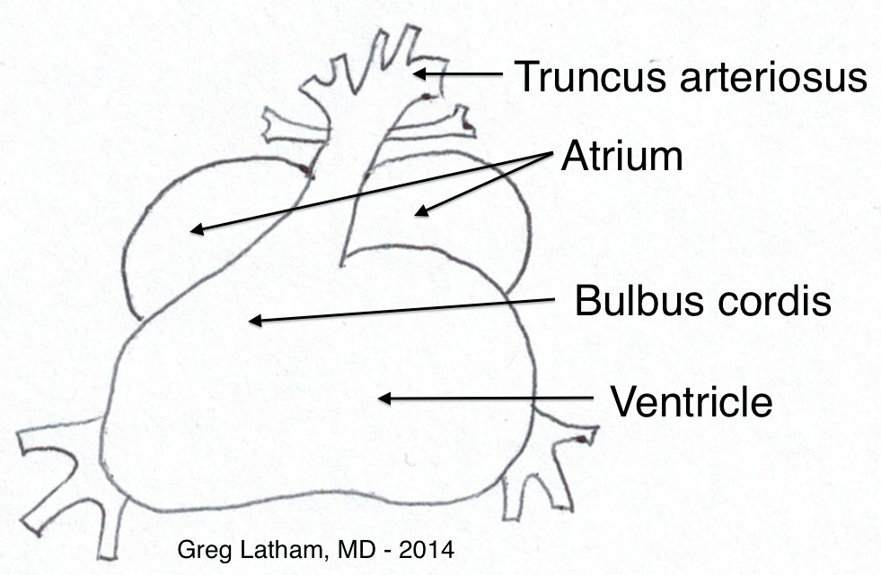
Day 21
The heart tube
Day 23
Looping begins
Day 27
Almost ready for circulation
Notes:
The heart is the first functional organ of the embryo and forms between the second and eighth weeks of life. On day 15, the mesoderm differentiates from the ectoderm and gives rise to the straight heart tube.
By day 21, the straight heart tube begins to indent to form the 4 initial heart structures: the truncus arteriosus, bulbus cordis, ventricle, and atrium.
Cardiac looping on day 23 causes the primitive heart tube to fold onto itself, migrating the eventual cardiac structures into their relative positions. The heart tissue begins to beat by day 23.
On day 27, the major structures have moved into place. At this point, the structure is already recognizable as a heart.
By day 30, the heart begins circulation

Slide 6
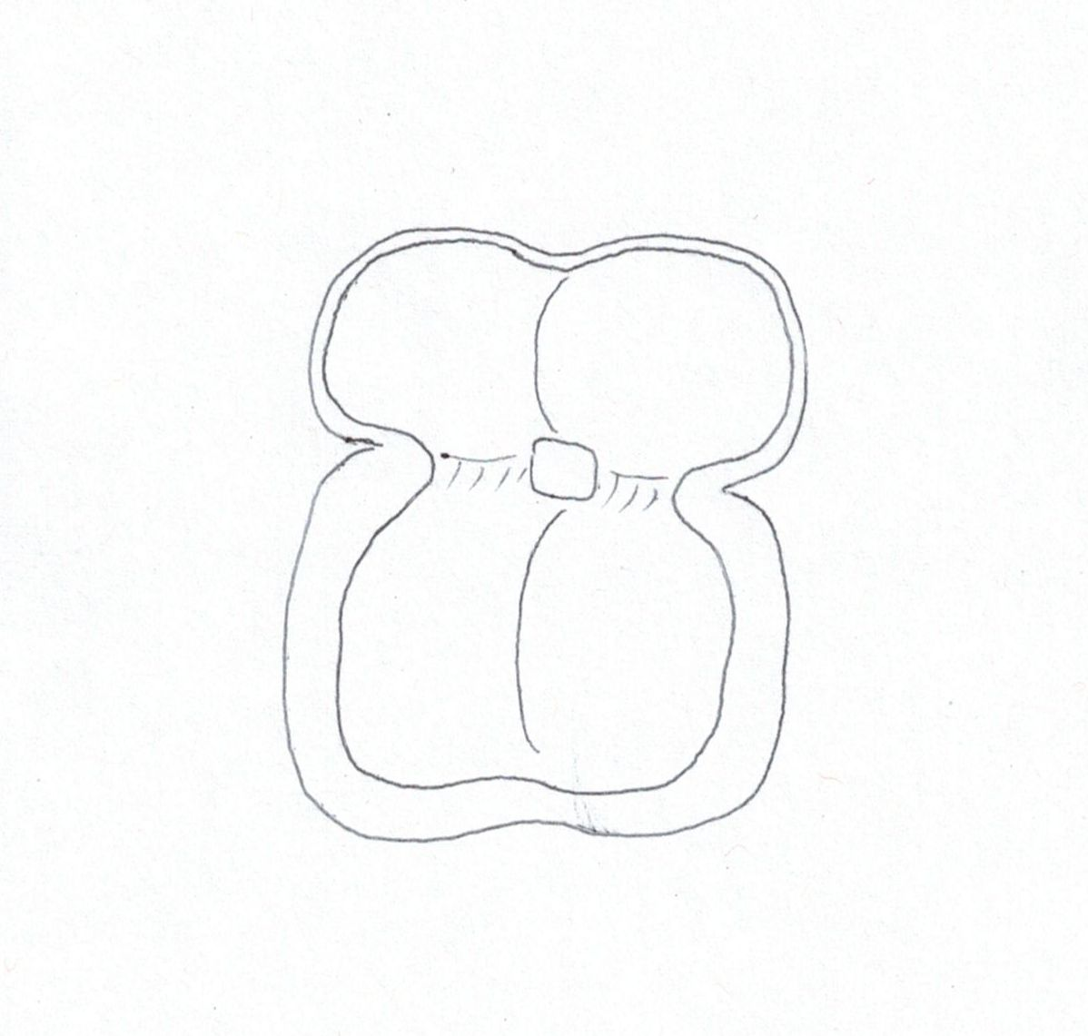
RA
LA
Endocardial cushion
RV
LV
Notes:
Various factors, including differential growth rates, constrictions at sites of future structures, genetic factors, cell differentiation, and influence from the surrounding pericardium and neural crest cells chaperone ongoing formation of the heart over the next several weeks.
Subsequent development includes septation and heart chamber formation, formation of heart valves, formation of the pulmonary vascular system, formation of the conduction and coronary artery systems, and septation and formation of the outflow tracts and great arteries. This picture loosely demonstrates the septation of the heart into 4 chambers, via the atrioventricular valves, atrial septum, and ventricular septum.
By day 50, the heart has matured almost completely into that seen at the end of gestation.

Slide 7
Postnatal cardiovascular development

Slide 8
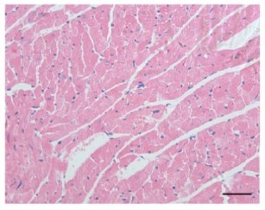
Neonatal myocardium
Neonatal myocardial contraction is weaker than in childhood or adulthood:
Less contractile elements
More connective tissue
Myofibrils are less organized
Inefficient calcium utilization
Minor reasons
Contractile protein immaturity
Inefficient energy storage and utilization
Immature cellular regulation of the action potential
Copyright free via Creative Commons,
PLoS One. 2013; 8(11): e80709.
Teitel DF, Cassidy SC, Fineman JR. Circulation Physiology. In: Moss AJ, Allen HD, eds. Moss and Adams' Heart Disease in Infants, Children, and Adolescents: Including the Fetus and Young Adult: Wolters Kluwer Health/Lippincott Williams & Wilkins, 2008.
Baum VC, Palmisano BW. The immature heart and anesthesia. Anesthesiology 1997; 87: 1529-1548.
Notes:
Although myocardial mechanics are qualitatively similar from embryonic stages through childhood, several pertinent differences exist that impact overall cardiac function. Compared with the adult, the immature neonatal myocardium cannot generate the same contractile force. The neonatal myocardium is comprised of less contractile elements and more connective tissue than adults, and the myofibrils are less organized. Neonatal myocardium relies more on extracellular calcium for contractility, compared to immediate release and uptake by the sarcoplasmic reticulum in adults, which may explain the exaggerated sensitivity in infants to hypocalcemia from rapid transfusion of blood products. Additional reasons for less contractile force exist in the neonatal period, including contractile protein immaturity, inefficient energy storage and utilization, and immature cellular regulation of the action potential compared to the adult.

Slide 9
Neonatal myocardium
Traditionally, it was thought that neonatal cardiac output is almost entirely heart rate dependent
However, neonatal hearts do respond to alterations in preload and afterload, but less so than in adults.
But the neonatal Starling curve is narrow, meaning less ability to alter stroke volume based on loading conditions
Overall, high metabolic demands of neonates require heart to operate at near-maximal capacity at most times
Baum VC, Palmisano BW. The immature heart and anesthesia. Anesthesiology 1997; 87: 1529-1548.
Notes:
Traditionally, it has been believed that neonatal cardiac output is primarily heart rate dependent; however, this view has been challenged. Neonatal hearts do respond to alterations in preload and afterload, but the effect is not as great as in adults. Poor ventricular compliance and likely a very narrow Frank-Starling curve predisposes the neonatal heart to have less of an ability to alter cardiac output based on stroke volume, preload, and afterload, thus having a greater reliance on heart rate for cardiac output. Overall, because of the high metabolic demands of the heart and other developing tissues, the neonatal heart operates at near-maximal capacity at most times.

Slide 10
Neonatal myocardium
Neonatal heart operates at near-maximal capacity at most times
Thus stressors (e.g. hypoxia, anesthesia) risk rapid decompensation in neonates:
Many anesthetics reduce O₂ consumption, but…
Overall myocardial suppression and lower heart rates under anesthesia risk
Likely worse in the setting of acute or chronic hypoxia
Baum VC, Palmisano BW. The immature heart and anesthesia. Anesthesiology 1997; 87: 1529-1548.
Notes:
As mentioned in the previous slide, the neonatal heart operates at near-maximal capacity at most times, which means that neonates are at high risk of rapid cardiac decompensation when the heart is stressed through hypoxia, acidosis, hypocalcemia, reduced coronary blood flow, or ventricular wall stress.
Anesthesia risks stressing the heart: although most anesthetics reduce myocardial O2 consumption and volatile anesthetics may dilate coronary arteries, the net effect of many anesthetics is an overall reduction in heart rate and cardiac output, risking myocardial hypoperfusion. In the setting of hypoxia and acidosis, the myocardial is significantly more sensitive to the depressant effects of anesthesia.

Slide 11
Neonatal myocardium
The neonatal and fetal heart does respond to sympathetic stimulation
Sympathetic nervous system is immature at birth
Parasympathetic innervation dominates
Exaggerated vagal responses to various stimuli
Sympathetic nervous system is mature by late infancy
Baum VC, Palmisano BW. The immature heart and anesthesia. Anesthesiology 1997; 87: 1529-1548.
Schure AY, Dinardo JA. Cardiac physiology and pharmacology. In: Coté CJ, Lerman J, Anderson BJ, eds. Coté and Lerman's a practice of anesthesia for infants and children, 5th edn. Philadelphia, PA: Elsevier, 2013.
Notes:
The neonatal and even fetal heart does respond to sympathetic stimulation. This is clearly seen with tachycardia during crying. The sympathetic nervous innervation of the heart, however, is immature at birth, and parasympathetic innervation dominates, leading to potentially exaggerated vagal responses to a number of stimuli. The sympathetic nervous system becomes mature by late infancy.

Slide 12
Fetal circulation
Notes:
Understanding the shunts at birth are important for understanding the development of pulmonary hypertension and how reversal of shunts occurs in certain settings.

Slide 13
The hypoxic environment
Fetal circulation is relatively hypoxic compared to the mother and after birth
PO₂ of umbilical vein blood entering fetus is 30 mmHg
PO₂ of blood returning to placenta is 16 mmHg
Presence of fetal shunts allows best utilization of limited O₂ to fetal tissues
3 fetal shunts:
Ductus venosus
Foramen ovale
Ductus arteriosus
Notes:
Fetal growth occurs in a relatively hypoxic environment. The PO₂ of umbilical vein blood entering the fetus is approximately 30 mmHg and is approximately 16 mmHg when returning to the placenta via the umbilical arteries. Several mechanisms, most notably fetal shunts, are in place to best utilize the limited O₂ available to the developing tissues. The three fetal shunts are the ductus venosus, foramen ovale, and ductus arteriosus.

Slide 14
Ductus venosus
Umbilical venous blood from the placenta has high velocity and PO₂
Ductus venosus is crucial to allow this fast, oxygenated blood to bypass liver
~50% of umbilical venous blood passes through ductus venosus, the remainder is distributed to both lobes of the liver
This blood preferentially streams to the coronary arteries and brain (shown in next several slides)
Rudolph AM. Hepatic and ductus venosus blood flows during fetal life. Hepatology. 1983 Mar;3(2):254–8.
Notes:
The ductus venosus aids in directing the oxygenated blood from the placenta directly to the heart. This bypass of the portal venous system maintains the high oxygenation and velocity of placental blood into the inferior vena cava (IVC) and heart. The remainder of IVC flow is from the fetal lower body and the hepatic vein and is both deoxygenated and low velocity

Slide 15
Fetal Circulation
Course of the oxygenated umbilical vein blood:
→ bypasses liver via ductus venosus
→ mixes with IVC
→ eustachian valve shunts towards PFO → LA
→ LA → LV → aortic valve
→ aorta → coronary and carotid arteries
Therefore, oxygenated blood from the umbilical vein perfuses the brain and coronary arteries by shunting across the liver (via the ductus venosus) and shunting across the right heart (via the foramen ovale)
See diagram on next slide
Notes:
As IVC flow enters the right atrium (RA), the eustachian valve preferentially streams most of the high-velocity, oxygenated umbilical venous blood from the ductus venosus towards the foramen ovale and into the left atrium (LA) and left ventricle (LV). LV ejection sends the relatively oxygenated blood to the ascending aorta and aortic arch vessels, providing blood with an SaO₂ of 60-65% to the highly metabolic heart and brain.
IVC = inferior vena cava; RA = right atrium; PFO = patent foramen ovale; LA = left atrium; LV = left ventricle; SVC = superior vena cava

Slide 16
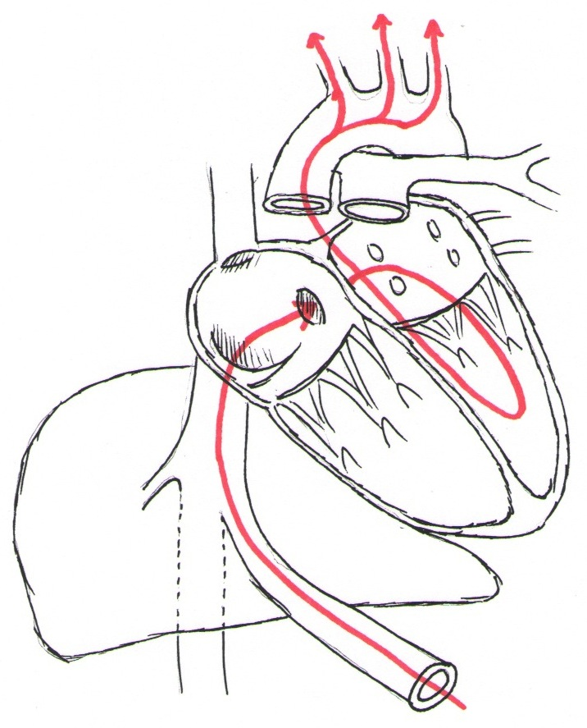
SVC
Aorta
PA
PFO
RA
EuV
LV
RV
Ductus
venosus
Liver
Umbilical vein
IVC
Greg Latham, MD
Notes:
The eustachian valve directs the majority of oxygenated placental blood across the PFO and eventually across the aortic valve. Therefore, this higher oxygenated blood comprises most of the blood flow to the heart (via coronary arteries) and the brain (via the carotic arteries on the aortic arch).
SVC = superior vena cava; RA = right atrium; EuV = eustachian valve; PFO = patent foramen ovale; RV = right ventricle; PA = pulmonary artery; LV = left ventricle; IVC = inferior vena cava.

Slide 17
Fetal Circulation
Desaturated SVC blood from the fetal brain takes a different course:
SVC→ RA → tricuspid valve (not to PFO)
→ pulmonary valve
→ ductus arteriosus
→ descending aorta
→ back to placenta for oxygenation
See diagram on next slide
Notes:
The low-velocity, desaturated blood from the lower body and hepatic vein enters the right atrium and mixes with deoxygenated blood return from the superior vena cava (SVC). Most of this low-velocity, deoxygenated venous return preferentially streams across the tricuspid valve and into the right ventricle (RV). RV ejection sends the deoxygenated blood into the pulmonary artery. The high pulmonary vascular resistance (PVR) directs 90% of the RV output across the third fetal shunt, the ductus arteriosus, and into the descending aorta. Two thirds of the descending aorta blood, with an SaO₂ of 50-55%, returns to the placenta, and the rest perfuses the abdominal organs and lower body.
IVC = inferior vena cava; RA = right atrium; PFO = patent foramen ovale; LA = left atrium; LV = left ventricle; SVC = superior vena cava

Slide 18
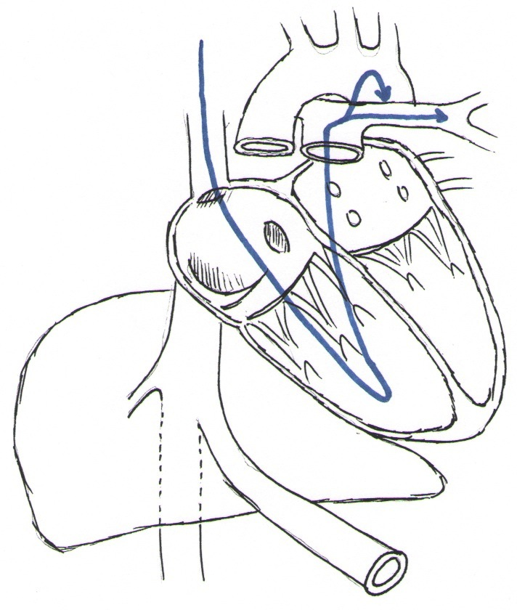
PDA
SVC
Aorta
PA
RA
TV
RV
LV
Ductus
venosus
Liver
Umbilical vein
IVC
Greg Latham, MD
Notes:
The more deoxygenated venous return to the heart is from the SVC, and it flows across the tricuspid valve, into the RV, and into the PA. Because PVR is high, very little goes to the lungs; most goes across the ductus arteriosus and into the descending aorta and towards the placenta for re-oxygenation.
SVC = superior vena cava; RA = right atrium; TV = tricuspid valve; RV = right ventricle; PA = pulmonary artery; LV = left ventricle; PDA = patent ductus arteriosus; IVC = inferior vena cava.

Slide 19
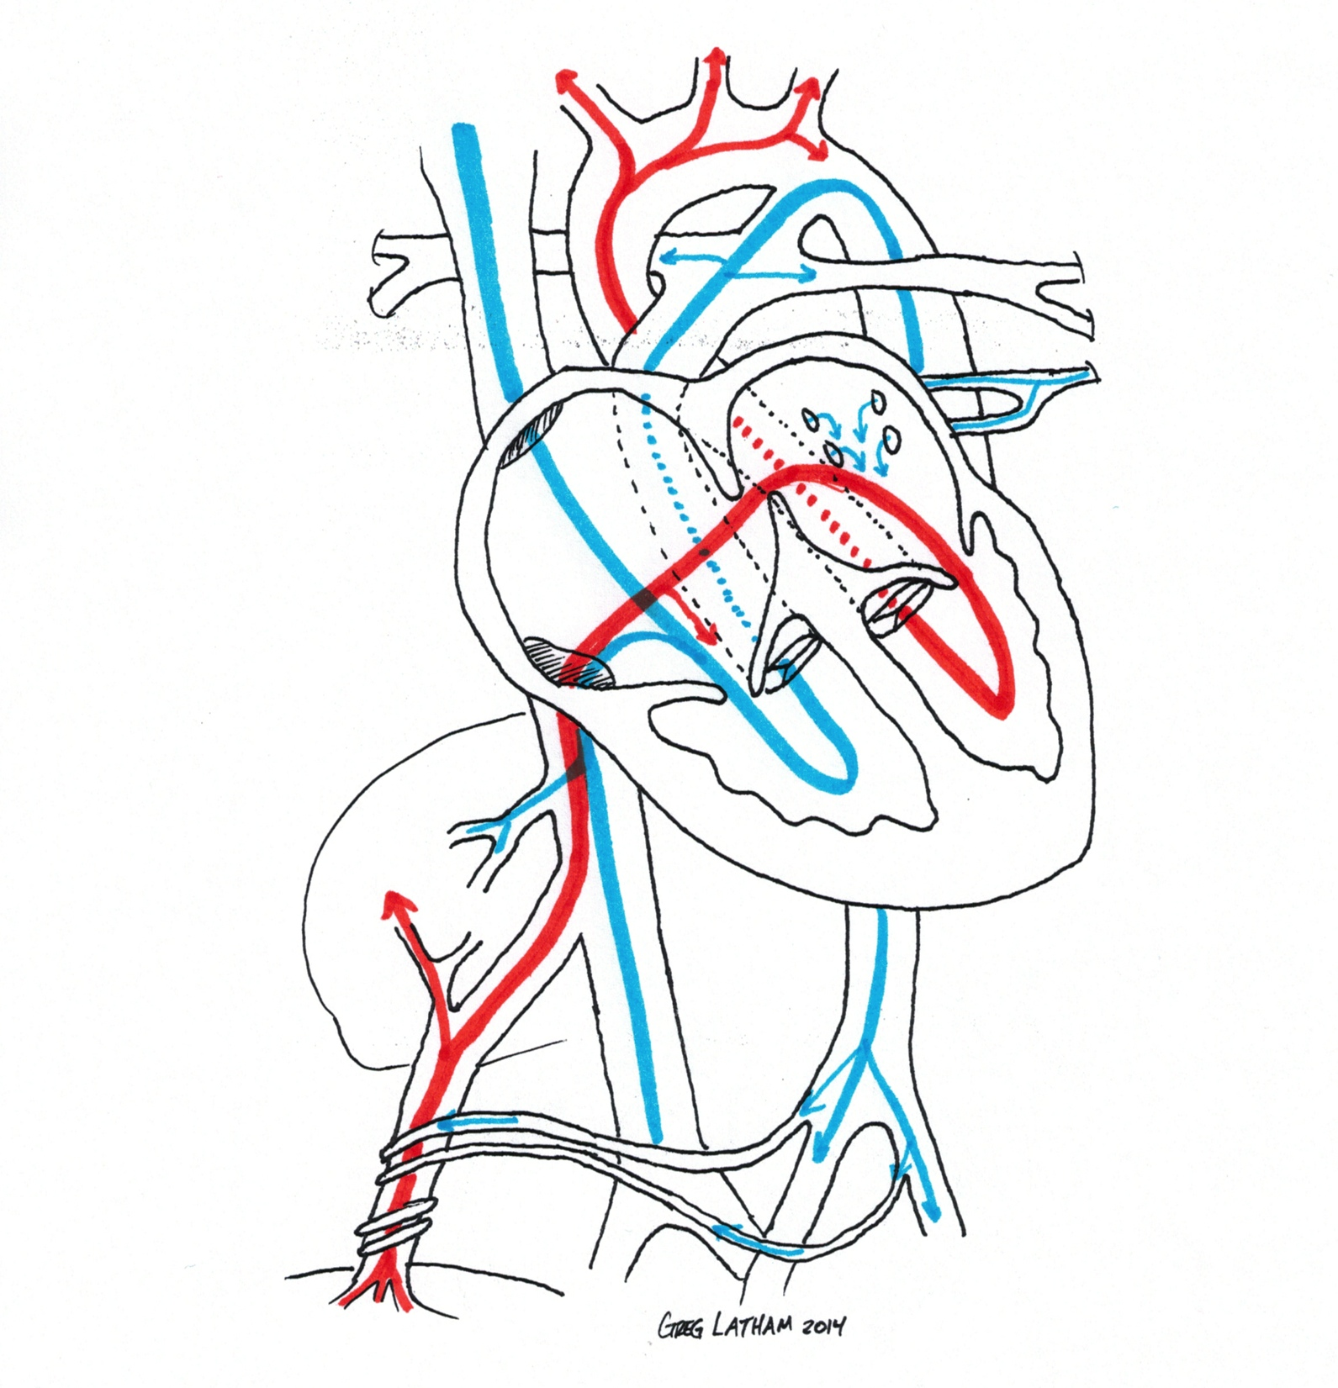
Oxygen Saturation of Fetal Blood
SVC
Ductus
arteriosus
25%
65%
55%
Pulmonary
artery
50%
Pulmonary
vein
40%
65%
Hepatic
vein
50%
Liver
65%
IVC
55%
25%
Aorta
80%
Umbilical
vein
Umbilical arteries
Placenta
Notes:
Umbilical venous blood has a saturation of 80% from the placenta. Although this high-velocity blood is preferentially streamed across the PFO, some desaturation occurs en route to the left ventricle by some degree of mixing with SVC and IVC return to the heart.
Overall, the left ventricle ejects blood with SaO2 of 65% to predominately the coronaries and brain, while the right ventricle ejects blood with SaO2 of 50% to the lungs and the rest of the body, via the ductus arteriosus and descending aorta.
Umbilical artery blood returning to the placenta has an SaO2 of approximately 50-55%.

Slide 20
Combined Cardiac Output of Fetal Blood – Right Ventricle
SVC
Ductus
arteriosus
10%
59%
Pulmonary
artery
7%
Pulmonary
vein
Hepatic
vein
66%
Liver
IVC
69%
Aorta
Umbilical
vein
45%
24%
Umbilical arteries
Placenta
Notes:
Cardiac output from the fetal right ventricle is summarized:
2/3 of cardiac output (66%) is from the right ventricle. Only 7% enters the lungs; the remainder crosses the ductus arteriosus to the descending aorta.
10% of additional cardiac output from the left ventricle and the aortic arch continues into the descending aorta to join the right ventricular output.
Once this less saturated blood is in the descending aorta, approximately two thirds of flow returns to the placenta via the umbilical arteries and one third continues on to the lower body.

Slide 21
Combined Cardiac Output of Fetal Blood – Left Ventricle
21%
SVC
10%
31%
Pulmonary
artery
Pulmonary
vein
34%
Hepatic
vein
Liver
IVC
Aorta
Umbilical
vein
Umbilical arteries
Placenta
Notes:
Cardiac output from the fetal left ventricle is summarized:
The majority of oxygen-rich placental blood crosses the PFO to enter the left ventricle. A scant amount of pulmonary venous into the left atrium flow joins this path.
Only 1/3 (34%) of combined cardiac output is from the left ventricle. As it leaves the left ventricle, one tenth of the output perfuses the coronary arteries, almost two thirds perfuses the head/arms, and almost one third continues down the descending aorta.

Slide 22
The hypoxic environment
Fetal oxygen delivery (DO₂) is maintained in the relative hypoxic environment because:
High cardiac output
High hemoglobin
Greater O₂ affinity of hemoglobin F for enhanced O₂ uptake at the placenta
Lower pH in fetal organs for enhanced O₂ release at the tissue level
Schure AY, Dinardo JA. Cardiac physiology and pharmacology. In: Coté CJ, Lerman J, Anderson BJ, eds. Coté and Lerman's a practice of anesthesia for infants and children, 5th edn. Philadelphia, PA: Elsevier, 2013.
Giardina B, et al. Physiological Relevance of the Overall ΔH of Oxygen Binding to Fetal Human Hemoglobin. J Mol Biol 1993, 229, 512-516
Notes:
Fetal oxygen delivery (DO₂) in this relatively hypoxic state is augmented by four factors: (1) relatively high cardiac output, (2) high hemoglobin concentrations, (3) greater oxygen affinity of hemoglobin F for enhanced O₂ binding at the placenta, and (4) increased acidosis in fetal tissues for enhanced O₂ release to the tissues.

Slide 23
Transitional circulation

Slide 24
Transitional circulation
Transitional circulation = transition from fetal to normal (adult) circulation
Transitional circulation begins when umbilical cord is clamped and lungs are inflated
Clamping umbilical cord:
Removal of low-resistance placenta → increase in SVR
Increase in SVR → increased left heart pressures
Breathing after birth:
Lung expansion and increased PaO₂
→ 8- to 10-fold drop in PVR
→ Significant increase in pulmonary blood flow
Notes:
At birth, several acute changes occur that profoundly impact the circulation, leading to a state called the transitional circulation. In the transitional state, the pulmonary arterial pressures are still high (although much lower than in utero), and flow reverses in the ductus arteriosus from right-to-left in utero to left-to-right. Maturation to the adult circulation occurs over a few weeks.
Clamping of the umbilical vessels at birth removes the large, low-resistance vascular bed of the placenta, causing an acute elevation of SVR and LV afterload. At the same time, lung expansion and the start of postnatal ventilation elicits a dramatic decrease in PVR and is associated with an 8- to 10-fold increase in pulmonary blood flow and subsequent LA filling.

Slide 25
Transitional Circulation - PFO
Cord clamping and lung inflation cause increased SVR and decreased PVR, respectively
This causes increased pulmonary blood flow and increased blood return to the left atrium
LA pressure > RA pressure → closes the flap-like foramen ovale.
Functional closure of PFO occurs quickly but anatomic closure usually requires weeks.
A PFO that is probe patent persists in approximately 25% of adults
Copyright free via Creative Commons,
Eur Heart J. 2012 Mar; 33(6): 705–713.
Notes:
The combined increase in pulmonary venous return and increased LV afterload results in a sudden increase in LA pressure. As LA pressure exceeds that of the RA minutes after birth, the flap-like foramen ovale functionally closes, signaling closure of the first fetal shunt. Complete anatomic closure, however, occurs more slowly or not at all. An anatomically patent foramen ovale can be found in over 50% of infants 2-6 months of age and in 25% of adults, most of which have little clinical significance.
SVR = systemic vascular resistance; PVR = pulmonary vascular resistance

Slide 26
Transitional Circulation - PDA
The ductus arteriosus remains patent in utero due to hypoxia, mild acidosis and placental prostaglandins. Removal of these factors after delivery causes functional closure with anatomic closure occurring weeks later
Persistent PDA often occurs in premature infants with lung disease. Indomethacin, via its anti-prostaglandin action can be used to try and close a PDA
Before anatomic closure of the PDA and PFO, pRA > pLA can cause reversion to fetal circulation (R → L shunt and cyanosis)
Hypothermia, hypercarbia, acidosis, hypoxia and sepsis can all cause a reversion to fetal circulation
Notes:
Within hours after birth, the rise in SVR and fall in PVR leads to a reversal of flow to left-to-right across the ductus arteriosus. The elevation in PO₂ and decrease of circulating prostaglandins after birth leads to constriction of the ductus arteriosus tissue. Functional closure of the duct occurs in over half of newborns by day 2 and in 98% by day 4; within 2-3 weeks, ductal fibrosis occurs, resulting in the ductal remnant called the ligamentum arteriosum.
Premature babies may require significantly longer time for ductal closure or may require surgical closure in cases of pulmonary over-circulation and systemic steal. Also, hypothermia, hypercarbia, acidosis, hypoxia and sepsis can all cause a reversion to fetal circulation.
pRA = right atrial pressure; pLA = left atrial pressure

Slide 27
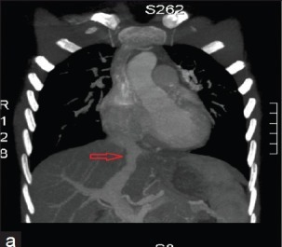
Transitional Circulation - DV
Flow through ductus venosus stops immediately when umbilical cord clamped
Full, irreversible closure occurs in 1-2 weeks
Fibrotic remnant is called ligamentum venosum
Copyright free via Creative Commons,
Ann Pediatr Cardiol. 2013 Jul-Dec; 6(2): 173–175.
Notes:
When the umbilical cord is clamped, flow through the ductus venosus stops, and portal venous flow dramatically decreases. Functional closure of the ductus venosus occurs in 1-2 weeks, and ongoing fibrosis results in the ligamentum venosum within months.

Slide 28
Persistent fetal circulation and Persistent pulmonary hypertension of the newborn (PPHN)

Slide 29
Persistent fetal circulation
Persistent fetal circulation = right-to-left flow across the foramen ovale and/or ductus arteriosus, as in utero
Two primary causes:
Congenital heart disease
Persistent pulmonary hypertension of the newborn (PPHN)
Copyright free via Creative Commons,
Pol J Radiol. 2014; 79: 164–168.
Sagittal reconstructed (A) and volume rendering (B) dual source CT images of a 15-day girl with a large PDA and pulmonary arterial hypertension
*
*
Notes:
Persistence of or reversal to the fetal circulation, that is right-to-left flow across the foramen ovale and/or ductus arteriosus, can occur in two newborn scenarios: (1) various forms of cyanotic congenital heart disease that maintain patency of the fetal shunts, and (2) persistent pulmonary hypertension of the newborn (PPHN). The numerous complex congenital heart lesions that cause persistence of ductal flow or intracardiac mixing at the atrial level are beyond the scope of this lecture and not further reviewed.

Slide 30
Persistent pulmonary hypertension of the newborn (PPHN)
PPHN = persistently high PVR after birth
Most common cause is parenchymal lung disease (e.g. meconium aspiration and respiratory distress syndrome)
Other causes:
Sepsis
Alveolar-capillary dysplasia
Surfactant dysfunction
Severe lung hypoplasia
Konduri GG, Kim UO. Advances in the diagnosis and management of persistent pulmonary hypertension of the newborn. Pediatr Clin North Am 2009; 56: 579-600.
Cabral JEB, Belik J. Persistent pulmonary hypertension of the newborn: recent advances in pathophysiology and treatment. J Pediatr (Rio J) 2013; 89: 226-242.
Notes:
PPHN occurs when PVR fails to sufficiently decrease at birth, and symptoms are present immediately at birth or shortly thereafter. The most common cause of PPHN is parenchymal lung disease, including meconium aspiration and respiratory distress syndrome. Other causes include sepsis, alveolar-capillary dysplasia, surfactant dysfunction, and severe lung hypoplasia (e.g., congenital diaphragmatic hernia).

Slide 31
PPHN
High PVR limits pulmonary blood flow and left atrial filling → high RA pressure keeps PFO open
High PVR, hypoxia, and hypercarbia (acidosis) keep PDA open
Thus combination of right-to-left shunts at PFO and PDA as well as poor alveolar ventilation cause hypoxemia
Treatment ranges from simple supplemental O2 to extracorporeal membrane oxygenation (ECMO)
Konduri GG, Kim UO. Advances in the diagnosis and management of persistent pulmonary hypertension of the newborn. Pediatr Clin North Am 2009; 56: 579-600.
Notes:
Continued elevation of PVR after birth limits pulmonary venous return to the LA, thus maintaining right-to-left shunt across the atrial septum and failure of foramen ovale closure. Furthermore, the elevated PVR promotes right-to-left shunt across the ductus arteriosus. Hypoxemia ensues from poor ventilation at the alveolar level and from the right-to-left shunts at the ductus arteriosus and foramen ovale. A vicious cycle occurs whereby the hypoxia further potentiates the elevated PVR and patency of the ductus arteriosus.
Mild forms may just require supplemental oxygen by nasal cannula to lessen PVR, but severe forms may require inotropic support or extracorporeal membrane oxygenation (ECMO).

Slide 32
PPHN and anesthesia care
Goal: maintain adequate oxygenation, myocardial function, and systemic perfusion
Avoid worsening PVR, so avoid:
Hypoxia
Acidosis (hypercarbia)
Excessive PEEP
Atelectasis
Catecholamine release (light anesthesia)
Notes:
Anesthetic management of the newborn with PPHN requires meticulous management to ensure adequate oxygenation and preservation of myocardial function and systemic perfusion.
The newborn pulmonary vasculature strongly reacts with vasoconstriction to several stimuli, most notably hypoxia. Additional stimuli include acidosis, elevation of leukotrienes and thromboxane, catecholamine release (including crying and light anesthesia), atelectasis, and excessive PEEP.

Slide 33
PPHN and anesthesia care
Increased FiO₂ causes pulmonary vasodilation, but
Hyperoxia can be harmful to newborn
Maximal pulmonary vasodilation occurs at relatively low O₂ levels
Thus, titrate O₂ to lowest acceptable amount, with goal PaO₂ of 60-90 mmHg
Maintain normocapnia
Use inhaled nitric oxide if required
Ensure adequate systemic BP; use inotropes as needed
Konduri GG, Kim UO. Advances in the diagnosis and management of persistent pulmonary hypertension of the newborn. Pediatr Clin North Am 2009; 56: 579-600.
Schure AY, Dinardo JA. Cardiac physiology and pharmacology. In: Coté CJ, Lerman J, Anderson BJ, eds. Coté and Lerman's a practice of anesthesia for infants and children, 5th edn. Philadelphia, PA: Elsevier, 2013.
Notes:
While oxygen therapy causes potent vasodilation and improved PO₂, hyperoxia can be harmful to the newborn, and maximal dilation occurs at relatively low O₂ levels. Thus, oxygen should be titrated to the lowest acceptable levels, with a PaO₂ of 60-90 mmHg as the goal. (See slide in next section for discussion of toxicity of hyperoxia)
Normocapnia is ideal; hypercapnia induces pulmonary vasoconstriction, and excessive alkalinization through hyperventilation may be harmful.
Inhaled nitric oxide (NO) is a potent selective pulmonary vasodilator and may be required perioperatively in the newborn.
Lastly, adequate systemic perfusion must be ensured, which may require inotropic support in newborns that are severely ill.

Slide 34
Newborn resuscitation and the use of oxygen

Slide 35
Newborn O₂ saturations
Transition to extrauterine life = marked increase in oxygen saturations in term newborns
Normal saturations in term infants:
Time after birth | Median SpO2 (interquartile range)
1 minute | 68% (60–77)
2 minutes | 76% (65–84)
3 minutes | 81% (71–90)
4 minutes | 88% (78–94)
5 minutes | 92% (83–96)
7 minutes | 95% (90–97)
10 minutes | 97% (94–98)
Dawson JA, et al. Defining the reference range for oxygen saturation for infants after birth.
PEDIATRICS. 2010 Jun;125(6):e1340–7.
Notes:
Immediately after birth, shunt across the foramen ovale functionally ceases within minutes, and right-to-left shunting across the ductus arteriosus slows and eventually reverses.
This leads to progressive increases in PaO2 and SpO2 within the first 10 minutes after birth.
The SpO2 values noted above are median numbers from a study of 468 infants who did NOT require supplemental oxygen in the delivery room.
Numbers are slightly lower for pre-term infants and are not presented here.

Slide 36
Newborn resuscitation & potential effects of O₂
Newborn hyperoxia can be toxic and lead to irreversible injury:
1 breath of 100% oxygen decreases minute ventilation; longer duration can lead to chronic lung injury
Resuscitation with 80% O₂ in delivery room decreases cerebral blood flow for 2 hours
Exposure to high FiO₂ for 3 minutes or longer may be associated with increased risk of childhood cancer
Can lead to oxidative stress and production of oxygen free radicals, lasting at least 28 days
Animal studies provide evidence of apoptotic cell death in the brain after various exposure to increased FiO₂
Effects are likely greater in premature compared to full term newborns, due to lack of adequate protective antioxidant levels
Goldsmith JP, Kattwinkel J. The role of oxygen in the delivery room. Clin Perinatol 2012; 39: 803-815.
Deuber C, Abbasi S, Schwoebel A, Terhaar M. The toxigen initiative: targeting oxygen saturation to avoid sequelae in very preterm infants. Adv Neonatal Care. 2013 Apr;13(2):139–45.
Notes:
A single breath of 100% oxygen given to human newborns in the first week of life has resulted in a decrease in minute volume, more so in preterm than in term infants.
Stabilization of human newborns with 80% oxygen in the delivery room decreases cerebral blood flow for up to 2 hours, compared to controls. May be due to a simultaneous fall in PCO₂
Two large studies have suggested that brief exposure to high oxygen concentration for 3 minutes or longer after birth is associated with increased risk of childhood cancer, primarily acute lymphatic leukemia
One study of human newborns has demonstrated oxidative stress associated with high oxygen administration with measurable effects lasting at least 28 days
Multiple animal studies have demonstrated evidence of apoptotic cell death in the retrosplenial cortex, hippocampus, frontal cortex, and thalamus, compared to the brains of control animals
All of these effects are likely worsened in premature compared to full term newborns

Slide 37
Newborn resuscitation & O₂
Because insufficient or excessive oxygenation can be harmful to the newborn infant, recommendations exist for newborn resuscitation:
Use oximetry; assessment of color is unreliable
For babies born at term, it is best to begin resuscitation with air rather than 100% oxygen.
Administration of supplementary oxygen should be regulated by blending oxygen and air, and the concentration delivered should be guided by oximetry.
If the heart rate is below 60 bpm after 90 seconds of resuscitation, the oxygen concentration should be increased to 100% until recovery of a normal heart rate.
Perlman JM, Wyllie J, Kattwinkel J, et al. Part 11: Neonatal resuscitation: 2010 International Consensus on Cardiopulmonary Resuscitation and Emergency Cardiovascular Care Science With Treatment Recommendations. Circulation 2010; 122: S516-538.
Kattwinkel J, et al. Neonatal resuscitation: 2010 American Heart Association Guidelines for Cardiopulmonary Resuscitation and Emergency Cardiovascular Care. PEDIATRICS. 2010 Nov;126(5):e1400–13.
Notes:
Based upon the potential harm of hyperoxia in newborns, the following are a subset of recommendations from the 2010 International Consensus on Cardiopulmonary Resuscitation and Emergency Cardiovascular Care Science With Treatment Recommendations - Neonatal Resuscitation:
Oximetry should be used for evaluation of oxygenation because assessment of color is unreliable.
For babies born at term it is best to begin resuscitation with air rather than 100% oxygen.
Administration of supplementary oxygen should be regulated by blending oxygen and air, and the concentration delivered should be guided by oximetry.
Hypoxia-induced bradycardia must be aggressively treated with oxygen, starting with 100% until recovery of normal heart rate, and then decreased thereafter.
Thus, resuscitation with room air or cautious escalation of fractional inspired O₂ should target normal postnatal saturations.

Slide 38
Newborn resuscitation & O₂
Although resuscitation of a term newborn should be initiated with room air, relative hypoxia is detrimental and must be avoided!
Pre-ductal SpO₂ (right upper extremity) must be used to guide targeted SpO₂ levels during delivery room resuscitation:
1 minute after delivery - 60-65%
2 minutes after delivery - 65-70%
3 minutes after delivery - 70-75%
4 minutes after delivery - 75-80%
5 minutes after delivery - 80-85%
10 minutes after delivery - 85-95%
Note: these goals are in delivery room, NOT operating room!
Kattwinkel J, et al. Neonatal resuscitation: 2010 American Heart Association Guidelines for Cardiopulmonary Resuscitation and Emergency Cardiovascular Care. PEDIATRICS. 2010 Nov;126(5):e1400–13.
Notes:
While hyperoxia is harmful to a newborn, hypoxia can be detrimental. Therefore, pulse oximetry must be used to guide resuscitation such that appropriate oxygenation is achieved.
Use of a pre-ductal saturation monitor, on the right upper extremity, is necessary because assessment of skin color is unreliable to appropriately assess saturation.
These values pertain to newborn resuscitation, not intraoperative resuscitation of young neonates.

Slide 39
Newborn care in OR
Normoxia is goal (>94%)
Avoid both hypoxemia (increased risk of mortality) and hyperoxemia (risk of ROP), especially in preterm
Beware of over-ventilation; a PaCO2 of 40-50 is beneficial:
Decreased lung injury
Increase cerebral blood flow
Increased O2 unloading at the tissue level
Thome UH, Ambalavanan N. Permissive hypercapnia to decrease lung injury in ventilated preterm neonates. Semin Fetal Neonatal Med. 2009 Feb;14(1):21–7.
Notes:
The goal is to supplement FiO2 as needed to maintain normoxia.
Especially in preterm newborns, avoid hypoxemia which risks increased mortality, and avoid hyperoxia which risks retinopathy of prematurity.
Lastly, don’t push end-tidal CO2s into the 30’s, where we normally have them for adults. Newborns and neonates have slightly higher resting PaCO2s compared to adults, and there are advantages to elevated PaCO2s. Including: decreased lung injury, increased cerebral blood flow, and shift of the oxyhemoglobin dissociation curve for improved unloading of O2 at the tissue level. On the other hand, extreme hypercapnia and subsequent acidosis can negatively provoke shunt reversal across the PFO/PDA due to elevated pulmonary vascular resistance and lead to myocardial depression.

Slide 40
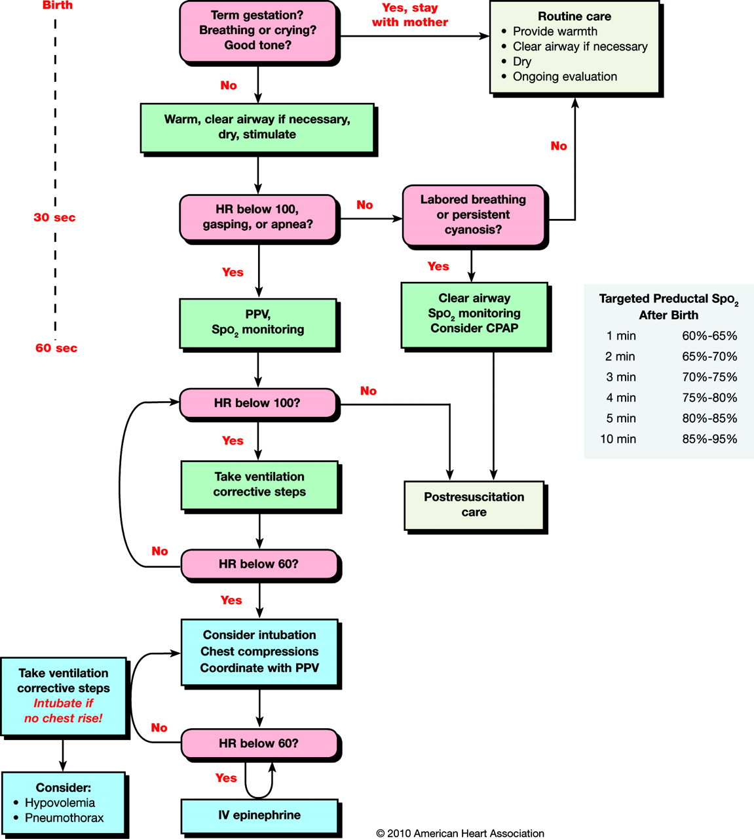
Newborn Resuscitation Algorithm.
Kattwinkel J et al. Pediatrics 2010;126:e1400-e1413
©2010 by American Academy of Pediatrics
Notes:
An algorithm is presented to tie together the timing and goals of newborn resuscitation.

