Slide 1
PEDIATRIC PHYSIOLOGY: IMPLICATIONS FOR THE ANESTHESIOLOGIST
Updated 5/2017
Francine S Yudkowitz, MD FAAP
Professor of Anesthesiology, Perioperative and Pain Medicine, and Pediatrics
Icahn School of Medicine at Mount Sinai
New York

Slide 2
DISCLOSURE
No relevant financial relationships

Slide 3
OBJECTIVES
Review the physiologic differences in the infant and adult:
Respiratory system
Cardiac system
Discuss the implications of these differences on anesthetic management

Slide 4
RESPIRATORY SYSTEM
Anatomic Considerations

Slide 5
OCCIPUT
Large occiput tends to over flex neck
Clinical significance
shoulder roll for optimal positioning
positioning after extubation
Notes:
The relatively large occiput places the infant neck in a flexed position. In order to optimally position the infant for intubation, a shoulder roll may be necessary. In contrast, the adult usually requires a pillow under the occiput.
After extubation, it is equally important to make sure that the neck is not over flexed as this will result in airway obstruction.

Slide 6
TONGUE
Relatively large
Clinical significance
more prone to airway obstruction
mask ventilation may be difficult
difficulty manipulating the laryngoscope blade
Notes:
The tongue is relatively large, not macroglossia. The clinical significance is that these patients are more prone to airway obstruction. It may make mask ventilation and manipulation of the laryngoscope blade more difficult.

Slide 7
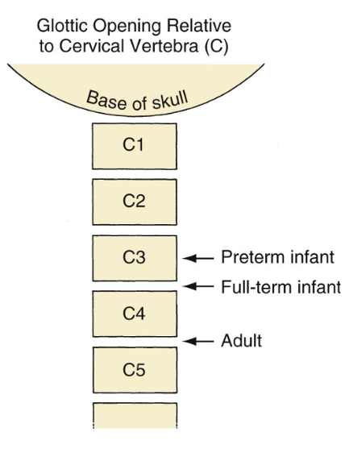
POSITION OF THE LARYNX
Clinical significance
Greater acute angulation between the tongue and glottic airway
Straight laryngoscope blade preferable
Angulation exacerbated with mandibular or midfacial hypoplasia
Cote, et al (editors) A Practice of Anesthesia for Infants and Children, 2013, p 238
Notes:
The position of the glottic opening varies with the age of the patient. The younger the patient the more cephalad the position. In the preterm infant, the glottic opening is approximately at cervical vertebral level 3, full-term infant at cervical level 3-4, and in the adult at cervical vertebral level 4-5. Some describe the larynx as not only being more cephalad but anterior as well.
The greater angulation between the base of the tongue and the glottic opening results in more difficulty in visualizing the glottic opening during laryngoscopy. For this reason, a straight blade is more often used in this population.

Slide 8
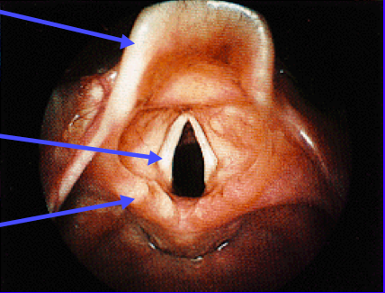
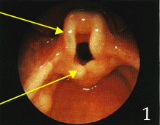
EPIGLOTTIS
ADULT
Broad and flat
Parallel to axis of trachea
Curved or straight blade
INFANT
Omega shaped
Angled away from axis of trachea (floppy)
Straight blade to lift epiglottis
Notes:
The adult epiglottis is broad and flat and parallel to the axis of the trachea, allowing for visualization of the glottic opening by placing a curved laryngoscope blade in the vallecula. In the infant, the epiglottis is folded on itself (omega shaped) and angled away from the tracheal axis (floppy). Placing a laryngoscope blade in the vallecula may not facilitate visualization of the glottic opening. A straight blade may be more optimal since it can be used to lift the epiglottis thus revealing the glottic opening.

Slide 9
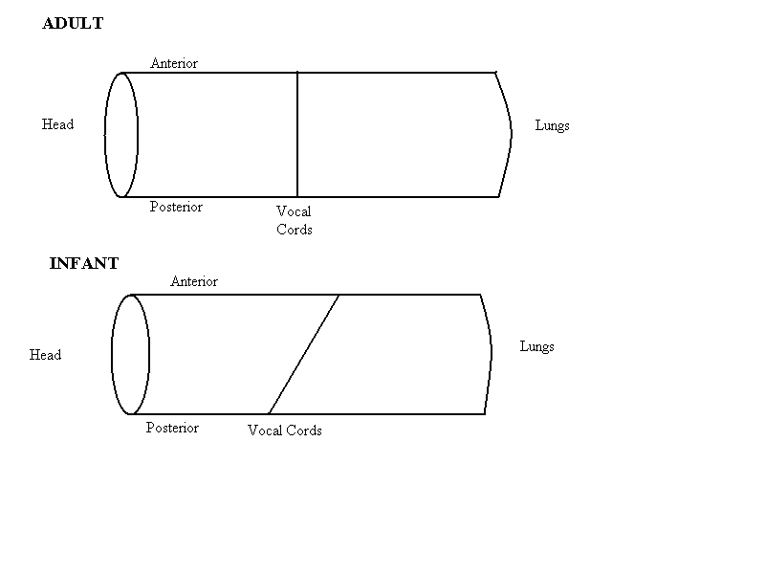
VOCAL CORDS
Clinical significance:
ETT hung up at anterior commisure
Pass ETT through posterior portion of VC
Particular problem with nasal intubation
Notes:
The vocal cords in the adult are perpendicular to the axis of the trachea whereas the vocal cords in the infant are angled, with the anterior aspect more caudad. The angled vocal cords make introduction of the endotracheal tube more difficult in that advancement of the tube may be impeded at the anterior commisure of the vocal cords. When inserting the endotracheal tube, care should be taken to try to advance it through the posterior aspect of the vocal cords. This is a particular problem when performing nasal intubations, where altering the position (eg. flexing the neck) may facilitate passage of the endotracheal tube.
When advancing the endotracheal tube, one has to decide whether the difficulty advancing the endotracheal tube is due to impediment by the anterior commisure or the endotracheal tube is too large and not passing through the cricoid ring. In the former, advancing through the posterior aspect of the vocal cords will facilitate intubation, whereas, in the latter a smaller size endotracheal tube will be necessary.

Slide 10
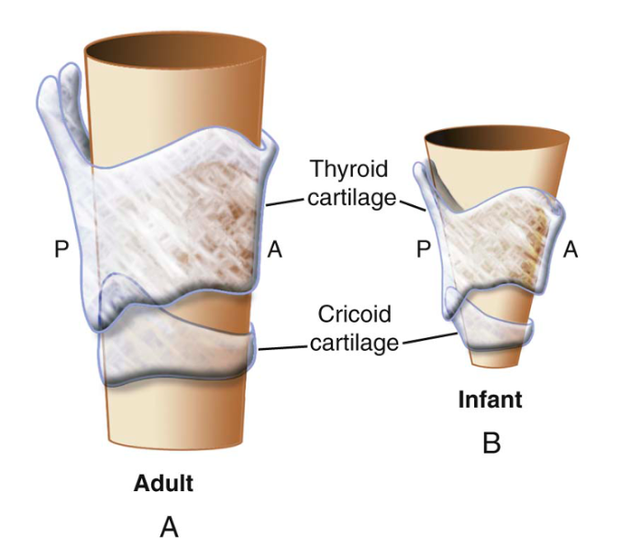
NARROWEST AREA OF LARYNX
Tubular shaped
Glottic opening
Funnel shaped
Cricoid cartilage
Cote, et al. A Practice of Anesthesia in Infants and Children. 2014, p241
Notes:
The traditional teaching is that the adult larynx is tubular shaped and the narrowest area of larynx in the adult is the glottic opening and in infants the larynx is funnel shaped and the cricoid cartilage is the narrowest area. The child attains the adult larynx configuration by about the age of 8-10 years.
Recent studies have challenged this teaching as follows: 1) The adult larynx is funnel shaped. 2) Recent MRI studies showed that in 70% of adults, the narrowest portion of the larynx is the subglottic area but not clinical issue since the size of tracheal tubes usually used in adults (7.0-7.5 mm ID) passes easily through the glottis and subglottic area. The infant larynx is more funneled shape, attaining adult configuration by 8-10 years of age.

Slide 11
AIRWAY COMPROMISE
INFANT
1 mm edema
75% loss of cross-sectional area
4 mm
ADULT
44% loss of cross-sectional area
1 mm edema
8 mm
Notes:
Because the infant's airway is smaller than the adult’s airway, similar amount of mucosal edema results in greater loss of cross sectional area. In the example above, 1 mm of mucosal edema in the infant results in 75% loss of cross sectional area whereas in the adult it results in only 44%.

Slide 12
AIRWAY COMPROMISE
INFANT
Laminar flow: R ~ 1/r⁴
↑resistance 16x vs. 3x
Turbulent flow: R ~ 1/r⁵
↑ resistance 32x vs. 5x
1 mm edema
4 mm
ADULT
1 mm edema
8 mm
Notes:
This leads to a greater increase in the airway resistance in the infant (16x) vs. the adult (3x) during laminar flow (quiet breathing) and 32x (infant) vs. 5x (adult) during turbulent flow.

Slide 13
TRADITIONAL TEACHING
Cricoid ring narrower than glottic opening
no need for cuffed ETT
Snug fitting ETT
may cause edema ➔ post-extubation stridor
leak < 30 cm H₂O
Until 8-10 years of age
Notes:
The traditional teaching has been that cuffed endotracheal tubes are unnecessary because the cricoid ring is the narrowest portion of the airway. As a matter of fact, they may even be detrimental because if the cuffed endotracheal tube is exerting excessive pressure on the mucosa, it may result in edema and post-extubation stridor. This would hold true even if an uncuffed endotracheal tube was inserted that was too “tight”. Generally, whether using an uncuffed or cuffed endotracheal tube, the leak should be detected at < 30 cm H₂O. If no leak is detected by 30 cm H₂O, this would indicate a relatively “tight” fit and depending on the clinical situation a smaller endotracheal tube should be used or air should be removed from the cuff if it was inflated. In order to be able to provide adequate tidal volumes, the detected leak around the endotracheal tube should first be detected above the peak airway pressure needed to provide adequate tidal volumes. For example, if 12 cm H₂O is needed to provide adequate tidal volumes, the leak around the endotracheal tube should first be detected at or above 13 cm H₂O. Thus, the airway pressure at which a leak around the endotracheal tube is detected should be above the peak airway pressure needed to provide adequate tidal volumes (in this example above 12 cm H₂O) but < 30 cm H₂O to decrease the risk of causing pressure related mucosal damage.

Slide 14
UNCUFFED ETT: ADVANTAGES/DISADVANTAGES
Large internal diameter
↓ airway resistance
↓ work of breathing
Suction secretions
Less mucosal damage
Multiple laryngoscopies
trauma to larynx
Unable to adjust leak
need to reintubate when patient critically ill
No protection against aspiration
May need higher FGFs
OR contamination
Inaccurate ETCO₂ & TV measurements
Notes:
There are many advantages and disadvantages associated with the use of uncuffed endotracheal tubes. The advantages are based on the fact that when using a cuffed endotracheal tube, you would have to use a smaller size to accommodate for the increased outer diameter due to presence of the cuff. The calculated uncuffed endotracheal tube size would be decreased by a half or full size depending on the preference of the anesthesiologist. However, there is recent literature to suggest that downsizing by a full size results in the use of a too small endotracheal tube and that downsizing by a half size is sufficient. Because the uncuffed endotracheal tube is of a larger internal diameter, there is less airway resistance and decreased work of breathing if the patient is spontaneously breathing with the endotracheal tube in place. Also, it is easier to suction secretions and theoretically less likely to cause pressure related mucosal damage.
The disadvantages of the uncuffed endotracheal tube is the need for multiple laryngoscopies and intubation to find the right fitting tube, which is associated with an increase in trauma to the larynx and thus post-extubation stridor. During changes of pulmonary compliance, there is an inability to adjust the leak and may necessitate changing the endotracheal tube at a time when the patient is critically ill and re-intubation with a larger endotracheal tube may place the patient at increased risk. This is especially problematic in the patient who is edematous. There is less protection against aspiration. Because of the leak, higher fresh gas flows are needed, OR pollution occurs, and ETCO₂ and tidal volume measurements are inaccurate.

Slide 15
CUFFED ETT: ADVANTAGES/DISADVANTAGES
Limit laryngoscopies
less trauma to larynx
rapid sequence induction
Ability to adjust leak with changes in pulmonary compliance
laparoscopy
liver transplant
↓ FGF
↓ OR Pollution
↓ Risk of aspiration
11% vs. 70%*
↑ Reliability of ETCO₂ & TV measurements
*Browning DH, et al: J Pediatr 1983;102:582-584
Smaller internal diameter
↑ airway resistance
↑ work of breathing
Difficult to suction
Mucosal damage from cuff
post-extubation croup
Notes:
There are many advantages to using cuffed endotracheal tubes. Because the leak can be adjusted by inflating OR DEFLATING the cuff, there is no need for multiple laryngoscopies to find the perfect “fit” resulting in less trauma to the larynx. It is also beneficial in rapid sequence inductions because if an uncuffed endotracheal tube chosen is too small, re-intubation would be necessary placing the patient at risk for aspiration a second time. The presence of a cuff allows for adjustments and obviates the need to change the endotracheal tube. The cuff allows for leak adjustments during changes of pulmonary compliance, such as during laparoscopic surgery. Decreased fresh gas flows can be used and there is a decrease in OR pollution. There is greater reliability of ETCO₂ and tidal volume measurements. The risk of aspiration is decreased (11% with cuffed vs. 70% with uncuffed endotracheal tubes).
The disadvantages revolve around the use of an endotracheal tube with a smaller internal diameter resulting in an increased resistance and work of breathing. However, usually the patient is being mechanically ventilated when an endotracheal tube is in place and spontaneously breathing occurs for a short period of time at the end of the case in anticipation of extubation. Also, it may be difficult to suction secretions and there is the theoretical concern about mucosal damage from pressure exerted by the cuff.

Slide 16
ETT SIZE
AGE | SIZE (mm ID) UNCUFFED | SIZE (mm ID) CUFFED
1000g | 2.5
1000 – 2500 g | 3.0
Neonate – 6 months | 3.0 - 3.5 | 3.0 – 3.5*
6 months – 1 year | 3.5 – 4.0 | 3.0 – 4.0
1 – 2 years | 4.0 – 5.0 | 3.5 – 4.5
> 2 years | (Age + 16)/4 | Age/4 + 3.5 or 3.0
* May need to use uncuffed tube
Notes:
The uncuffed endotracheal tube size is determined by age. Prior to 2 years of age, these are the recommended sizes. Once the child turns 2, the equation age/4 + 4 can be used to estimate the appropriate size tube. However, the appropriateness of the endotracheal tube size is determined by checking for a leak once the endotracheal tube is placed. This may result in the need to change to a larger or smaller size. If using a cuffed endotracheal tube, decrease by half size. Leaks can be adjusted by inflating or deflating the cuff.
When using a cuffed endotracheal tube it is important to check for a leak and to make sure that it is < 30 cm H₂O. This is equally important when using uncuffed endotracheal tubes.

Slide 17
RESPIRATORY SYSTEM
Physiologic Considerations

Slide 18
LUNG VOLUMES
mL/kg = adult values
Dead space
Tidal volume
Functional residual capacity (dynamic)
Notes:
Lung volumes are equal in adults and infants on a mL/kg basis. Note that the dynamic FRC is the same in infants and adults, which will be explained shortly.

Slide 19
AIRWAY RESISTANCE
Work of breathing = to adults on per kg basis
Nose
Adult 60%
Infant 25%
Bronchi and small airways
small diameter
greater compliance of supporting structures
Chest wall
increased compliance
Functional airway closure during breathing
Notes:
The work of breathing is the same as adults on a per kg basis. Resistance through the nose is greater in the adult than infant. The resistance in the bronchi and small airway is greater in infants because of the small diameter and more compliant supporting structures. Chest wall compliance is increased leading to greater chest wall collapse. All these lead to functional airway closure during spontaneous breathing.

Slide 20
PULMONARY COMPLIANCE
⬇ Lung compliance
Decreased elastin
Static elastic recoil pressure low
⬇ Lung volume (alveolar collapse)
⬆CW compliance
Cartilaginous ribs
Diaphragm and intercostal muscles
Less tone
Less efficient (Predominantly type II fibers [sprinters])
Notes:
Total pulmonary compliance consists of 1) lung compliance which is decreased secondary to decreased elastin and static elastic recoil pressure is low and 2) chest wall compliance which is increased because of cartilaginous ribs and less tone and efficiency of the diaphragm and intercostal muscles. This leads to decreased lung volumes which leads to alveolar collapse.

Slide 21
DIAPHRAGM & INTERCOSTAL MUSCLES
Type I fibers (marathoners)
slow twitch, high oxidative
fatigue resistant
Type II fibers (sprinters)
fast twitch, low oxidative
fatigue prone
less energy efficient
Notes:
The diaphragm consists of Type I fibers that are fatigue resistant and Type II fibers that are fatigue prone and less energy efficient.

Slide 22
PERCENT TYPE I FIBERS
Early fatigue with ↑ work of breathing
intubation & mechanical ventilation
AGE | DIAPHRAGM (%) | INTERCOSTAL (%)
Preterm | 10 | 20
Term | 25 | 45
1 year old | 55 | 65
Adult | 55 | 65
Notes:
The % of Type 1 fibers (fatigue resistant) is less in infants than adults and increases with age. The clinical significance is that there is fatigue with increased work of breathing and infants may need to be tracheally intubated and mechanically ventilated when under anesthesia.

Slide 23
EXHALATION
Dynamic
FRC
Incomplete due to rapid RR
Laryngeal “braking”
Adductor muscles contract creating PEEP
⬆ Intercostal muscle tone
Notes:
FRC is actively maintained in the infant during exhalation by three mechanisms: 1) exhalation is incomplete due to rapid RR, 2) increased intercostal muscle tone and 3) laryngeal “braking” where the adductor muscles are contracted creating PEEP

Slide 24
CLINICAL SIGNIFICANCE
All mechanisms for maintaining FRC are lost under anesthesia
⬇FRC
Airway closure
Atelectasis
Intubation and ventilation
Consider using PEEP
Reverse muscle relaxation
Notes:
These 3 mechanisms are obliterated under general anesthesia leading to decreased FRC leading to airway closure and atelectasis. Therefore, in most cases infants need to be tracheally intubated and mechanically ventilated under general anesthesia. Consider using PEEP to reverse the loss of FRC from atelectasis. Also, since muscle tone is important for adequate ventilation, neuromuscular blockade should be reversed in most situations. Even slight residual neuromuscular blockade may impair ventilation in infants.

Slide 25
CLOSING VOLUME: Volume at which small airways begin to close
O₂
O₂
Absorption
Atelectasis
Shunt occurs resulting in decreased pO₂
Notes:
Closing volume is that lung volume at which small airways begin to close. On the left is a normal alveolar unit where oxygen enters the alveolus and diffuses into the passing blood vessel to change deoxygenated to oxygenated blood. In the middle is an obstructed airway to the alveolus. Oxygen already delivered diffuses into the blood vessel. However, in the last illustration, all the oxygen is absorbed and the alveolus collapses (absorption atelectasis). This creates a shunt and resultant decrease in pO₂.

Slide 26
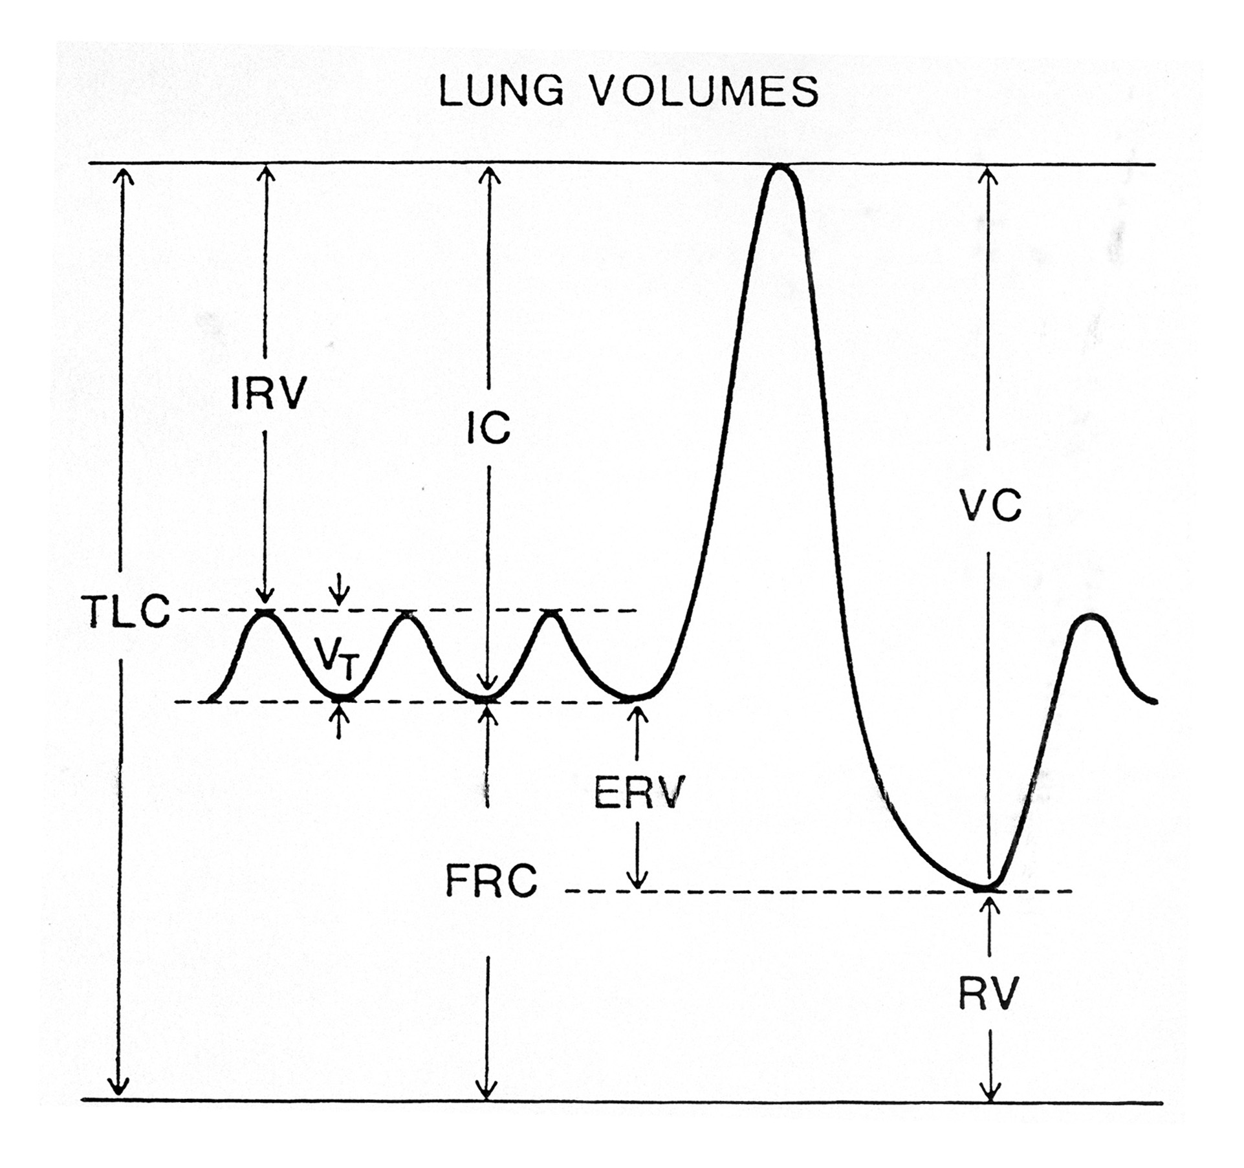
ADULT
Closing volume
40 yo FRC=CV supine
60 yo FRC=CV erect
Notes:
Closing volume in the adult is within FRC and below resting tidal volume, therefore, atelectasis does not occur unless there is a decrease in FRC. As we age, closing volume increases.

Slide 27
INFANT
Closing volume
Clinical significance:
V/Q mismatch
Notes:
However, in the infant closing volume is increased and within tidal volume breathing. Further losses of FRC, as during general anesthesia, will result in closing volume being higher within tidal volume. Atelectasis occurs resulting in shunt.

Slide 28
ALVEOLAR VENTILATION
⬆ O₂ consumption
3x adult values in preterm
2x adult values in infant (6-7mL/kg/min)
Clinical significance: rapid oxygen desaturation during apnea
⬆ Alveolar ventilation
2-3x adult values
increased RR
Clinical significance: greater speed of mask induction and emergence
Notes:
Oxygen consumption is increased in the infant as compared to the adult leading to rapid oxygen desaturation during apnea.
Alveolar ventilation is also increased in the infant and this is based on an increased respiratory rate. The tidal volume on a mL/kg basis is the same in the infant and adult. The clinical significance is that there is a greater speed of mask induction and emergence in the infant. In other words, they go to sleep faster than an adult.

Slide 29
V_{A} / FRC
Greater than adults
adults: 1.5/1
infants: 5/1
Clinical significance
Rapid induction and emergence
Notes:
Alveolar ventilation to FRC ratio is higher in infants than adults because of the higher alveolar ventilation in infants vs. adults.

Slide 30
V_{A}/FRC
 | Infant (4 kg) | 3 yo | 5 yo | Adult
V_{A} (mL) | 600 150 mL/kg | 1760 117 mL/kg | 1800 100 mL/kg | 4200 60 ml/kg
FRC (mL) | 120 | 490 | 680 | 2800
V_{A}/FRC | 5/1 | 3.5/1 | 2.6/1 | 1.5/1
VO₂ mL/kg/min | 6-8 | 4-6 | 4-6 | 2-3
Notes:
This table shows the changing alveolar ventilation to FRC ratio with age. As the child ages, the alveolar ventilation decreases and the ratio approaches the normal adult ration of 1.5/1. We see this clinically, in that as the child gets older and the ratio decreases rate of induction and emergence slows as well.

Slide 31
RESPIRATORY SYSTEM
CONTROL

Slide 32
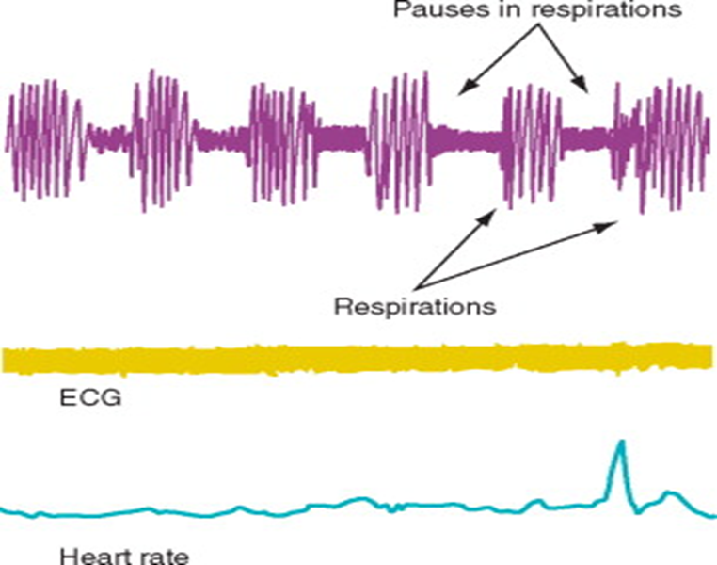
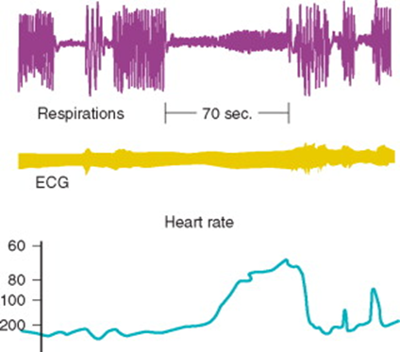
RESPIRATORY PATTERNS
Periodic breathing
< 10 seconds
Without ⬇ SpO₂ or HR SpO₂ or HR
Normal in neonatal period only (full-term)
Central apnea
> 15 (20) seconds
< 15 (20) seconds with ⬇ SpO₂ or HR
Notes:
Periodic breathing is defined as apnea for less than 10 seconds without any change in oxygen saturation or heart rate. This is normal in the neonatal period only in the full-term infant. Central apnea is defined as apnea for 15 or 20 seconds (depends where you read) even without changes in oxygen saturation and heart rate OR less than 15 or 20 seconds with concomitant changes in oxygen saturation or heart rate.

Slide 33
RESPIRATORY RESPONSE
Blunted CO₂ response
improves with ⬆ gestational age
improves with ⬆ postnatal age
Hypoxia response
⬆ RR x 1 minute, then apnea
Notes:
Infants have a blunted response to pCO₂ that improves with gestational and postnatal ages. The response to hypoxia is to increase the RR but only for one minutes and then become apneic.

Slide 34
RESPIRATORY RESPONSE
⬇ Ventilatory drive (apnea)
anemia
hypoglycemia
hypocalcemia
hypothermia
Apnea
vagus mediated airway reflexes
Hering-Breuer Reflex (lung inflation)
Notes:
Infants will have a decreased ventilatory drive under various conditions. Apnea is a vagally mediated airway reflex. Lung inflation will result in apnea as well.

Slide 35
CARDIOVASCULAR SYSTEM

Slide 36
CARDIAC OUTPUT
Cardiac output
neonates 350 mL/kg/min
infants 150 mL/kg/min
adults 75 mL/kg/min
Meet the demands of ↑VO₂
Notes:
Cardiac output in infants is higher in order to meet the metabolic demans.

Slide 37
C.O. DETERMINANTS: SV x HR
Limited ability to ⬆ SV in response to changes in preload and afterload
non-compliant myocardium
more connective tissue
less mature myocytes (30% vs. 60%)
maximum stroke volume at lower LVEDP
C.O. is heart rate dependent
Bradycardia is NOT well tolerated
Tachycardia (> 180) will result in ⬇ CO
Notes:
Because of the non-compliant myocardium, secondary to less mature myocytes and more connective tissue, the infant is unable to increase cardiac output by increasing stroke volume. Therefore, infants are heart rate dependent for adequate cardiac output. Bradycardia is not well tolerated in this patient population. Extreme tachycardia will also result in decreased cardiac output.

Slide 38
CARDIAC OUTPUT
⬇ CO management
optimize volume and hemoglobin
catecholamines most useful
drugs that ⬆ SVR only are NOT useful
use drugs that ⬆ HR and contractility
Notes:
Decreased cardiac output management in the infant consists of 1) optimizing volume status and hemoglobin (optimize oxygen carrying capacity) 2) catecholamines are most useful 3) drugs that just increase the SVR are not useful and 4) use drugs that increase heart rate and contractility.

Slide 39
NEURAL CONTROL
Vagotonic
immature sympathetic innervation
high levels of catecholamines at birth
maximal adrenergic stimulation of myocytes
⬇ functional reserve
Clinical significance:
bradycardia initial response to various insults
hypoxemia
intubation
Notes:
Because of an immature sympathetic system, the parasympathetic system is relatively unopposed (vagotonic). There are high catecholamine levels at birth, therefore, there is maximal adrenergic stimulation of the heart resulting in decreased functional reserve. Therefore, bradycardia is the usual initial response to various insults, such as intubation and hypoxia.

Slide 40
ANTICHOLINERGIC PREMED
Vagotonic
instrumentation of the airway
CO is heart rate dependent
bradycardia with halothane
bradycardia after one dose of succinylcholine
Notes:
Anticholinergic premedication, either atropine or glycopyrrolate, is usually administered to counteract the bradycardia that might occur during a general anesthetic. Indications include prior to laryngoscopy (stimulation of the vagus nerve) or succinylcholine. It is taught that bradycardia can be seen after one dose of succinylcholine in the infant as compared to the adult. However, the degree of bradycardia, should it occur, has been shown to not be significant (not needing treatment) and self-limiting. Therefore, it is not an absolute indication for anticholinergic prophylaxis. Also, when halothane was the predominant potent anesthetic agent used in children, anticholinergic premedication was necessary to counteract the bradycardia induced by halothane.

Slide 41
ANTICHOLINERGIC PREMED
PRO
CON
Dry mucous membranes advantageous for inhalation inductions
Vagotonic and heart rate dependent
If bradycardic, onset delayed
Dry mucous membranes and blocking of vagal reflexes not necessary with modern inhalational agents
Sevoflurane promotes tachycardia
Patient discomfort from dry mouth
Friable mucous membranes
Decreased mucociliary function - inspissated secretions
Interferes with temperature regulation
Reduced LES pressure
Central anticholinergic syndrome

Slide 42
EFFECT OF PRE-TREATMENT WITH INTRAVENOUS ATROPINE OR GLYCOPYRROLATE ON CARDIAC ARRHYTHMIAS DURING HALOTHANE ANAESTHESIA FOR ADENOIDECTOMY IN CHILDREN
77 patients, adenoidectomy
Atropine, glycopyrrolate, or saline
no difference in incidence of ventricular arrhythmias
bradycardia in saline group, but resolved without treatment
atropine caused a persistent sinus tachycardia
Routine pretreatment unnecessary in children undergoing adenoidectomy during halothane anesthesia
Annila et al: BJ Anaesth 80:756-760, 1998
Notes:
This study looked at pediatric patients undergoing adenoidectomy. There was no difference in the incidence of ventricular arrhythmias in all groups. The saline group did develop bradycardia but it did not require any intervention. Atropine did cause a persistent sinus tachycardia. They concluded that routine pretreatment was unnecessary in these patients.

Slide 43
ANTICHOLINERGIC PROPHYLAXIS
SHOULD IT BE GIVEN ROUTINELY?

Slide 44
CURRENT TREND
Routine use has greatly diminished
less secretions with modern anesthetics
decrease use of halothane and succinylcholine
postoperative discomfort
central anticholinergic syndrome
impairs temperature regulation
Notes:
The routine prophylactic administration of an anticholinergic has greatly diminished because of the above listed items.

Slide 45
INDICATIONS
Age-related: < 6 months; < 1 year of age
Development of bradycardia
Hx of bradycardia during intubation/induction
Procedures inducing vagal reflexes
oculocardiac reflex
Succinylcholine/High dose opioids
Ketamine
Excessive secretions
Oral surgery
Position other than supine
Notes:
The use of prophylactic anticholinergics is based on the preference of the anesthesiologist based on the above list.

Slide 46
ATROPINE DOSE
20 mcg/kg
AHA 2015 PALS Guidelines
Minimum dose (0.1 mg) no longer required
Notes:
The minimum dose of atropine (0.1 mg) wasrecommended because of the possibility of bradycardia occurring with a smaller dose. This phenomena is not well studied but rather based on anecdotal reports. A minimum dose of 0.1 mg in a premature infant would be a large overdose based on 20 mcg/kg (eg. in a 2 kg infant it would be 0.05 mg/kg) and has resulted in very high heart rates for prolonged periods of time. The updated AHA guidelines published in November 2015 removed the minimum dose requirement for atropine and no longer mandates atropine premedication prior to endotracheal intubation.

Slide 47
SUMMARY
Pediatric patients are not just small adults
Understanding the anatomical and physiologic differences allows for a more intelligent approach to caring for these patients during anesthesia and surgery

