Slide 1
Single Injection (non-catheter) Caudal Blocks for Pediatric Anesthesia
Updated 7/2017
James Ko, M.D., M.P.H.
Elliot Krane, M.D.
Stanford Children’s Health, Stanford University
Stanford, CA

Slide 2
Overview
Indications
Special considerations
Technique
Local anesthesia options
Adjuncts to local anesthetics
Possible complications
Summary

Slide 3
Scope
Single “shot” caudal epidural injection is a frequently utilized regional anesthetic technique in children.
There is over 50 years of experience and safety data available for review

Slide 4
Indications for a Single “Shot” Caudal
Surgery involving dermatomes below T10:
  Urologic procedures
  Lower abdominal surgery
  Pelvic and lower extremity surgery
If performed prior to incision, caudal block will
  decrease maintenance anesthetic requirement
  facilitate earlier extubation
  provide early postoperative pain control

Slide 5
Age Parameters
There is no literature definitively establishing upper or lower age limits for caudal blocks.
The decision is based upon a risk/benefit analysis and ease of use analysis individualized to each patient, situation, and anesthesia provider.

Slide 6
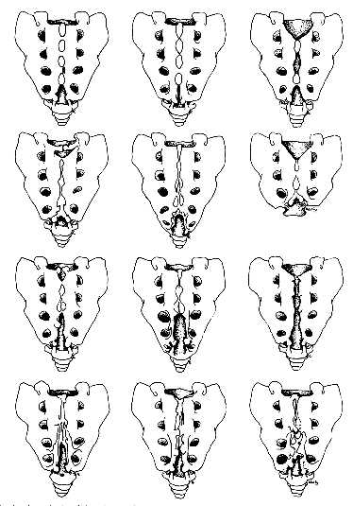
Special Considerations: Contraindications
Sacral deformities
  Unclear landmarks
  Sacral dimple
    May overlie spinal dysraphism, spina bifida occulta or tethered cord
    If MR imaging is available, it may rule out anomalies
    Ultrasound evaluation of the sacrum in skilled hands will also rule out anomalies and allow visualization of the thecal sac and spinal cord.
    Sacral dimples are common and themselves are not an indication for MR scanning unless unusually deep or associated with neurologic abnormalities

Slide 7
Special Considerations: Contraindications
Neurologic abnormalities of the spinal cord or peripheral nervous system
  Postoperative progression of neuropathy often occurs after a surgical procedure, and may implicate the caudal block if performed
  Local anesthetics are neurotoxic, and neuropathic peripheral nerves are at increased risk of expression of neurotoxicity
  New postoperative neurologic deficits will require imaging to rule out complications of an epidural injection or needle insertion

Slide 8
Special Considerations: Contraindications
Increased risk of infection
  Skin infection in region of caudal needle insertion
  Bacteremia, sepsis

Slide 9
Technique: Equipment and Supplies
Needles
  23G “butterfly” needle (infants)
  22G IV cannula (older children)
  Regional block needles (Crawford needle, Tuohy needle, peripheral nerve needles)

Slide 10
Non-styleted Needle: A Warning
The reason for styling spinal and epidural needles is to avoid introducing skin cells into the CSF, where they may grow into a dermoid tumor mass. Styleted needles prevent a core of skin filling the needle tip.
The risk of dermoid tumors in the epidural space is negligible. The risk is in entering the thecae sac.
Some anesthesiologists recommend making an entry hole in the skin with a first needle (e.g. 21g hypodermic needle) then introducing the caudal needle into the previously broken skin if a styleted needle is not being used.

Slide 11
Supples
Sterile gloves
Skin preparation solution
  Chlorhexidine
  Povidone iodine if allergic to chlorhexidine
Sterile towels to drape area
Sterile gauze
Syringe containing injectate
Sterile dressing (“Band-Aid”)

Slide 12
Technique
Position: prone, or lateral decubitus with knees to chest
Cleanse skin and drape area
Care not to allow skin preparation solution to run into the gluteal fold to contact the anus. A gauze in the gluteal fold will prevent this.

Slide 13
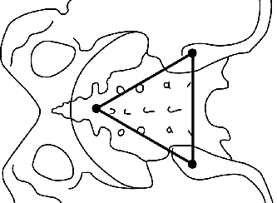
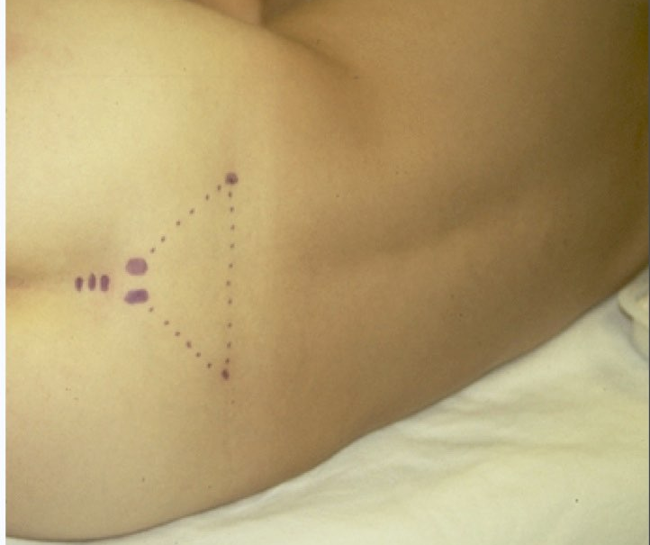
Identify the sacral hiatus using
Palpation and Surface Anatomy
Start by palpating the posterior superior iliac spines (PSIS), visualize an equilateral triangle defined by the two PSIS’s. The 3rd angle will overlie the sacral hiatus in most children. Palpate the two sacral cornuae at this location; the indentation between them will be the sacral ligament and sacral hiatus.

Slide 14
Identify the sacral hiatus using
Ultrasound
Linear high resolution transducer in sagittal plane, midline. Start at L5 and scan caudally until the sacrum and the sacral hiatus are visible. The needle may be inserted under visualization in-plane.
D: Dura (ventral and dorsal)
ES: Termination of thecae sac
SCM: Sacral membrane. Note the hiatus as the space between the ventral table of bone and the posterior elements.

Slide 15
Needle Insertion
Needle is inserted 45° to skin in midline over sacral hiatus.
Advance slowly until a distinct “pop” or “give” is felt as the sacrococcygeal ligament is pierced.
Needle angle is flattened and advanced a 1cm, not further.

Slide 16
Avoiding an Intravascular Injection
Aspirate to rule out vascular or CSF placement
Test dose to rule out intravascular placement
  0.1ml/kg of 1:200,000 epinephrine (0.5µg/kg)

Slide 17
Avoiding an Intravascular Injection
Observe for:
  Heart rate increase > 10 ppm
  Systolic blood pressure increase > 15 mm Hg
  T-wave amplitude increase > 25%
  Within 90sec of test dose administration

Slide 18
Pitfalls of Epinephrine Test Doses
Concomitant administration of inhalation anesthetics during epinephrine test dosing may yield false negatives
Since the sensitivity of this test is not 100%, incremental injection of local anesthetic (while observing for signs of LAST) should be done

Slide 19
Injection of Local Anesthetic
Inject full dose in 25% fractions over several minutes
Bulging of skin over sacrum indicates misplaced needle
Ultrasound may be used at L5/S1 in transverse or saggital planes to observe local anesthetic in the epidural space. Usually will see compression of dura.

Slide 20
Dosing of Local Anesthetic
Block level depends upon volume of local anesthetic injected
ml = 0.05 ml/kg/#dermatomes to be blocked
Rule of thumb: 0.5 ml/kg produces a T10 sensory level; 1 ml/kg produces a T6 sensory block.

Slide 21
Choice of Local Anesthetic
Bupivacaine
Levo-Bupivacaine (in Europe)
Ropivacaine
Lidocaine

Slide 22
Dosing of Local Anesthetic
Reduce dose 50% if newborn < 6 weeks
Reduce dose by 25% – 50% in presence of hepatic dysfunction, cardiac dysfunction, volume contraction, hypoproteinemia

Slide 23
Bupivacaine
The most cardiotoxic of choices
Maximum dose = 3 mg/kg in an otherwise healthy child
Duration of action 2 – 6 hours (with or without epinephrine)

Slide 24
Levo-bupivacaine
Maximum dose = 3 mg/kg
Levo enantiomer has similar duration as bupivacaine
Levo enantiomer reduces cardio and CNS toxicity
Not marketed in the U.S. or Canada

Slide 25
Ropivacaine
Maximum dose = 3 - 4 mg/kg
Provides similar duration as bupivacaine
Compared with bupivacaine:
  Reduced cardio and CNS toxicity
  Reduced motor block

Slide 26
Lidocaine
Maximum dose = 5 mg/kg
Provides very short duration of action
Advantage: ability to monitor blood levels during continuous infusions

Slide 27
Adjuvants: Opioids
Options:
  Preservative free morphine, 30 - 50 µg/kg
  Hyrdomorphone 10 – 20 µg/kg
  Fentanyl 0.25 – 0.5 µg/kg
Enhanced analgesia due to spinal and central analgesia
Risk: delayed respiratory depression, nausea, pruritus, urinary retention

Slide 28
Adjuvants: Opioids
Fentanyl exerts most or all of its effects via systemic absorption from epidural space and not through selective spinal analgesia
Hydromorphone, more lipophilic than morphine, causes less nausea and vomiting than morphine
Risk of delayed respiratory depression mandates observation & monitoring for >12 hours

Slide 29
Adjuvants: Clonidine
Enhanced analgesia by direct stimulation of alpha-2 receptors and mu opioid receptors in spinal cord
Benefits: lengthens duration of opioid analgesia
No respiratory depression, pruritus, urinary effect
Dose 1 – 2 µg/kg

Slide 30
Adjuvants: Other
There have been other adjuvants reported (ketamine, diazepam, neostigmine, dexamethasone, dexmedetomidine for example) but none have been proven to not be neurotoxic in vitro or in vivo and should not be used.
In fact, ketamine is indeed neurotoxic in the rabbit epidural model.
We do not recommend clinically using these in children at this time.

Slide 31
Postoperative Management
A clear plan should address pain once caudal block recedes and should be communicated to caregivers and parents
Some patients may have distress over lower extremity numbness and weakness. This is usually alleviated with small doses of benzodiazepines.

Slide 32
Complications
Intravascular / intraosseous injection local anesthetic systemic toxicity (LAST)
Infection / epidural abscess
Bleeding / epidural hematoma
Neuronal injury
Bowel perforation

Slide 33
Keys to Success
Equilateral triangle method is most reliable method of locating the sacral hiatus. Most technique failures are due to needle placement that is too caudad.
Test dose
Clonidine to lengthen duration of analgesia

Slide 34
Keys to Success
Equilateral triangle method is most reliable method of locating the sacral hiatus. Most technique failures are due to needle placement that is too caudad.
Test dose
Clonidine to lengthen duration of analgesia

Slide 35
Keys to Success
If surgery or pain is located above the umbilicus, a lumbar epidural (with or without catheter) will provide more reliable and effective analgesia.
The success rate will be enhanced with the use of ultrasound to confirm epidural drug injection if there is any doubt about the anatomy

Slide 36
Summary
Caudal analgesia/anesthesia is safe and effective for pediatric patients
Complications and failures are minimized by close attention to anatomic landmarks, sterile technique, and ultrasound guidance in some cases
Medication choice should be individualized to patient and surgery

Slide 37
Bibliography
Baird R, et al. A systematic review and meta-analysis of caudal blockade versus alternative analgesic strategies for pediatric inguinal hernia repair. J Ped Surg 2013;48:1077
Cook B, et al. Comparison of adrenaline, clonidine and ketamine on the duration of caudal analgesia produced by bupivacaine in children. BJA 1995;75:698
Dobereiner E, et al: Evidence-based clinical update: which local anesthetic drug for pediatric caudal block provides optimal efficacy with the fewest side effects? Can J Anesth 2010;57:1102
Krane E. Spinal epidermoid tumors: will a forgotten complication rise again? [editorial]. Reg Anes Pain Med 1999;24:494
Menzies R, et al. A survey of pediatric caudal extradural anesthesia practice Ped Anesth 2009;19:829
Polaner DM, et al. Pediatric Regional Anesthesia Network (PRAN): a multi-institutional study of the use and incidence of complications of pediatric regional anesthesia. Anes Analg 2012;115:1353
Roberts S. Ultrasonographic guidance in pediatric regional anesthesia. Part 2: techniques. Pet Anes 2006;16:1112
Tobias J Caudal epidural block: a review of test dosing and recognition of systemic injection in children. Anes Analg 2001;93:1156
Tsui B, et al. Color flow Doppler ultrasonography can distinguish caudal epidural injection from intrathecal injection. Anes Analg 2013;116:1376

