Slide 1
Peripheral Nerve Blocks for Pediatric Anesthesia
Updated 11/2019
Katie Telischak, MD
Odinakachukwu Ehie, MD
UCSF Department of Anesthesia and Perioperative Care
Notes:
¹ Resident Physician
Department of Anesthesiology and Perioperative Care
University of California, San Francisco
² Clinical Assistant Professor
Department of Anesthesiology and Perioperative Care
University of California, San Francisco

Slide 2
Disclosures
No relevant financial relationships

Slide 3
Learning Objectives:
Review the indications and contraindications for peripheral nerve blocks (PNBs) in children
Identify the basic anatomy of the common PNBs including TAP, ESP, Supraclavicular, Femoral, and Popliteal blocks
Describe the sensory innervation of the nerves covered by the above blocks
Assess indications for choosing particular PNBs based on the analgesia provided

Slide 4
Peripheral Nerve Blockade (PNB)
Indications
Important tool in multimodal pain control for surgery on the extremities or smaller low abdominal incisions
May assist with opioid sparing anesthesia
May reduce dose exposure for general anesthetic
May reduce perioperative pain and the morbidity associated with undertreated pain in children
In settings with limited postoperative monitoring and analgesic options that PNB can be a safe way to improve pain control in wards

Slide 5
Peripheral Nerve Blockade
Contraindications
Absolute:
Parental or patient refusal
Local infection
Allergy to local anesthetic
Relative:
Pre-existing neurologic deficits
Coagulation disorders

Slide 6
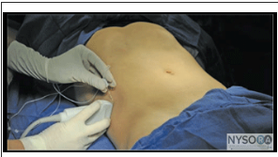
TAP Block
Indications: Lower abdominal surgery
Dosing: 0.3-0.5ml/kg/side of 0.25% bupivacaine
Distribution: T10-L1
Abdominal skin, muscles, and parietal peritoneum via block to the intercostal nerves, subcostal nerve, iliohypogastric, and ilioinguinal nerves.
Duration: variable, likely 8-12 hrs
Complications: Peritoneal entry and bowel injury
Source: NYSORA.COM

Slide 7
Transversus Abdominis Plane (TAP) Block
Indications
Useful alternative in pediatric patients with spinal anomalies preventing neuraxial anesthesia
Most suitable for abdominal surgery below the umbilicus, such as appendectomy, colectomy, hernia repair
Orange arrow in image indicates the target fascial layer for the needle.
Orange arrow indicates needle trajectory
EOM = External Oblique Muscle
IOM = Internal Oblique Muscle
TAM = Transverse Abdominis Muscle
Source: NYSORA.COM

Slide 8
Transversus Abdominis Plane (TAP) Block
At the mid-axillary line, the anterior rami of the T9-T12 and first lumbar nerves are found in the intermuscular plane between the internal oblique and transversus abdominis muscle
Blockade provides unilateral analgesia to skin, muscle, and parietal peritoneum of the anterior abdominal wall
Orange arrow indicates needle trajectory
EOM = External Oblique Muscle
IOM = Internal Oblique Muscle
TAM = Transverse Abdominis Muscle
Source: NYSORA.COM

Slide 9
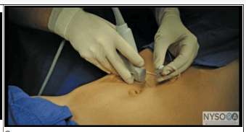
Rectus Sheath Block
Indications: Surgery to umbilical region
A good option for upper abdominal surgery if epidural is not possible
Dosing: 0.1ml/kg 0.25% bupivacaine to each side
Distribution: Midline abdominal incision
Duration: around 8-12 hrs
Complications: Peritoneal entry and bowel injury
Source for both images: NYSORA.COM

Slide 10
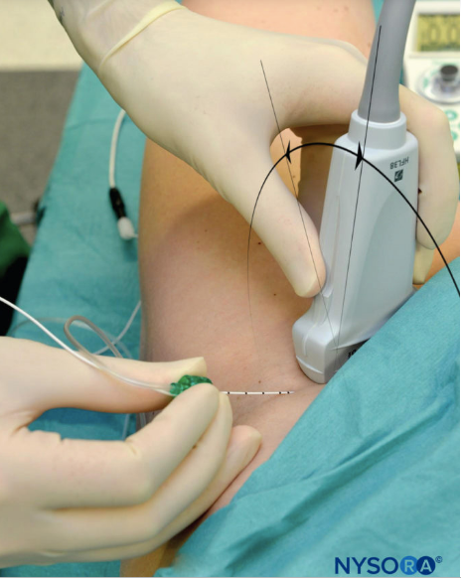
Femoral Nerve Block
Caudal
Indications:
Surgery on the anterior thigh, femur, patella, or knee
Hip fracture analgesia perioperatively
Dosing: 0.2-0.4ml/kg
Distribution:
Derives from roots of L2-4
Anterior/medial thigh, knee, medial leg, medial foot
Hip, knee, and ankle joints
Indicated for surgery where anesthesia to these areas would be beneficial
Duration: 8-12 hrs
Complications: Intravascular injection, nerve injury
Cranial
Source: NYSORA.COM

Slide 11
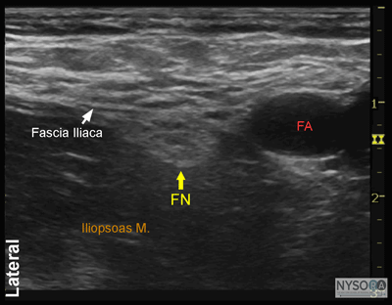
Femoral Nerve Block
Procedure occurs at the level of the femoral crease
At this level, the nerve (hyperechoic) lies beneath the fascia iliaca and above the iliopsoas muscle (hypoechoic)
The position of the nerve is immediately lateral to the artery
From lateral to medial: NAVEL (Femoral Nerve, Artery, Vein, Empty Space, Lymphatics)
Orange arrow indicates needle trajectory
FN = Femoral Nerve
FA = Femoral Artery
Source: NYSORA.COM

Slide 12
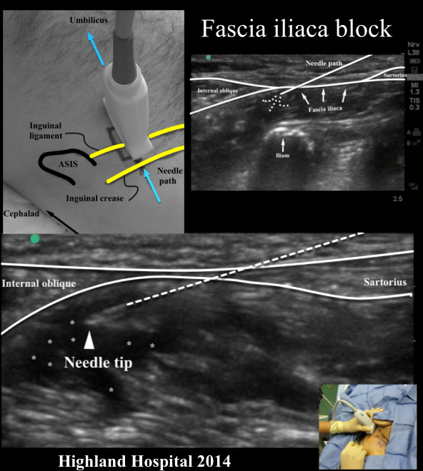
Fascia Iliaca Block (3-in-1 Block)
3-in-1 block provides local anesthetic to three of the nerve branches from the lumbar plexus
Blockade of the femoral nerve, lateral femoral cutaneous nerve, and obturator nerve
Indicated for hip fractures
Performed with accurate placement of local anesthetic along femoral nerve
Mechanism for the block is the caudal, lateral and medial spread of the local anesthetic
Source: NYSORA.COM

Slide 13
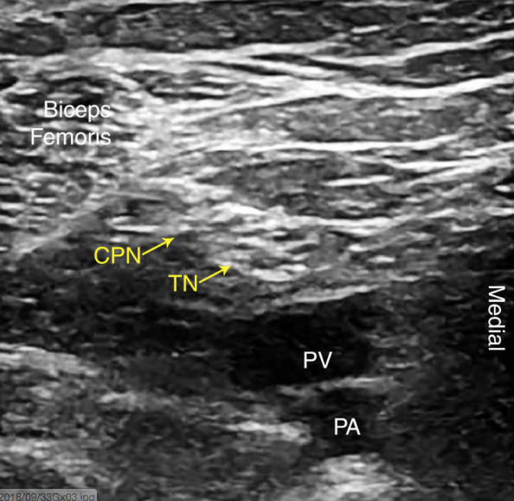
Popliteal Sciatic Block
Indications: foot & ankle surgery
Often combined with Saphenous block for lower extremity surgery to cover both femoral and sciatic nerve distribution
Variations: Fascia Iliaca plane block
Large volume plane block deposited beneath the fascia iliaca to spread to the femoral nerve and LFCN
Dosing: 0.3-0.5ml/kg
Distribution
Derives from roots of L4-S3
All of the lower extremity below the knee except the medial leg/foot
Indicated for surgery on the lower leg
Complications: Intravascular injection, nerve injury
Duration: around 8 – 12 hrs
CPN = Common Peroneal Nerve
TN = Tibial Nerve
Source: NYSORA.COM

Slide 14
Popliteal Sciatic Block
Procedure occurs in the popliteal fossa
Identify the popliteal artery (PA) and popliteal vein (PV)
At this level, the sciatic nerve has typically branched into the common peroneal nerve (CPN) and tibial nerve (TN)
The CPN and TN appear as a hyper-echoic bundle that is lateral and superficial to the popliteal vein
Branch point is variable—track the nerves up above the popliteal fossa to be certain that you are capturing both the CPN and TN together in the block site
Superficiall
Deep
Blue arrows indicate possible needle trajectory, depositing local anesthetic between CPN and TN, and above nerves.
Source: NYSORA.COM

Slide 15
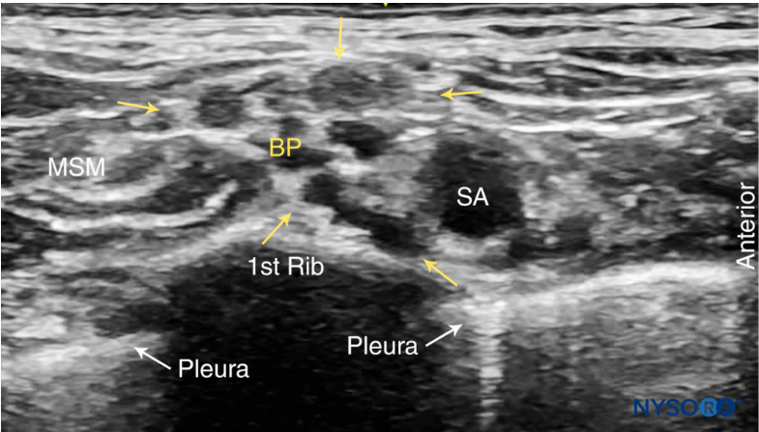
Supraclavicular Block
Indications
Upper extremity surgery
Most common US-guided approach to the brachial plexus (BP) due to ease and comprehensive analgesia for entire arm
Dosing: 0.3-0.5ml/kg of 0.25% bupivacaine
Complications
PTX, intravascular injection, nerve injury
Duration: around 8 – 12 hrs
Distribution
Divisions of the brachial plexus (roots of C5-T1)
Block reliably covers upper extremity
Spares the suprascapular nerve so may produce incomplete shoulder coverage
BP = Brachial Plexus
SA = Subclavian Artery
MSM = Middle Scalene Muscle
Source: NYSORA.COM

Slide 16
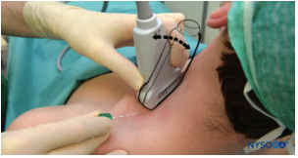
Supraclavicular Block
Place probe superior to the clavicle and identify the subclavian artery
Identify the subclavian artery (SA)
The plexus is just superior & posterior to the SA
Do not start block until you clearly identify pleura and rib deep to the brachial plexus (BP)
Maintain pleura in view during procedure to reduce risk of pneumothorax
Blue arrows indicate needle trajectory
Source for both images: NYSORA.COM

Slide 17
Erector Spinae Plane (ESP) Block
Fascial plane block targeting spinal nerves
Indications
Rib fractures, some thoracic or high abdominal surgery
Good safety profile as there is significant distance from block site to important structures such as spinal cord or major vessels
Dosing: 0.5ml/kg/side of 0.25% bupivacaine
Distribution
Block likely occurs at the ventral and dorsal rami of the spinal nerves, likely via diffusion back from site of injection in fascial plane
Complications: PTX
Duration: likely 8-12 hrs
Orange arrow indicates needle trajectory
TP = Transverse Process
PVS = Paravertebral Space
Source: NYSORA.COM

Slide 18
Erector Spinae Plane (ESP) Block
Procedure occurs at the transverse process
Erector spinae muscle lies on top of the transverse process
Target the fascial plane deep to the muscle, just above the transverse process
Orient the ultrasound probe in a longitudinal direction, adjacent to the palpated spinous process
Slowly scan in a medial to lateral direction until the flattened hyperechoic shape (with rectangular acoustic shadow below) of the transverse process is identified
Choose the most central spinous process for the block as LA will spread both cranially and caudally
Injection of LA should spread along the fascial layer laterally and medially, similar to the spread seen with the TAP block injection.
If injection shows spread into the muscle, advance needle further to get to appropriate compartment
Source: NYSORA.COM

Slide 19
Block | Indications | Dosing for 0.25% Bupivacaine or 0.2% Ropivacaine | Distribution | Complications
TAP | Lower abdominal | 0.3-0.5ml/kg/side | T10-L1 nerve roots | Peritoneal entry, bowel injury
Rectus Sheath | Umbilicus region | 0.2-0.3ml/kg/side | Midline abdominal incision | Peritoneal entry, bowel injury
Femoral | Anterior/medial lower extremity | 0.2-0.4ml/kg | L2-4 nerve roots | Intravascular injection, nerve injury
Popliteal | Foot and ankle | 0.3-0.5ml/kg | L4-S3 nerve roots | Nerve injury, intravascular injection
Supraclavicular | Upper extremity | 0.3-0.5ml/kg | C5-T1 nerve roots | PTX, intravascular injection
ESP | Thoracic, high abdominal | 0.5ml/kg/side | Ventral and dorsal rami of spinal nerves | PTX

Slide 20
Conclusions:
Peripheral nerve blocks can be an important tool in multimodal analgesia, allowing reduced exposure to general anesthetics, opioid sparing, and improved pain control postoperatively
Choice of peripheral nerve block is based on the sensory distribution of the nerves targeted and the planned surgery
A thorough understanding of the anatomy of each block lowers the risk of common complications

Slide 21
References:
www.nysora.com (permission was granted to use all images from NYSORA)
Euroespa.com
Forero, M et al, The erector spinae plane block: a novel analgesic technique in thoracic neuropathic pain, Regional Anesthesia & Pain Medicine, 2016; 41(5):621-627.
Cruz Eng,H et al. (2018, February). How do I do it: erector spinae block for rib fractures: the Penn State Health experience. Retrieved from www.asra.com/asra-news/articles/39/how-do-i-do-it-erector-spinae-block-for-rib
Stein, AL et al., Updates in pediatric regional anesthesia and its role in the treatment of acute pain in the ambulatory setting, Curr Pain Headache Rep (2017) 21:11.
Johr, M. Practical pediatric regional anesthesia, Curr Opin Anaesthesiol. 2013 Jun;26(3):327-32.

