Slide 1
Anesthesia for CPAM (congenital pulmonary airway malformation)
Neha Patel, MD
Andrew Costandi, MD, MMM

Slide 2
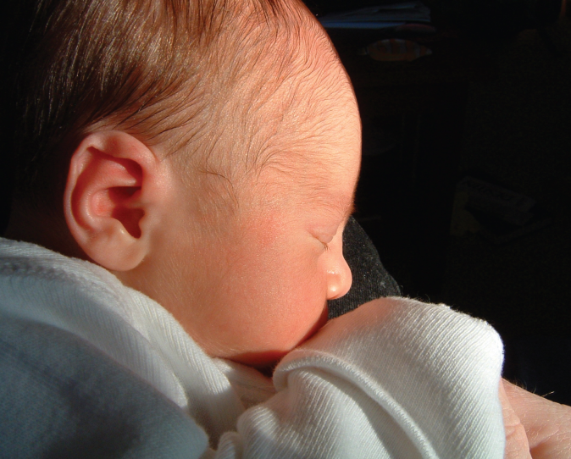
Objectives
Understand the diagnosis of Congenital Pulmonary Airway Malformation (CPAM)
Describe the prognosis of patients with CPAM
Outline treatment options for patients
Describe the anesthetic considerations for surgical resection of CPAM
© OpenStax Anatomy and Physiology/ Wikimedia Commons / CC-BY-4.0

Slide 3
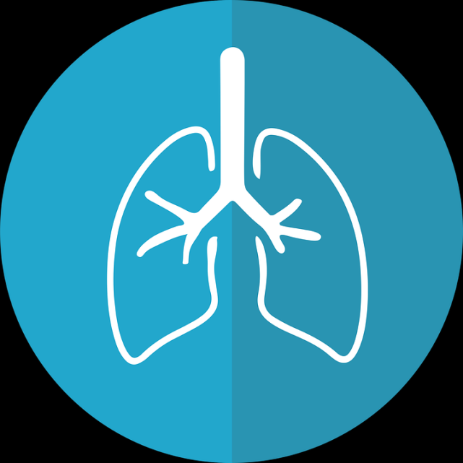
Congenital Pulmonary Airway Malformation
Incidence 1:8,300 to 1:35,000 live births
Cystic and adenomatous lesions arise from the tracheobronchial tree
Maldevelopment of terminal bronchiolar structures
Unilateral
Lower lung lobe
Notes:
Congenital Pulmonary Airway Malformation is the second most common congenital lung lesion in children. It occurs slightly more in men than woman. Cysts occur sporadically and not related to a genetic mutation, race, age or exposure. Widespread use of prenatal ultrasonography has lead to increased prenatal diagnosis. These lesions occur from maldevelopment of the terminal bronchiolar structures and are unilateral on either the right or left side in the lower lung lobes.

Slide 4
Differential Diagnosis
Congenital Lung Lesion | Anatomy | Blood Supply | Other
CPAM | Polycystic, connected to the lower tracheobronchial tree | Pulmonary circulation | Bilateral Lung involvement is rare
Bronchopulmonary Sequestration | NOT connected to tracheobronchial tree | Anomalous systemic circulation | Homogeneous mass, often on the left side
Congital lobar emphysema | Non-cystic | Pulmonary circulation | Involve multiple lobes or both lungs
Bronchogenic cyst | NOT connected to tracheobronchial tree | Pulmonary circulation | Located high: cervical, paratracheal, carinal
Diaphragmatic Hernia | Herniated bowel loops may resemble cysts | Systemic circulation | Mediastinal, cardiac, liver deviation
Notes:
When evaluating patients for congenital airway malformations, it is important to have an understanding of what other potential congenital lung lesions exist. Ultrasound is sensitive for diagnosis of prenatal lung lesions but has a low specificity. Often fetal MR imaging can further identify pulmonary anatomy, blood supply and associated structures. 15% of bronchogenic cysts are intraparenchymal, making it difficult to distinguish from CPAM. MRI can help distinguish bowel in the thorax from cysts.
The differential diagnosis includes bronchopulmonary sequestration, congenital lobar emphysema, bronchogenic cyst and diaphragmatic hernia. Other more rare conditions not listed include neuroenteric cysts (associated with vertebral anomalies), mediastinal cystic teratoma (anterior mediastinal mass), and rare fetal neoplasms. Now lets review some xrays of these disease processes to demonstrate how they are different.

Slide 5
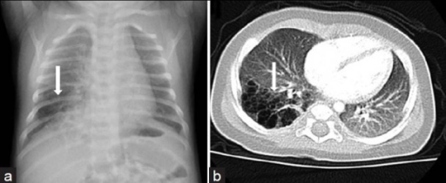
CPAM: Chest Radiograph and CT Scan in a 10 Month Old Infant
a: Chest Radiograph: Hyper-lucency (arrow) in the right lower lobe
b: CT Scan: Lung windows demonstrate several small cysts (arrow) in the right lower lobe
Odev K, Guler I, Altinok T, Pekcan S, Batur A, Ozbiner H. Cystic and cavitary lung lesions in children: radiologic findings with pathologic correlation. J Clin Imaging Sci. 2013;3:60. Published 2013 Dec 31.
Notes:
Type II congenital cystic adenomatoid malformation (CPAM) in a 10-month-old infant. a) Chest radiograph shows an area of hyperlucency (arrow) in the right lower lobe. b) CT scan (lung window) demonstrates the presence of several small cysts (arrow) in the right lower lobe
Used with permission under Creative Commons Attribution-Noncommercial-Share Alike 3.0 Unported LicenseCreative Commons
CC BY-NC-SA 3.0

Slide 6
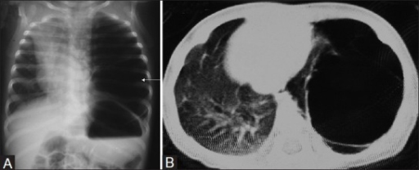
CPAM: Chest Radiograph and CT Scan in a 3 Month Old Infant
A: Chest Radiograph: Hyper-lucent left lung fields with septations (arrow) and mass effect
B: CT Scan: Lung windows axial section demonstrates thin walled cyst in left lower lobe
Prabhu SM, Choudhury SR, Solanki RS, Shetty GS, Agarwala S. Inadvertent chest tube insertion in congenital cystic adenomatoid malformation and congenital lobar emphysema-highlighting an important problem. Indian J Radiol Imaging. 2013;23(1):8–14.
Notes:
A 3-month-old infant with respiratory distress. (A) Chest radiograph shows cystic hyperlucent left lung field with septations (arrow) and mass effect. This was mistaken as pneumatocele with resultant chest tube insertion. (B) CT chest axial section with lung window shows a thin-walled cyst in left lower lobe with mass effect. Diagnosis was confirmed after surgery as type 1 CCAM
Used with permission under Creative Commons Attribution-Noncommercial-Share Alike 3.0 Unported LicenseCreative Commons
CC BY-NC-SA 3.0

Slide 7
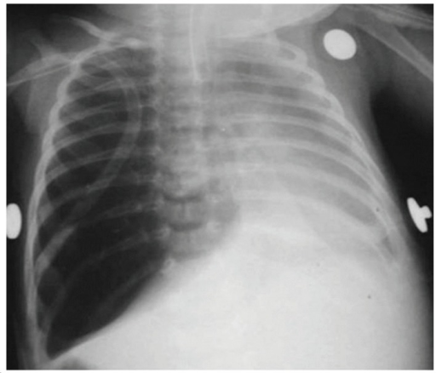
Congenital Lobar Emphysema: Chest Radiograph
Cataneo DC, Rodrigues OR, Hasimoto EN, Schmidt AF Jr, Cataneo AJ. Congenital lobar emphysema: 30-year case series in two university hospitals. J Bras Pneumol. 2013;39(4):418–426.
Notes:
Chest X-ray of a child with congenital lobar emphysema misdiagnosed as right tension pneumothorax. The child was referred to the facility with a right pleural tube already in place.
Image used with permission under Creative Commons Attribution-Noncommercial-Share Alike 3.0 Unported License
Creative Commons
CC BY-NC-SA 3.0

Slide 8
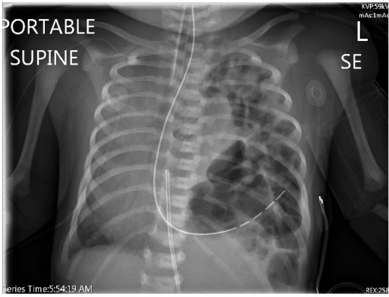
Congenital Diaphragmatic Hernia: Chest Radiograph
Kawamura N, Bhandal S. Coexistent Congenital Diaphragmatic Hernia with Extrapulmonary Sequestration. Can Respir J. 2016;2016:1460480.
Notes:
Congenital diaphragmatic hernia. Chest radiograph showing left diaphragmatic hernia and contralateral shift of the heart and mediastinum.
Image used with permission under Creative Commons Attribution-Noncommercial-Share Alike 3.0 Unported License
CC BY-NC-SA 3.0

Slide 9
CPAM Pathophysiology
Pulmonary hypoplasia
Mediastinal shift
Cardiac or IVC compression
Fetal Hydrops
Maternal Mirror Syndrome
Esophageal compression
Notes:
Symptoms of CPAM depend on the size and location of the cysts. The larger cysts can cause the listed symptoms. Pulmonary hypoplasia can lead to pulmonary hypertension at birth. Large masses can cause mediastinal shift, cardiac and IVC compression leading to fetal hydrops. Fetal hydrops presents with pleural effusions, pericardial effusion, ascites, generalized edema and polyhydraminos. Maternal mirror syndrome is when the mother has edema in response to fetal hydrops. Esophageal compression can lead to proximal esophageal dilation, small stomach and polyhydraminos.

Slide 10
Classification
Type | Characteristics
0 | Rare - severe (Infant Death) Tracheal or bronchial tissue origin
I | Most common - Mild/moderate symptoms at birth Distal bronchi origin (Cystic)
II | Incidentally diagnosed with co-existing diseases Small heterogeneous multiple cysts
III | Severe form , antenatal symptoms Large, mixed solid and fluid filled cysts
IV | Congenital, mild/moderate symptoms Small, distal bronchi, often diagnosed after birth
Notes:
CPAM is classified based on the type of cysts. 26% are macrocystic and 74% microcystic and the cysts can be simple, fluid filled or mixed/solid. Macrocystic lesions are more likely to be symptomatic postnatally. Type 0 is rare and associated with infant death due to the high location of the lesion. Type I is the most common form. Type II CPAM are often associated with other congenital anomalies and diagnosed during evaluation for co-existing anomalies. Type IV lesions are diagnosed at birth or in childhood secondary to frequent infections or the development of tension pneumothorax. Type I and IV lesions are associated with malignancy.
Type 0 1-3% of CPAM, Type I 60-70% of CPAM, type II 15-20% of CPAMs, 5-10% type III and IV

Slide 11
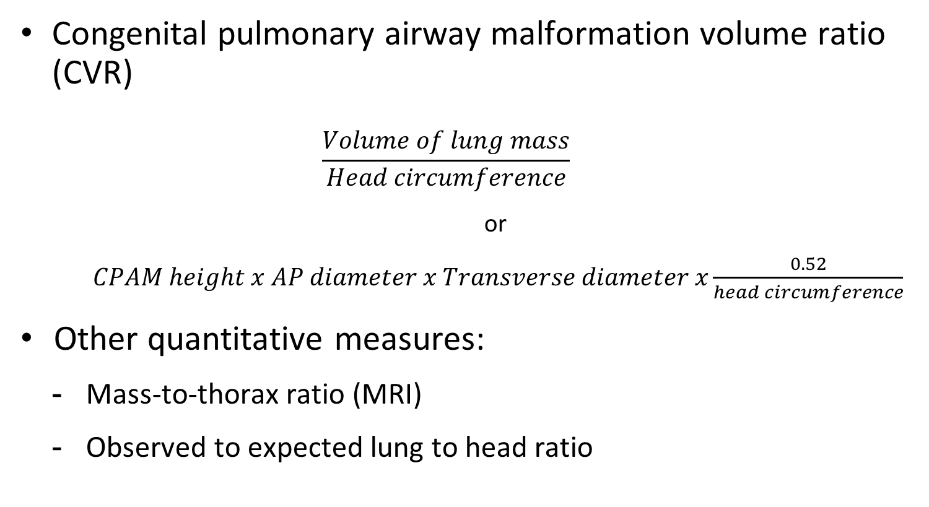
Evaluation
Congenital pulmonary airway malformation volume ratio (CVR)
$$\frac{Volume of lung mass}{Head circumference}$$
or
$CPAM height x AP diameter x Transverse diameter x\frac{0.52}{head circumference}$
Other quantitative measures:
Mass-to-thorax ratio (MRI)
Observed to expected lung to head ratio
Notes:
Multiple evaluation tools exist to determine the size and predict risk associated with a CPAM. Quantitative measurements help assist prediction of prenatal course. Most frequently used measurement is the congenital pulmonary airway malformation volume to head ratio. It is calculated by looking at the lung mass volume to the head circumference. Other measures do a similar equation but compare the mass to thorax size or look at the observed vs expected lung to head ratio.
A CVR > 1.6 is predictive of developing fetal hydrops. A CVR < 0.91 and MTR < 0.51 predicts a favorable outcome.

Slide 12
Prognosis
Rapid growth at 20-26 weeks
CVR > 1.6 is predictive of developing fetal hydrops
Pulmonary hypoplasia and pulmonary HTN
Risk of cancer (pleuropulmonary blastoma)
Co-existing disease:
Cardiovascular
Urogenital (renal dysgenesis)
TEF, intestinal atresia, diaphragmatic
Central nervous system
Bony anomalies
Notes:
Patients prenatal course depends on the gestational age, size of the mass, amount of associated compression and associated anomalies. CPAM often has rapid growth at 20-26 weeks, then growth plateaus or regress. 50% persist to delivery, most have a relative decrease in size due to normal fetal thoracic growth. A CPAM volume ratio (CVR) > 1.6 is predictive of developing fetal hydrops. The presence of hydrops is a predictor of poor outcome with a near 100% chance of perinatal death without intervention. Microcystic and low CPAM ratio masses often resolve before delivery. Patients with pulmonary hypoplasia can develop pulmonary HTN at birth and is associated with a poor prognosis. Type IV and I CPAM lesions have a risk of malignant transformation. 10-20% of fetuses have associated congenital anomalies. The cardiovascular risk is conotrunchal abnormalities. CNS abnormality is often agenesis of the corpus callosum. Patients can also have a cleft lip/palate.
Patients who are moderate to high risk are often followed throughout pregnancy with serial US examination to assess lung mass size, change in CVR and the development of hydrops.

Slide 13
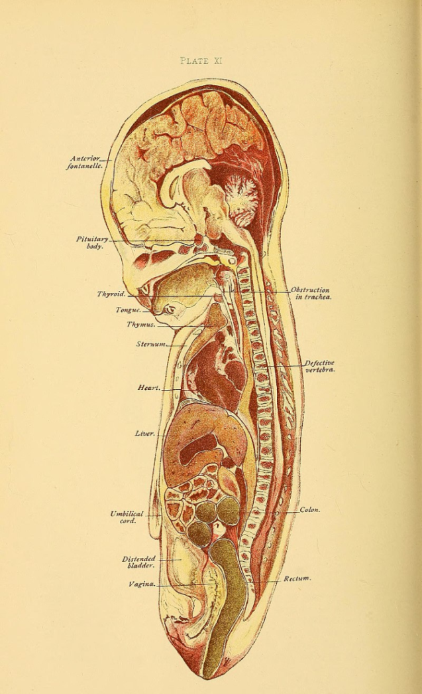
Antenatal Treatment Options
Hydropic Fetus 20-32 weeks
Steroids
Thoracentesis or cyst aspiration
Thoracoamniotic shunt*
In utero surgical resection*
Laser ablation or sclerotherapy
© Ballantyne, J. W. (John William)/ Wikimedia Commons / Manual of antenatal pathology and hygiene : the foetus / 1902
Notes:
For fetuses at 20-32 weeks gestation, treatment options include steroids or intrauterine surgery.
Steroids are the only medical treatment of CPAM and some evidence to suggest it may reverse hydrops. Patients often try two courses of steroids before surgery.
Thoracentesis and cyst aspiration have limited usefulness since the fluid often re-accumulates. They are often used as a temporizing method. Thoracoamniotic shunt is a more definitive in utero treatment and works best on macrocystic, dominant lesions with no large solid component. Reported survival rates range from 60-90%. There is limited evidence of efficacy of laser ablation or sclerotherapy
Maternal-Fetal surgery has a high risk of serious pregnancy complications including premature labor, premature rupture of membranes and future uterine rupture.
Complications of shunt procedures include displacement of the catheter, thrombus/occlusion of the catheter, fetal hemorrhage, procedure related placental abruption, or premature labor
In utero procedures are reserved for lesions that are mixed with a predominant solid component.
After surgery, hydrops resolve in 1-2 weeks with reversal of mediastinal shift over 3 weeks.

Slide 14
Antenatal Treatment Options
Hydropic Fetus 32-34 weeks
Early delivery and immediate postnatal resection
Ex-utero intrapartum therapy (EXIT surgery)
Notes:
Antenatal treatment options are often offered to patient who have developed fetal hydrops or are at high risk and without significant co-existing disease. Hydrops rarely spontaneously resolve. 1/3 of fetuses with CPAM will develop hydrops due to hemodynamic alteration from vena cava obstruction, often the large lesions that persist in the 3rd trimester and microcytic lesions. Hydrops does not occur after 28 weeks since the growth of has plateaued.
Viable fetuses at 32-34 weeks gestation are candidates for early delivery and immediate postnatal resection or EXIT procedure. The EXIT procedure has the benefit of uteroplacental perfusion of the fetus during surgical repair.

Slide 15
Post-natal Surgical Candidates
Surgery is curative for symptomatic infants
Benefits of surgery for asymptomatic infants
Allows continued lung growth
Reduces infections
Prevents malignancy
Notes:
Post-natal surgical candidates are symptomatic neonates or older children (6-12 months of age) to allow heathy lung development, prevent infections or malignancy. A CVR > 1.0 is predictive for the need of perinatal resection and symptoms at birth. Fetuses with large masses associated with mediastinal shift and hydrops should be delivered at a tertiary care center with ECMO capacity.

Slide 16
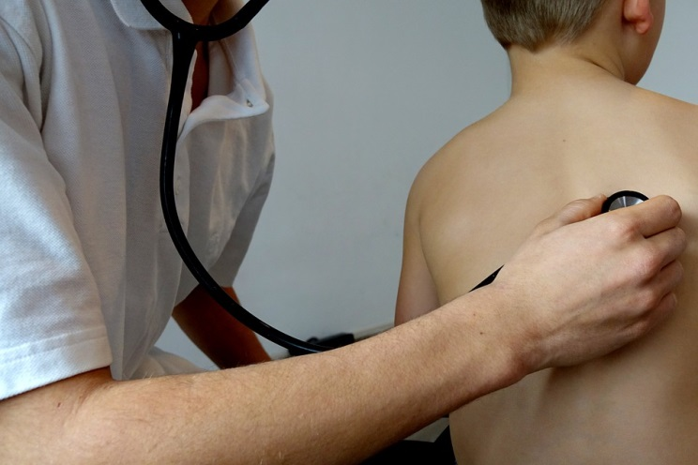
Preoperative Considerations
Perinatal evaluation and treatment course
Respiratory Status
Oxygen requirement, need for ventilatory support
CVR > 1.0 in non-hydropic fetuses is predictive of respiratory symptoms at birth
CXR, CT, MRI
HFOV, ECMO
Workup for co-existing disease
Notes:
Preoperative considerations include an evaluation of perinatal course and treatment. As well as evaluation for current respiratory status. Symptomatic fetuses may require oxygen, ventilatory support, HFOV or even ECMO. The patient often has at least an X-ray but may have a CT or MRI which can help further identify surrounding structures and size of the mass. After birth the cysts appear as air, fluid containing cysts. These fetuses should also be evaluated for co-existing disease.

Slide 17
Airway Management
Two lung ventilation for classic thoracotomy with lung retraction
One lung ventilation for Video-Assisted Thoracoscopic Surgery (VATS)
Mainstem intubation
Bronchial blocker
3 Fr Fogarty embolectomy catheter
Balloon tipped angiography catheter
5 Fr Pediatric bronchial blocker (Cook)
Notes:
Prior to 1990s the majority of infants had a classic open thoracotomy incision which was performed with double lung ventilation. The surgeon would retract the surgical lung. Lung retraction can lead to lung injury and bleeding.
Video-assisted thoracoscopic surgery has the advantage of smaller chest incisions, reduced postoperative pain and rapid postoperative recovery. This requires one lung ventilation which can be challenging in a neonate. Methods to do this include mainstem intubation or placement of a bronchial blocker. Left endobronchial intubation without a fiberoptic scope can be achieved with turning the endotracheal tube 180 degrees and turning the head to the right. Common bronchial blockers used in neonates include a 3Fr Fogarty embolectomy catheter, balloon tipped angiography catheter or 5 fr pediatric bronchial blocker. When placing a fogarty catheter, it might be helpful to bend the tip of its stylette toward the bronchus on the operative side. It has a low volume, high pressure balloon. Balloon tipped angiography catheter is a closed tip catheter so does not allow the surgical lung to be suctioned, air exhaled, or provide continuous positive pressure. The Cook catheter is a high volume, low pressure balloon but has a large diameter and useful in children greater than 2 years old. Bronchial blockers can be placed inside or alongside the endotracheal tube. Bronchial blockers are challenging because they can become dislodged and completely occlude ventilation. VATS can be performed while both lungs are being ventilated by using CO2 insufflation and placement of a retractor to displace lung tissue in the operative field.

Slide 18
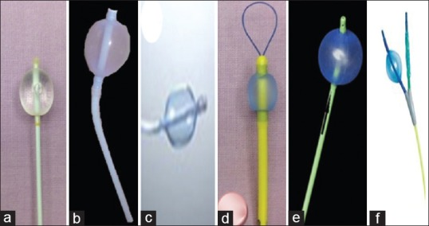
Bronchial Blockers for Achieving Single Lung Ventilation
a. Fogarty's vascular embolectomy catheter b: Univent tube bronchial blocker
c: Coopdech blocker d: Arndt blocker
e: Cohen tip-deflecting blocker f: EZ-blocker
Purohit A, Bhargava S, Mangal V, Parashar VK. Lung isolation, one-lung ventilation and hypoxaemia during lung isolation. Indian J Anaesth. 2015;59(9):606–617.
Notes:
A: Fogarty's vascular embolectomy catheter
B: Univent tube bronchial blocker is introduced through a single-lumen, ‘silastic’ ETT containing a small additional channel within the concave anterior wall that houses a pre-shaped retractable cuffed bronchial blocker used for lung isolation (not suitable for neonates given the smallest ETT has a 7.5 cm outer diameter)
C: Coopdech blocker: blue colored high volume low pressure cuff, angulated tip with a murphys eye
D: Arndt blocker, Cook catheter bronchial blocker (no preshaped tip and small lumen with a wire that can help guide the catheter into place)
E: Cohen tip-deflecting endobronchial blocker
F: EZ-blocker: each end is to be placed in a bronchus with each lumen available to suction or provide CPAP
Some advantages of a bronchial blocker include easy recognition of anatomy if the tip of a single tube is above the carina, best device for difficult airways, less risk of cuff damage, no need to replace a tube if the patient needs to remain mechanically ventilated at the end of surgery. Some disadvantages of a bronchial blocker is that is has a small channel for suctioning/lung decompression. There is a risk of converting from one to two lung ventilation due to dislodgement of seal or movement during surgery.
Image used with permission under Creative Commons Attribution-Noncommercial-Share Alike 3.0 Unported License

Slide 19
Intraoperative Considerations
More challenging to maintain adequate oxygenation in infants
Higher oxygen consumption
Higher V/Q mismatch
Smaller functional residual capacity
Smaller ETT and risk of a mucus plug
Notes:
Thoracoscopic surgery in infants is challenging and maybe difficult to maintain oxygenation due to infants higher oxygen consumption, unlike adults, infants have more V/Q mismatch in the lateral decubitus position. This maybe due to soft, easily compressible rib cage. They also have small functional residual capacity and higher risk of mucus plug completely occluding the endotracheal tube. CPAM intraoperative expansion may lead to further compression to surrounding structures: contralateral lung (difficulty with ventilation/oxygenation), mediastinal shift, cardiac compression and cardiovascular collapse.

Slide 20
Anesthetic Technique
Adequate IV access; consider 2nd IV
Arterial line in cases of severe cardiopulmonary disease
Ventilation strategy to minimize cyst expansion
Maintain spontaneous ventilation (ketamine, dexmedetomidine)
Ventilation strategy (to avoid cyst expansion)
Avoid nitrous oxide
Minimize positive pressure ventilation
Notes:
Most thorascopic surgeries are done with standard ASA monitors and large bore IV access. An arterial line maybe necessary if the patient has severe pre-existing disease, central line placement should be considered if IV access is difficult. Induction should maintain spontaneous ventilation because positive pressure ventilation can cause CPAM expansion and lead to difficulty with oxygenation or ventilation. CPAM expansion can also cause mediastinal shift, cardiac compression and cardiovascular collapse. Ventilatory strategy is to avoid cyst expansion with avoiding nitrous oxide and positive pressure ventilation.

Slide 21

Pain Management
IV opioid nurse controlled analgesia
Epidural (percutaneous vs caudal)
Intercostal blocks
Paravertebral blocks
Erector Spinae Plane blocks
Intrapleural infusions
Notes:
Pain management is an important part of the anesthetic plan. Pain management options include intravenous opiates or regional anesthesia. Infants who receive intravenous morphine should be monitored closely for respiratory depression because they have reduced clearance of morphine which can accumulate with frequent dosing.
An epidural is the most commonly utilized regional technique and a catheter can be placed through an epidural needle or threaded from the caudal space. Resistance to advancing an epidural catheter can be overcome by simple flexion or extension of the spine. Because relatively large volumes of local anesthesia is required for intercostal, paravertebral and pleural blocks, dilute solutions of local anesthesia are suggested to decrease the risk of local anesthetic toxicity.
Infants are at risk for local anesthetic toxicity so recommended doses are decreased the standard local anesthetic infusion rates: bupivacaine 0.2-0.3 mcg/kg/hr for less then 48 hours.

Slide 22
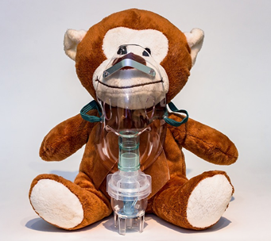
Post-operative Management
Early extubation
Utilize multimodal analgesia
Benefits include minimizing barotrauma and air leaks which allow bronchial repair to heal
Consider leaving infants with severe co-existing disease or prematurity intubated
Notes:
Early extubation is encouraged to avoid barotrauma to the surgical site, prevent air leak and allow bronchial repair to heal. This can be achieved with multimodal anesthesia with short acting medications and regional anesthesia. Patients with severe preexisting respiratory compromise, significant co-existing disease or prematurity may need to remain intubated postoperatively.

Slide 23
Summary
CPAM is a common neonatal congenital lung lesion
Prognosis depends on size and compression of surrounding structures
Depending on the severity of symptoms, fetal surgery maybe indicated
Anesthesia for neonatal thoracic surgery can be successfully done with a thorough understanding of the surgery, anesthetic risks and appropriate planning

Slide 24
References
Guruswamy et al. Anesthetic management of neonate with congenital cyst adenoid malformation. BrJ Ana 2001
Egloff et al. Prenatal diagnosis and management of congenital pulmonary airway malformation. uptodate.com 2019.
Oermann et al. Congenital pulmonary airway malformation. uptodate.com 2019.
Hammer. Pediatric Thoracic Anesthesia. Anesth Analg 2001; 92:1449-64.
Letal et al. Paediatric lung isolation. BJA Education, 17 (2): 57–62 (2017)
Rahman N1, Lakhoo K. Comparison between open and thoracoscopic resection of congenital lung lesions. J Pediatr Surg. 2009 Feb;44(2):333-6.
Karapurkar SA1, Borkar JD, Birmole BJ. Malformation of lung in neonates (lobectomy for congenital lobar emphysema and lung cyst). J Postgrad Med. 1993 Oct-Dec;39(4):224-7.
Tobias. Anaesthesia for neonatal thoracic surgery. Best Pract Res Clin Anaesthesiol. 2004 Jun;18(2):303-20.
Baird R1, Puligandla PS2, Laberge JM3. Congenital lung malformations: informing best practice. Semin Pediatr Surg. 2014 Oct;23(5):270-7.
Tsao K1, Albanese CT, Harrison MR. Prenatal therapy for thoracic and mediastinal lesions. World J Surg. 2003 Jan;27(1):77-83.
Kapralik J1, Wayne C1, Chan E1, Nasr A2. Surgical versus conservative management of congenital pulmonary airway malformation in children: A systematic review and meta-analysis. J Pediatr Surg. 2016 Mar;51(3):508-12.
Davis, Cladis, Motoyama. Smith’s Anesthesia for Infants and Children. 8th edition. 2011.

Slide 25
References
Husler et al. Prenatally diagnosed fetal lung lesions with associated conotruncal heart defects: is there a genetic association. Prenat Diagn. 2007 Dec;27(12):1123-8.AMA
Chiluveru SA, Dave NM, Dias RJ, Garasia MB. Congenital pulmonary airway malformation with atrial septal defect and pulmonary hypertension for lobectomy-anesthetic considerations. Ann Card Anaesth. 2016;19(2):372–374.
Purohit A, Bhargava S, Mangal V, Parashar VK. Lung isolation, one-lung ventilation and hypoxaemia during lung isolation. Indian J Anaesth. 2015;59(9):606–617.
Seok JH, Kim EJ, Ban JS, et al. Severe desaturation while attempting one-lung ventilation for congenital cystic adenomatoid malformation with respiratory distress syndrome in neonate -A case report-. Korean J Anesthesiol. 2013;65(1):80–84.
Pani N, Panda CK. Anaesthetic consideration for neonatal surgical emergencies. Indian J Anaesth. 2012;56(5):463–469.
Stock images from pixabay.com (free for commercial use)

