Slide 1
COVID-19 in Children: Perioperative Considerations
Updated 6/2020
J. Matthew Kynes, MD
Vanderbilt Children’s Hospital
Nashville, TN, USA

Slide 2
No Disclosures BUT…
Disclaimer: COVID-19 is a very new illness, and information is developing rapidly. Some of the information in this lecture may become outdated or inaccurate as new studies become available.

Slide 3
Overview
Epidemiology – How often are children infected?
Presentation – How do we know children are infected?
Outcomes – What happens to children who are infected?
Notes:
The discussion in this lecture centers around three basic issues

Slide 4
How often are children infected?

Slide 5
Pediatric Incidence in Early Affected Countries
Notes:
We have data from China, Italy, and the US. Early reports from China were for symptomatic patients and and asymptomatic contacts. Italy reported all of their cases, although we don’t know who they were able to test. In the US most early studies are from test of those that are symptomatic.

Slide 6
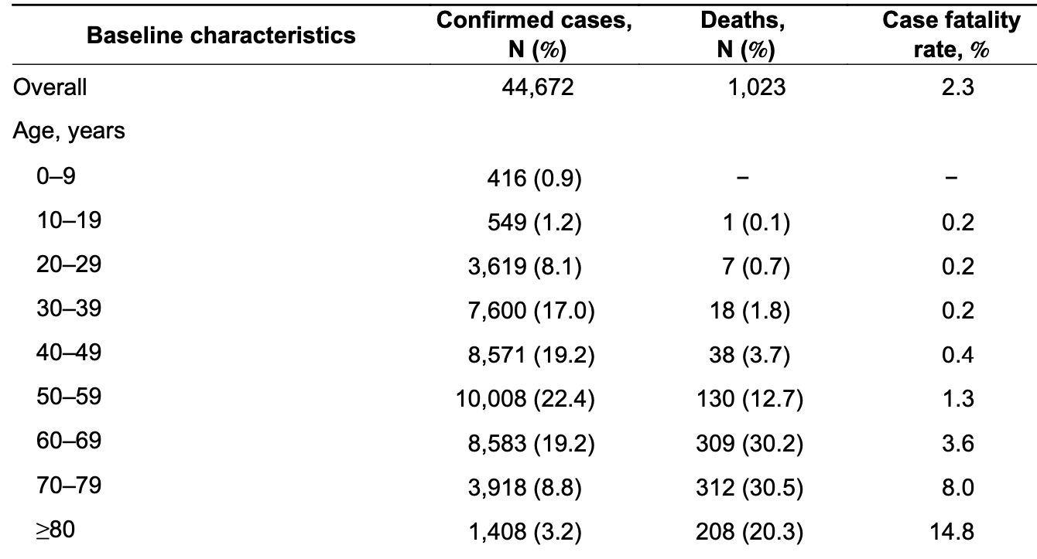
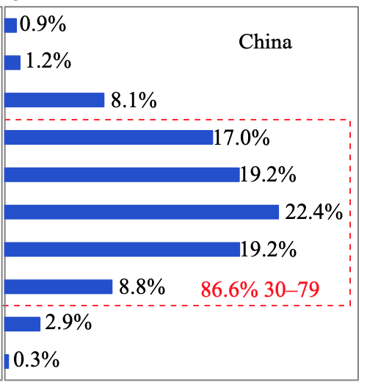
China
CCDC Weekly. Vol 2 No. 8. Feb 2020
Notes:
The first, a report of data from the Chinese Center for Disease Control and Prevention, noted that only 2.1% of the 72,314 patients diagnosed with COVID-19 (confirmed and suspected) were younger than 20 years. The highest proportion of positive cases was in the 50-59 year old group, with 87% of all cases age 30-79.

Slide 7
Italy
Livingston et al. JAMA March 2020
Notes:
The initial report on COVID-19 from Italy in March 2020 reported that 1.2% of 22,000 confirmed cases were in ages 0-18yo, seen in the chart on the right.
In addition, out of 1625 deaths there were none in patients under age 30, shown in this table.

Slide 8
USA
US: 1.7% of cases are <18Y
Median Age in children: 11 years
15-17 years 32%
10-14 years 27%
5-9 years 15%
1-4 years 11%
0-1 year 15%
Notes:
This is Data from the US CDC COVID Response Team Released on April 6th.
Of the 149,082 cases analyzed where age was recorded, about 1.7% or 2572, of pts from this time frame were pediatric pts <18 y/o. As you can see, no pediatric cases were reported to the CDC until March 2nd.

Slide 9
Population-based Testing (Iceland)
1412 children < 10 years of age tested
Targeted testing cohort of 564 children: 6.7% (38) were positive (compared with 13.7% of persons > 10 years of age)
Population Screening Cohort of 848 children: 0% (0) were positive (compared with 0.8% of persons > 10 years of age)
“The lower rate of positive tests in children < 10 years old adds support to the hypothesis that children are less susceptible to SARS-CoV-2 infection compared to adults. Similarly the lack of positive tests amongst > 800 children screened goes against the theory that the low reported rates of COVID-19 in children are due to a large number of undocumented / asymptomatic pediatric cases…”
Gudbjartsson et al. NEJM 2020
Notes:
Ultimately, we would like to know how many cases there are among all people, not just among patients tested who are symptomatic. Iceland performed population-based testing that gives some information on this. The results are seen here.
In another example, the Italian town of Vo, which screened 70% of its population and found 0 children <10 years positive, despite a 2.6% positive rate in the general population.
Ultimately, antibody data may be able to give a clearer picture of how many people in a given population have been affected.
Suppression of COVID-19 outbreak in the municipality of Vo, Italy. Lavezzo et al. medRxiv 2020.04.17.20053157;
Gudbjartsson DF, Helgason A, Jonsson H, Magnusson OT, Melsted P, Norddahl GL, et al. Spread of SARS-CoV-2 in the Icelandic Population. N Engl J Med, Published April 14th 2020, doi:10.1056/NEJMoa2006100.

Slide 10
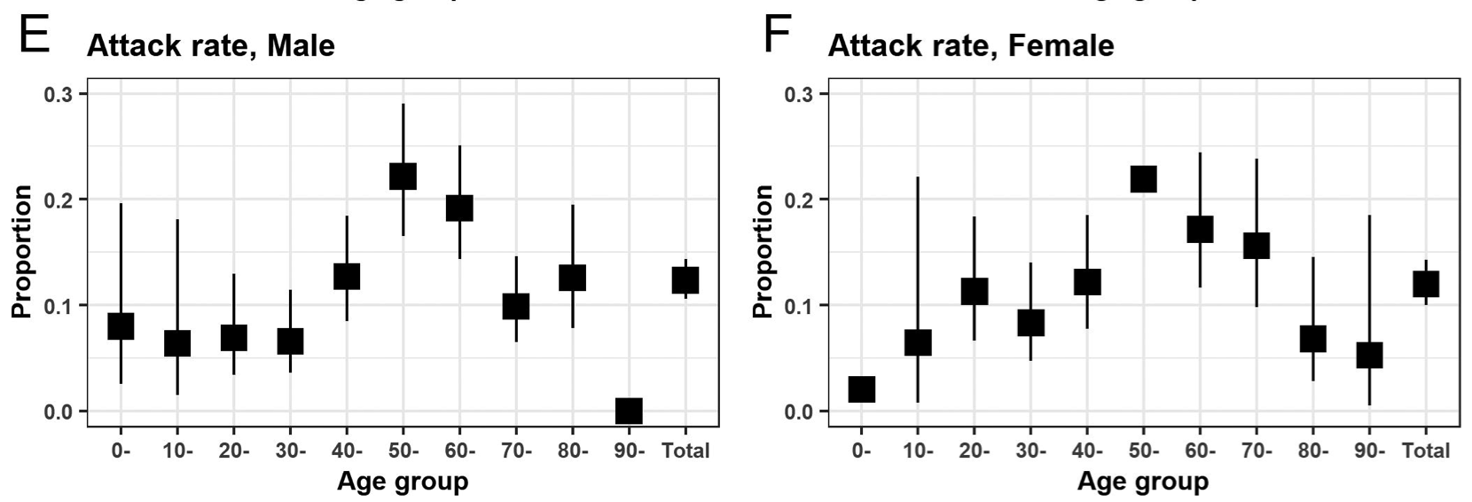
Attack Rate in Children
Attack rate = proportion of people who have had contact with a confirmed case that subsequently became infected
Mizumoto et al. medRxiv. 2020
Notes:
At least some of the lower rate of infection in children is due to a lower risk of infection after exposure to the virus.
The attack rate gives an idea of how likely different populations are to be infected after exposure to someone with the virus.
This report from Japan examined 2496 contacts of 313 domestically acquired cases and found a much lower attack rate in children (7.2% males, 3.8% females) compared to adults (22% in people aged 50 -59 years).
Similarly, Authors from China found that susceptibility to SARS-CoV2 infection increased with age. Young individuals (aged 0-14 years) had a lower risk of infection than individual aged 15-64 years [OR=0.34 (95%CI: 0.24-0.49), p-value<0.0001]. In contrast, older individuals aged 65 years and over had a higher risk of infection than adults 15-64 years [OR=1.47 (95%CI: 1.12-1.92), p-value=0.005]. These findings are in contrast with a previous study in Shenzhen, where susceptibility to infection did not change with age.
Changes in contact patterns shape the dynamics of the COVID-19 outbreak in China
By Juanjuan Zhang, Maria Litvinova, Yuxia Liang, Yan Wang, Wei Wang, Shanlu Zhao, Qianhui Wu, Stefano Merler, Cécile Viboud, Alessandro Vespignani, Marco Ajelli, Hongjie Yu
Published Online29 Apr 2020. Science.
Age specificity of cases and attack rate of novel coronavirus disease (COVID-19)
Kenji Mizumoto, Ryosuke Omori, Hiroshi Nishiura
medRxiv 2020.03.09.20033142; doi:https://doi.org/10.1101/2020.03.09.20033142

Slide 11
How do we know children are infected?
Notes:
We now move on to discuss manifestations of COVID-19 in children

Slide 12
Presentation
 | Lu et al (China, N=171) | Parri et al (Italy, N=100)
Cough | 48.5% | 44%
Shortness of breath | -- | 11%
Pharyngeal edema | 46.2% | --
Fever | 41.5% | 54%
Duration of fever | 3 days | --
Diarrhea | 8.8% | 9%
Fatigue | 7.6% | 9%
Rhinorrhea | 7.6% | 22%
Vomiting | 6.4% | 10%
Nasal congestion | 5.3% | --
Tachypnea | 28.7% | --
Tachycardia | 42.1% | --
O2 saturation <92% | 2.3% | 1%
Table 1: Epidemiologic Characteristics, Clinical Features and Outcomes in the Italian CONFIDENCE Cohort as Compared with Other Cohorts
Notes:
Clinical features – several studies have reported symptom distribution among pediatric patients diagnosed with COVID-19. The results from two of these are shown here. One is of 171 children diagnosed in China during an inpatient admission, and the other is 100 children presenting to pediatric emergency rooms in Italy.
Data from China showed 13% of confirmed cases had no symptoms (cases detected by contact tracing). Considering both confirmed and suspected cases, 32% of children aged 6-10yrs were asymptomatic.
Children tend to have more mild illness. The most common presenting features are cough and fever, occurring in over half of symptomatic patients. Upper respiratory tract symptoms such as rhinorrhea and sore throat are also relatively common, occurring in 30-40% of patients. It is not uncommon for children to have diarrhea and/or vomiting (around 10% of cases).
These results are similar for patients who presented to emergency rooms in Italy.
Lu X, et al. N Engl J Med, March 2020.
Parri N, Lenge M, Buonsenso D; Coronavirus Infection in Pediatric Emergency Departments (CONFIDENCE) Research Group. Children with Covid-19 in Pediatric Emergency Departments in Italy [published online ahead of print, 2020 May 1]. N Engl J Med. doi:10.1056/NEJMc2007617

Slide 13
Presentation in Children Compared to Adults
Less severe in children than adults
Notes:
There are some differences in symptom presentation in children compared with adults.
Of the 291 peds pts with reported symptoms recorded, 73% of these children had fever/cough/SOB vs 93% of adults, but as you can see, only 56% of those experience fever, with 71% of adults having fever. Cough is present 54% of the time for kids and 80% of the time for adults.

Slide 14
Disease Severity in Children
*Mild, moderate and severe severity not available in Dong et al
Notes:
Disease severity among children is also generally milder than in adult patients. This table shows distribution of severity among pediatric patients tested in three studies (Le, Dong and Parri et al). This demonstrates that a large proportion of positive cases in children are asymptomatic and mild.
Epidemiology of COVID-19 Among Children in China
Yuanyuan Dong, Xi Mo, Yabin Hu, Xin Qi, Fan Jiang, Zhongyi Jiang, Shilu Tong
Pediatrics Apr 2020, e20200702; DOI: 10.1542/peds.2020-0702

Slide 15
What happens to children who are infected?
Notes:
Finally, we will discuss outcomes among children affected by this disease

Slide 16
Notes:
Overall fatality and severe complications from COVID in children have been low. Case fatality is extremely low. This chart displays case fatality rates by age collected from South Korea, Spain, China and Italy and for all populations below age 20 years the reported CFR has been near 0%.
Similarly, in a report of 171 children younger than 16 years hospitalized in Wuhan province, only 3 were admitted to the intensive care unit (ICU), and 1 of those children died. The overall disease severity in children was reported to be significantly milder than in adults.
Lu X, et al. N Engl J Med, March 2020.

Slide 17
Characteristics of Critical Illness
Underlying medical conditions in 48 PICU patients:
“Medically complex” (40%)
Immune suppression/malignancy (23%)
Obesity (15%)
36% with 2 or more comorbidities
Notes:
Of the pediatric patients who have presented with critical illness, there are a few common clinical characteristics that have been identified.
In 48 patients in North American PICUs, 40 children (83%) had preexisting underlying medical conditions, 35 (73%) presented with respiratory symptoms, and 18 (38%) required invasive ventilation, and the hospital mortality rate was 4.2% for those admitted for intensive care.
Shekerdemian LS, Mahmood NR, Wolfe KK, et al. Characteristics and Outcomes of Children With Coronavirus Disease 2019 (COVID-19) Infection Admitted to US and Canadian Pediatric Intensive Care Units. JAMA Pediatr. Published online May 11, 2020. doi:10.1001/jamapediatrics.2020.1948

Slide 18
Characteristics of Critical Illness
48 PICU Patients with Covid-19
Interventions:
38% mechanical ventilation
25% vasoactive drugs
Outcomes:
Length of stay in PICU – 5 days
Hospital mortality – 4.2%
Notes:
Of the pediatric patients who have presented with critical illness, there are a few common clinical characteristics that have been identified.
In 48 patients in North American PICUs, 40 children (83%) had preexisting underlying medical conditions, 35 (73%) presented with respiratory symptoms, and 18 (38%) required invasive ventilation, and the hospital mortality rate was 4.2% for those admitted for intensive care.
Shekerdemian LS, Mahmood NR, Wolfe KK, et al. Characteristics and Outcomes of Children With Coronavirus Disease 2019 (COVID-19) Infection Admitted to US and Canadian Pediatric Intensive Care Units. JAMA Pediatr. Published online May 11, 2020. doi:10.1001/jamapediatrics.2020.1948

Slide 19
Pediatric Multisystem Inflammatory Syndrome
Presentation: persistent fever, inflammation (neutrophilia, elevated CRP, and lymphopenia) with evidence of single or multi-organ dysfunction (shock, cardiac, respiratory, renal, gastrointestinal, or neurological disorder) Exclusion of any other microbial cause, including bacterial sepsis, staphylococcal or streptococcal shock syndromes
SARS-CoV-2 PCR testing may be positive or negative
Treatment has included IVIG, aspirin, antibiotics and supportive care
Notes:
In May, there emerged several reports of clusters of pediatric patients presenting with a positive COVID-19 diagnosis AND a hyperinflammatory syndrome resulting in multiorgan dysfunction.
The presentation is similar to other inflammatory syndromes such as Kawasaki disease, Toxic Shock Syndrome, and hyperinflammatory syndromes such as Hemophagocytic Lymphocytic Histiocytosis (HLH) and SLE.
The symptoms are seen here in this case definition.
Importantly, although this syndrome has been reported in pediatric patients in China, USA and UK, it appears to be a very rare manifestation of COVID-19.
DFTB, T. Paediatric Multisystem Inflammatory Syndrome, Don't Forget the Bubbles, 2020. Available at: http://doi.org/10.31440/DFTB.25760

Slide 20
Conclusions
COVID-19 in children remains rare and often asymptomatic or mild
Presenting symptoms may include cough, fever, and gastrointestinal symptoms or it may be diagnosed without symptoms
Patients with severe disease are more likely to be medically complex with multiple comorbidities, and most of these patients will recover

