Slide 1
Inherited Coagulopathies in Children: Von Willebrand Disease
Andrew J. Costandi, MD, MMM
Children’s Hospital Los Angeles
USC Keck School of Medicine

Slide 2
Faculty Disclosures
None
Notes:
Neither author has any conflicts of interest to disclose.
All images provided by the authors, by the toolbox art staff, from openi.nlm.nih.gov, or licensed from Dreamstime Inc, unless otherwise specifically cited. All images used for educational purposes only.

Slide 3
Learning Objectives
Upon completion of this activity, participants will be able to:
Describe the physiology of hemostasis in the pediatric patient
Describe the pathophysiology of Von Willebrand Disease (VWD)
Discuss appropriate perioperative management of children with VWD

Slide 4
Hemostasis
Primary Hemostasis
Vascular spasm
Platelet plug formation
Secondary Hemostasis
Coagulation Cascade
Formation of blood clot
Tertiary Hemostasis
Clot lysis
Vascular remodeling
Notes:
In order for us to understand the diseases related to factor deficiencies in children, we must have a solid understanding of coagulation physiology. Normal coagulation represents a balance between the pro coagulant pathway that is responsible for clot formation and the inhibitory control of several inhibitors that limit clot formation thus avoiding thrombus propagation. Any imbalance in these pathways will lead to either poor or excessive formation of clot. Normally, the endothelial cells lining the vascular wall exhibit antithrombotic properties to prevent clot formation.
When a blood vessel is injured, the body tries to stop the bleeding to achieve “Hemostasis”.Hemostasis, defined as arrest of bleeding, comes from Greek, “heme” meaning blood and “stasis” meaning to stop. So how does the body achieve Hemostasis?
When a vascular injury is encountered:
The affected vessel immediately spasms in an attempt to control bleeding.
A platelet plug is then formed within minutes at the site of injury (Primary Hemostasis).
With the formation of platelet plug a clotting cascade is triggered leading to generation of fibrin to reinforce the platelet plug (Secondary Hemostasis).
Finally, this is eventually followed by removal of clot by fibrinolysis or what we call Vascular Remodeling.

Slide 5
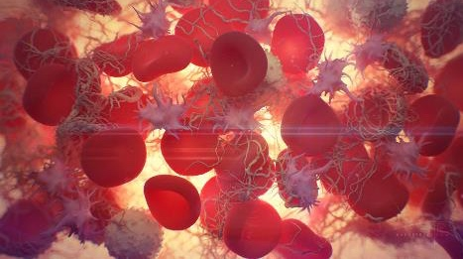
Primary Hemostasis Platelet Response
Platelet adhesion
Platelet activation
Platelet aggregation
"Blood clotting" by Alexey Kashpersky, Radius Digital Science is licensed under CC BY-NC 4.0
Notes:
The three primary functions of platelets in response to a vascular injury are to adhere to the damaged subendothelial surface, activate through the release of substances in dense and alpha granules, and to aggregate through platelet-platelet cohesion.

Slide 6
Primary Hemostasis: Platelet Adhesion
Normal: Endothelial cells lining the vascular wall exhibit antithrombotic properties
Intimal injury: Release of procoagulant subendothelial elements like collagen and VWF
Platelet adhesion to site of injury
Collagen on the subendothelial surface is bound by platelet integrins
VWF on the subendothelial surface is bound by platelet glycoprotein GPIb-IX-V
Notes:
Platelet Adhesion:
Normally, the endothelial cells lining the vascular wall exhibit antithrombotic properties to prevent clot formation. When intimal injury occurs, “procoagulant” subendothelial elements such as collagen and von Willebrand Factor (VWF) are exposed leading to platelet adhesion at the site of vascular injury.
VWF on the subendothelial surface is bound by platelet surface glycoprotein GPIb-IX-V
Collagen on the subendothelial surface is bound by platelet integrins.
Of note, platelet glycoprotein deficiency can lead to certain inherited bleeding disorders like Glanzmann thrombo-asthenia (deficiency of IIb/IIIa) or Bernard-Soulier syndrome (deficiency of platelet glycoprotein Ib).

Slide 7
Primary Hemostasis: Platelet Activation
Release of
Thromboxane A2
Fibrinogen
Factor V
ADP
Conformational and shape change
Elongated pseudopods
Extremely adhesive platelets
Notes:
Platelet Activation:
With platelet activation, compounds like fibrinogen, factor V, ADP and thromboxane A2 are released. Conformational and significant shape change occurs in platelets leading to production of elongated pseudopods that make the platelets extremely adhesive.
Platelet aggregation and Stabilization
VWF and fibrinogen serve as bridges between platelets leading to platelet aggregation. This is further enhanced by the Thromboxane A2 and ADP produced by the activated platelets providing stimulus for further platelet aggregation and formation of platelet plug. The coagulation cascade is then triggered leading to fibrin deposition on the plug to reinforce it.

Slide 8
Primary Hemostasis: Platelet Aggregation
Thromboxane A2 and ADP stimulate platelet aggregation
VWF and fibrinogen bridge between platelets
Coagulation cascade is triggered and fibrin is deposited
"Blood clotting" by Alexey Kashpersky, Radius Digital Science is licensed under CC BY-NC 4.0
Notes:
Platelet aggregation and Stabilization
VWF and fibrinogen serve as bridges between platelets leading to platelet aggregation. This is further enhanced by the Thromboxane A2 and ADP produced by the activated platelets providing stimulus for further platelet aggregation and formation of platelet plug. The coagulation cascade is then triggered leading to fibrin deposition on the plug to reinforce it.

Slide 9
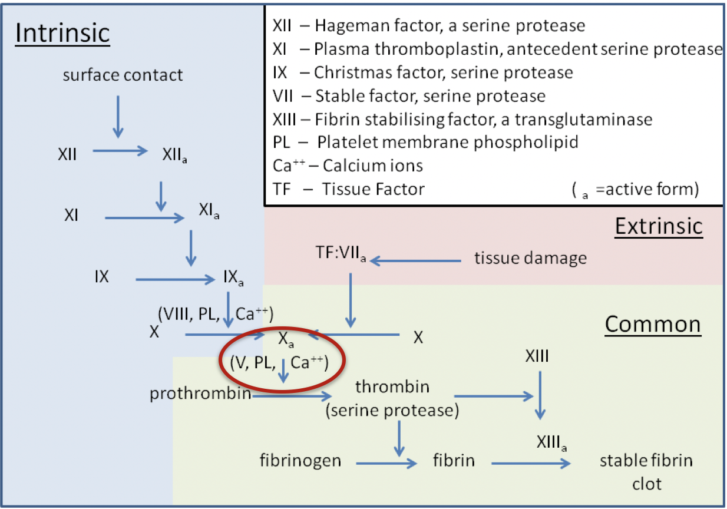
Secondary Hemostasis
The “Classic” model
By Dr Graham Beards - Own work, CC BY-SA 3.0, https://commons.wikimedia.org/w/index.php?curid=19094276
Notes:
The classic coagulation cascade proposed in 1964: Two pathways, “extrinsic” and ”intrinsic”, operating in parallel with a common goal to activate Factor X via two separate mechanisms.
The Extrinsic pathway is triggered by vascular injury leading to the exposure of Tissue Factor (TF) or Factor III (FIII) (NOT usually found in the intravascular space) to Factor VIIa and calcium, leading to activation of Factor X.
The Intrinsic pathway, on the other hand, depends on elements found in intravascular space. Contact activation of factor XII occurs when blood comes into contact with a surface containing negative electrical charges. The subsequent cascade involves factors XI, XI, VIII, each activating the next to ultimately activate Factor X and arrive at the Common pathway..
The Common pathway: Activated factor X (Fxa) along with factor V (FV), calcium (FIV), tissue phospholipids and platelet phospholipids form the prothrombinase complex (RED OVAL) which converts prothrombin (FII) to thrombin (FIIa). This thrombin further cleaves circulating fibrinogen (FI) to insoluble fibrin and activates factor XIII (FXIII - fibrin stabilizing factor). FXIII covalently crosslinks fibrin polymers incorporated in the platelet plug stabilizing the clot and forming a permanent secondary hemostatic plug.

Slide 10
Cell-based Model of Coagulation
Simultaneous, interactive pathways that overlap to augment production of thrombin
Initiation
Termination
Amplification
Propagation
Notes:
Current evidence changed our understanding of the coagulation pathway from 2 separate and parallel pathways systems that activate FX to: interactive cellular, physical and biochemical reactions that work in overlapping stages to form and augment thrombin generation and clot formation. The cell-based model of hemostasis proposes that coagulation requires the participation of 2 different cells types: a cell‐bearing TF, and platelets and 4 multicomponent complexes, 3 of which are procoagulant and 1 anticoagulant
Coagulation takes place on different cell surfaces in four overlapping steps: initiation, amplification, propagation and termination with each phase occurring on a different cell surface. Thrombin generation is primarily initiated by the generation or exposure of tissue factor (TF) at the wound site and its interaction with activated factor VII via the extrinsic pathway. This initial small amount of generated thrombin primes the clotting cascade and activates platelets, leading to explosive thrombin generation during the amplification phase.

Slide 11
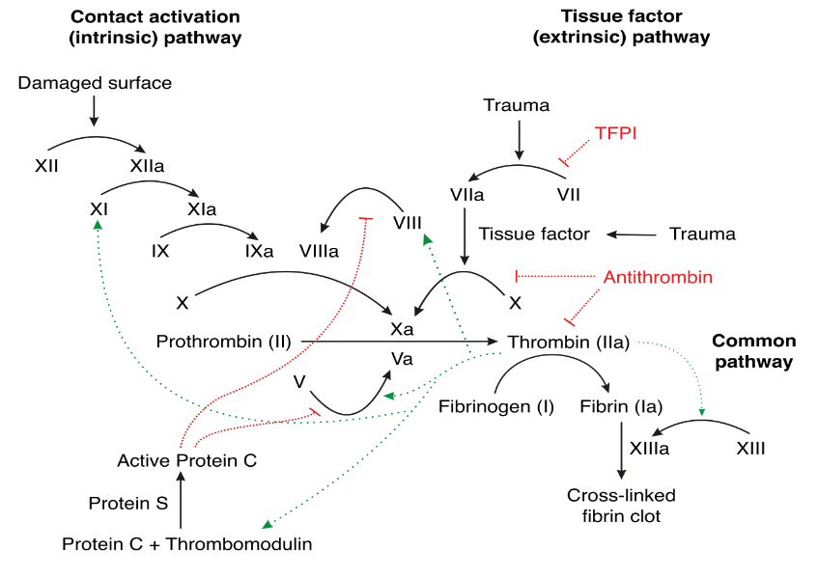
Secondary Hemostasis
1. Extrinsic X-ase
3.Intrinsic X-ase
2. Prothrombinase
4. Protein C Complex
Joe D [CC BY-SA 3.0 (http://creativecommons.org/licenses/by-sa/3.0/)]
Notes:
The cell‐based model represents a significant improvement in our understanding of the hemostatic process including the contributions of cells and the role of the extrinsic and intrinsic systems in generating FXa that occur on different cell surfaces simultaneously, rather than separate pathways. This adequately explains the significant clinical bleeding observed with FXI, FIX, and FVIII deficiencies (required for generation of FXa on platelet membranes). It also highlights the importance of generating thrombin directly on the activated platelet surface, not just on the surface of the TF‐bearing cell.
Image Source
Joe D [CC BY-SA 3.0 (http://creativecommons.org/licenses/by-sa/3.0/)]

Slide 12
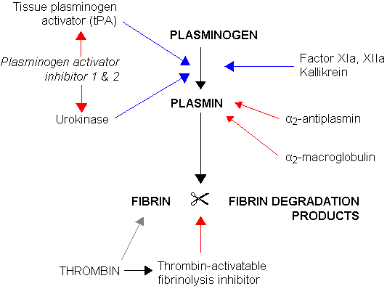
Tertiary Hemostasis
Tissue plasminogen activators activate plasminogen to plasmin Fibrinolysis
Notes:
To restore vessel patency, the clot must be organized and removed. Plasminogen is activated by Plasminogen activators (tissue plasminogen activator, urokinase) to plasmin which acts on the fibrin clot to dissolve it and regulate the coagulation process. Fibrinolysis is controlled by plasminogen activator inhibitors (PAIs) such as PAI-1 and plasmin inhibitors such as α2-antiplasmin.

Slide 13
Neonatal Coagulation
~ 50% adult levels at birth
Decreased Vitamin K dependent factors (II, VII, IX, X)
Decreased factor XI and XII, Prekallikrein, Kallikrein
Decreased anticoagulant proteins (C, S, AT‐III)
Vitamin K critical for coagulation
Neonates have low Vitamin K
Notes:
Hemostasis in the pediatric patient evolves as the child grows and matures, and normal adult laboratory values are not often the norm for a child. All of the procoagulants are synthesized in the liver except for von Willebrand factor (VWF), which is synthesized in megakaryocytes and endothelial cells, and factor VIII, which is produced in endothelial cells in the liver as well as other tissues such as lymphatics and renal glomeruli.
Factors II, VII, IX, and X have levels that are at least half that of adults in the neonatal period and gradually increase to adult values over the first 6 months of life due to an immature neonatal liver and deficiencies in vitamin K. Factor VIII has been reported to have levels that are higher in childhood compared to adults (increased on day 1 of life then falling in the newborn period before rising in childhood to adult levels). Levels of von Willebrand factor are similar to adults, although some children have elevated levels. The levels of the coagulation inhibitors “protein C and protein S” are low in the neonate and increase throughout childhood.
Term infants, especially those who are exclusively breast fed, are deficient in vitamin K and consequently may have vitamin K deficiency bleeding (VKDB).

Slide 14
Clinical Presentation
Purpuric Dysfunction: disorders of platelets and blood vessels
Mucocutaneous Bleeding
Recurrent Epistaxis
Petechiae
Small ecchymoses
Excessive bleeding after minor trauma or surgery
Notes:
In assessing the patient's bleeding history, it is important to characterize the type of bleeding. Bleeding disorders can be divided into 2 main broad categories:
Purpuric dysfunction (Disorders of platelets and blood vessels)
Coagulation Protein Disorders.
Bleeding into the skin and mucous membranes is characteristic of disorders of platelets and their interaction with blood vessels (purpuric disorders) and may be manifested as petechiae and/or ecchymoses. Bleeding into soft tissue, muscle, and joints suggests the presence of hemophilia or other disorders of coagulation proteins.

Slide 15
Bleeding Disorders In Children Platelet Disorders
Inherited Disorders:
Von Willebrand Disease (VWD)
Wiskott-Aldrich Syndrome (WAS)
Bernard-Soulier syndrome
Glanzmann thrombasthenia
Acquired Disorders:
Uremia
Myeloproliferative Disorders
Medication (Aspirin, NSAIDs,..)
Notes:
Individuals with platelet function disorders have mucocutaneous bleeding, recurring epistaxis, gastrointestinal bleeding, menorrhagia, and excessive bleeding during or immediately after trauma and surgery. Joint, muscle, and intracranial bleeding is rare. Diagnosis is made using platelet aggregation assays, flow cytometry, and platelet electron microscopy.
Acquired causes of abnormal platelet function are much more common than inherited causes and include use of aspirin and nonsteroidal anti-inflammatory drugs (NSAIDS), beta-lactam antibiotics, serotonin-specific reuptake inhibitors, uremia, and the myeloproliferative and myelodysplastic syndromes.
Wiskott-Aldrich syndrome (WAS) is an X-linked hereditary disorder. Presents with immune deficiency, thrombocytopenia, eczema, and an increased risk of autoimmune disorders and malignancy.
Bernard-Soulier syndrome – Characterized by a defect in the platelet glycoprotein Ib-IX-V complex. Presents with bleeding that is greater than expected for the degree of thrombocytopenia.
Glanzmann thrombasthenia – Characterized by a defect in the platelet glycoprotein IIb/IIIa complex. Presents with normal platelet count but with single isolated platelets without any platelet clumping on smear examination.

Slide 16
Laboratory Tests
CBC and platelets
Peripheral blood smear
Coagulation Studies
PTT (INR)
aPTT
Fibrinogen
Notes:
In cases of suspected bleeding disorders in children, the following laboratory tests should be ordered first:
Complete blood cell (CBC) count
Peripheral blood smear (platelet size and shape)
Prothrombin time (PT)/INR - Measures the extrinsic and common pathway. Sensitive to alterations in the vitamin K-dependent coagulation factors, factors II, VII, IX and X
activated partial thromboplastin time (aPTT) - Measures the intrinsic and common pathways of coagulation
Fibrinogen.

Slide 17
Laboratory Tests
Disorder | Platelet Count | PT/INR | aPTT | Fibrinogen
Qualitative Platelet Disorder | Normal/Low | Normal | Normal | Normal
Quantitative Platelet Disorder | Low | Normal | Normal | Normal
Hemophilia | Normal | Normal | Prolonged | Normal
Von Willebrand Disease (VWD) | Normal | Normal | Normal/Prolonged | Normal
DIC | Low | Prolonged | Prolonged | Low
Notes:
This chart summarizes how platelet disorders, hemophilia, Von Willebrand Disease and DIC have different results with testing. Note platelet disorders have low or normal platelet values, but the other tests are normal. DIC is alone in the above conditions which results in a low fibrinogen level. Hemophilia and VWF both have normal PT and prolonged aPTT emphasizing the effect of these conditions on the intrinsic and common coagulation pathways.

Slide 18
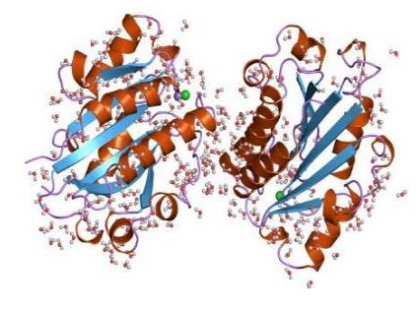
Von Willebrand Factor: Synthesis
Vascular endothelium
Stored in secretory granules
Released by stress and drugs (DDAVP)
Bone marrow megakaryocytes
Stored in platelet alpha granules
Released after platelet activation
Not released by DDAVP
Notes:
VWF is a multimeric glycoprotein that promotes platelet adhesion and aggregation and is a carrier for FVIII in plasma.
VWF is synthesized in two cell types:
In the vascular endothelium, VWF is synthesized and subsequently stored in secretory granules from which it can be released by stress or drugs such as desmopressin.
VWF is also synthesized in bone marrow megakaryocytes where it is stored in platelet alpha-granules from which it is released following platelet activation. DDAVP does not release platelet VWF.
Image source: European Bioinformatics Institute - http://www.ebi.ac.uk/pdbe-srv/view/images/entry/1lfa600.png

Slide 19
Von Willebrand Factor
Promotes platelet adhesion and aggregation
Carrier and protector for FVIII in plasma
Increased
African-Americans
Aging
Pregnancy
Acute Stress
Inflammation
Decreased
Hypothyroidism
"Blood clotting" by Alexey Kashpersky, Radius Digital Science is licensed under CC BY-NC 4.0
Notes:
VWF is a multimeric glycoprotein that promotes platelet adhesion and aggregation and is a carrier for FVIII in plasma.
In plasma, the FVIII–VWF complex circulates as a loosely coiled protein complex that does not interact strongly with platelets or endothelial cells under basal conditions. The complex protects FVIII from proteolytic degradation, thus prolonging its half-life. In addition, the interaction of platelets with the vascular endothelium efficiently places FVIII near the site of vascular injury.
VWF levels are increased in the African/ African-American race, with aging, pregnancy and with acute stress or inflammation. VWF is reduced by hypothyroidism and rarely by autoantibodies to VWF.
Image source: European Bioinformatics Institute - http://www.ebi.ac.uk/pdbe-srv/view/images/entry/1lfa600.png

Slide 20
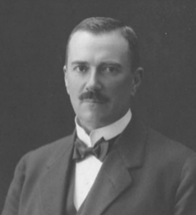
Von Willebrand Disease (VWD)
Qualitative or Quantitative Defect in VWF
1:100 population have defect in VWF
1:10,000 patients clinically significant
Franchini M, Capra F, Targher G, Montagnana M, Lippi G. Relationship between ABO blood group and von Willebrand factor levels: from biology to clinical implications. Thromb J. 2007;5:14.
Notes:
Shown here is Finnish physician Erik Adolf von Willebrand who first described this disease in 1926. Von Willebrand disease is a qualitative or quantitative defect in VWF and is the most common disorder of coagulation.
Plasma VWF levels, are 25%–35% lower in type-0 individuals than in non-type O individuals. Recent studies have suggested that ABO blood group determinants may be important in influencing the susceptibility of plasma VWF to proteolysis by ADAMTS13. Multimeric analysis and collagen-binding assays both demonstrated that proteolysis was significantly faster for group O VWF compared to non-O VWF. On a clinical level, studies have shown that compared with type O, non-O individuals could have an increased thrombotic risk via having higher VWF-FVIII levels
Image Source: https://en.wikipedia.org/wiki/Erik_Adolf_von_Willebrand (free license)

Slide 21
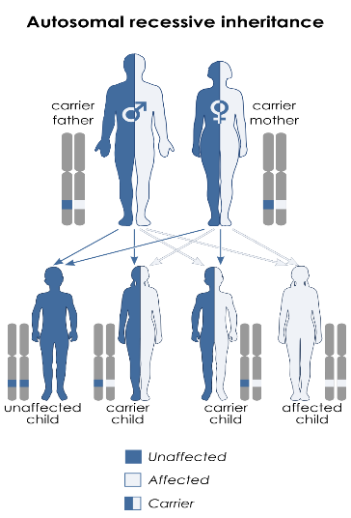
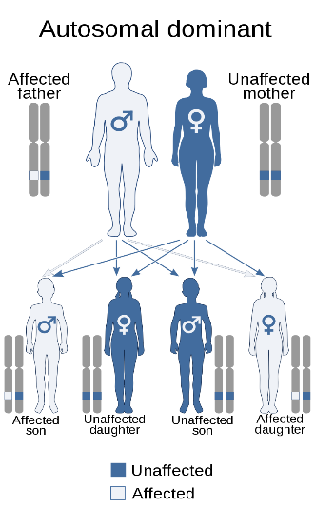
VWD: Transmission
Type III
Type I & II
CC BY-SA 3.0, https://commons.wikimedia.org/w/index.php?curid=19018894
Notes:
VWD is an inherited disease where the parent carrying the gene may or may not be symptomatic.
Type I and type II are autosomal dominant and account for 95% of cases. They are inherited if the gene is passed on to the offspring from either of the parent.
Type III is autosomal recessive and inherited only if the gene is passed from both the parents.
Image Source:
By Domaina - Own work based on File:ABO system codominance.svg and File:Autodominant.jpg, CC BY-SA 3.0, https://commons.wikimedia.org/w/index.php?curid=18567014
By Kashmiri, based on earlier work by Domaina - Own work based on Autosomal dominant - en.svg and Autorecessive.jpg, CC BY-SA 3.0, https://commons.wikimedia.org/w/index.php?curid=19018894

Slide 22
VWD: Types
Type | Defect | Inheritance
Type I: (70%) | Quantitative Defect | Autosomal Dominant
Type II: (25%) (2A, 2B, 2M,2N) | Qualitative Defect | Autosomal Dominant
Type III: (5%) | Profound Quantitative Defect | Autosomal Recessive
Acquired: (Rare) | Auto-Antibodies to VWF VWF adsorption to cells | In association with: lymphoid malignancies, lymphoproliferative disorders, myeloproliferative disorders
Sadler JE, Budde U, Eikenboom JC, et al. Update on the pathophysiology and classification of von Willebrand disease: a report of the Subcommittee on von Willebrand Factor. J Thromb Haemost. 2006;4:2103–14
Notes:
There are multiple subtypes of VWD. The International Society of Thrombosis and Hemostasis (ISTH) classification is as follow:
Type 1 VWD: Characterized by a partial quantitative deficiency of von Willebrand factor (low VWF antigen, low factor VIII clotting activity, and low VWF activity). Mucous membrane bleeding and prolonged oozing after surgery or tooth extractions are the predominant symptoms. VWF levels can differentiate mild hemophilia A from VWD. Individuals with hemophilia A have a normal VWF antigen level.
Type 2A and 2B VWD are characterized by a qualitative deficiency of VWF with a decrease of the high molecular-weight multimers
Type 2M VWD is also characterized by a qualitative deficiency of VWF with a similar decrease in function as seen in type 2A; however, it is associated with a normal multimer pattern.
Type 2N VWD is an uncommon variant resulting in defective binding of factor VIII to VWF. VWF platelet binding is completely normal.
Type 3 VWD is characterized by a complete or near-complete quantitative deficiency of VWF.
Acquired VWD: Associated particularly with lymphoproliferative disease and monoclonal gammopathy as well as with other underlying disorders such as tumors, autoimmune disease, hypothyroidism, cardiac and valvular defects, and drugs such as ciprofloxacin and valproic acid. Multiple mechanisms have been proposed such as decreased synthesis from hypothyroidism, rapid destruction or proteolysis due to circulating antibodies, and tumor cell absorption of VWF.

Slide 23
VWD: Clinical Presentation
Epistaxis
Oral bleeding
Excessive bleeding following minor wounds
Excessive postoperative bleeding
Notes:
Clinical presentation of VWD is characterized by mucosal bleeding and easy bruising depending on the severity of the deficiency of the factor. As mentioned earlier, platelet disorders frequently present with mucosal bleeding.
Patients with Type I may present with no bleeds or very minor bleeding while patients with Type III can present with severe spontaneous bleeds.

Slide 24
VWD: Diagnosis
Bleeding profile: VWD
Prolonged bleeding time
Normal platelet count
Normal PT & prolonged or normal aPTT
Screening
Platelet function analyzer (PFA-100)
Notes:
In VWD patients, the platelet count is usually normal, only in type IIb a mild to moderate thrombocytopenia can be found. The bleeding time (BT) is usually prolonged, the prothrombin time (PT) is normal, whereas the activated partial thromboplastin time (APTT) may be prolonged, depending on the plasma FVIII levels.
Bleeding time used to be the only diagnostic tool to evaluate primary hemostasis. However, this test is cumbersome and difficult to standardize and, consequently, has shown only very limited value in correctly predicting clinically significant disorders of primary hemostasis. Platelet Function Analyzer (PFA-100) was introduced later to replace bleeding time and to be used as an easy-to-use and reliable in vitro tool for investigating primary hemostasis. However, there are conflicting data with regard to sensitivity and specificity for VWD.

Slide 25
VWD: Diagnosis
Establish Diagnosis (Profile Testing):
VWF antigen: (VWFAg)
VWF activity: Ristocetin cofactor activity (VWF:RCo)
Factor VIII coagulant assay
Classify VWD Subtypes
VWF multimer test
Notes:
Once VWD is suspected, profile testing should be done by:
1. Measuring the plasma levels of VWF (VWF:Ag)
2. Measuring the function of the VWF protein which is present as ristocetin cofactor activity (VWF:RCo)
3. Assessing the ability of the VWF to serve as carrier protein to maintain normal survival of FVIII (Factor VIII coagulant assay)
4. Analyzing the VWF multimers to classify VWF Subtypes (VWF multimer test)
Ristocetin cofactor activity (VWF:Rco). The ristocetin cofactor activity is the most sensitive and specific test for VWD. It’s a functional assay that measures the ability of plasma VWF to agglutinate platelets in the presence of ristocetin, an antibiotic similar to vancomycin, via VWF, GP Ib, factor IX, and factor V interactions.
VWF antigen (VWF:Ag). An immunoassay that measures the concentration of VWF protein in plasma. Measuring VWF Ag concurrently with VWF:Rco indicate whether there is a deficiency of VWF production or no.
Factor VIII coagulant assay. is a measure of the cofactor function of the clotting factor, FVIII, in plasma.
VWF multimer test. VWF multimer analysis is a qualitative assay that depicts the variable concentrations of the different-sized VWF multimer. This information helps identify the TYPE of von Willebrand disease.

Slide 26
VWD: Treatment
Releasing endogenous VWF Stores Desmopressin (DDAVP)
Replace with exogenous VWF:
VWF concentrates
Platelets
Cryoprecipitate
Promote Hemostasis: Antifibrinolytics
Notes:
Therapies to prevent or control bleeding in persons who have VWD follow three general strategies.
The first strategy is to increase plasma concentration of VWF by releasing endogenous VWF stores through stimulation of endothelial cells with DDAVP.
The second approach is to replace VWF by using human plasma-derived, viral-inactivated concentrates.
The third strategy employs agents that promote hemostasis and wound healing but do not substantially alter the plasma concentration of VWF.
In countries with limited resources and access to VWF concentrates, cryoprecipitate and platelet concentrates has been used to increase VWF level.
The three treatment options are not mutually exclusive, and patients may receive any one or all three classes of agents at the same time. The appropriateness of therapeutic choice is dependent on the type and severity of VWD, the severity of the hemostatic challenge, and the nature of the actual or potential bleeding. Patients undergoing major surgery will require a VWF level of 80% - 100% of the normal level. We will discuss treatment further on the next couple of slides.

Slide 27
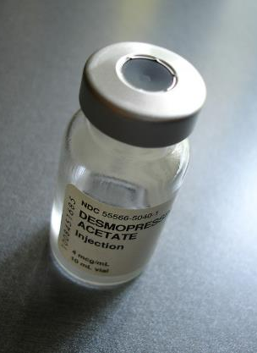
Desmopressin (DDAVP)
Intranasal dose
If < 50 kg → 150 mcg
If > 50 kg → 300 mcg
IV dose = 0.3 mcg/kg (max 20mcg)
Produces 3-5 fold increase in VWF:FVIII
Peak @ 30-90 mins
Duration of 8-12 hours
"DDAVP" by ballookey is licensed under CC BY-NC-ND 2.0
Notes:
DDAVP is effective in almost all patients with mild or moderate type 1 disease
Nasal administration of high-dose desmopressin acetate (Stimate®) is often effective for minor bleeding, but intravenous administration is the preferred route for surgical bleeding prophylaxis and for treatment of major hemorrhage.
Intranasal dose for children older than 5 years and <50 kg = 150 mcg and 300 mcg for patients who are >50 kg.
The dosing for intravenous therapy is 0.3 mcg/kg (max of 20 mcg) diluted into 20 ml of saline and infused over 30 mins.
Tachyphylaxis occurs inconsistently to patients who are dosed repeatedly at relatively short interval (12-24 hours for more than 2-3 days of therapy).
The development of tachyphylaxis is thought to occur due to partial or complete depletion of FVIII:C and VWF in the storage pool sites
Minor side effects of DDAVP are common and include: facial flushing, transient hypertension or hypotension, headache, or gastrointestinal upset.
Water retention after a dose of DDAVP, with an increase in urinary osmolality, is common; however, decreased serum sodium in otherwise healthy adults is variable and is related to multiple dose.
Children less than 2 years old have a lower response to DDAVP in general and its use is NOT recommended. Water retention, hyponatremia and seizures have been reported in young children and infants who received multiple doses of DDAVP and aggressive hydration.

Slide 28
Desmopressin (DDAVP)
Low cost
No risk of transmission of viral infections
Complications of prolonged treatment:
Tachyphylaxis
Hyponatremia
"DDAVP" by ballookey is licensed under CC BY-NC-ND 2.0
Notes:
DDAVP is used in mild or moderate hemophilia A as well as carriers. As mentioned earlier it has not value in hemophilia B. DDAVP is diluted in 30-50 mL of normal saline and infused over 20 to 30 minutes.
Tachyphylaxis and Hyponatremia can occur with prolonged treatment

Slide 29
VWF Replacement Therapy
VWF Concentrates
Type I VWD unresponsive to DDAVP
Children younger than 2 years of age
Types 2 & Type 3
VWF Concentrates Dosage
VWF:RCo units primarily
FVIII units secondarily
1 IU = Level of VWF:Rco in 1 ml fresh pooled plasma
1 IU/Kg of VWF:Rco raises plasma VWF:RCo by 1.5 IU/dL
The ultimate goal of surgical prophylaxis is to achieve a therapeutic level of 100 IU/dL VWF:RCo
Notes:
Replacement therapy is indicated for significant bleeding events or before major surgery in patients who have:
Type I VWD unresponsive to DDAVP and Children younger than 2 years of age
Types 2 & Type 3.
The products that contain VWF:RCo activity differ significantly in their ratios of VWF:RCo to FVIII.
Plasma‐derived FVIII concentrates may contain variable amounts of von Willebrand factor (VWF).
Recombinant VWF concentrates are dosed primarily on the basis of labeled VWF:RCo units and secondarily on the basis of labeled FVIII units. 1 IU corresponds to the level of VWF:Rco found in 1 mL of fresh-pooled human plasma. An infusion of 1 IU/kg of VWF:Rco raises the plasma level of VWF:Rco by 1.5 IU/dL
The ultimate goal of surgical prophylaxis is to achieve a therapeutic level of 100 IU/dL VWF:RCo and 50 IU/dL VWF:RCo for the first 3-5 days postoperatively in minor surgeries and for 7-14 days in major surgeries.
For surgery, the recommended loading dose is 40-80 VWF:RCo IU/kg administered intravenously every 8 to 12 hours.

Slide 30
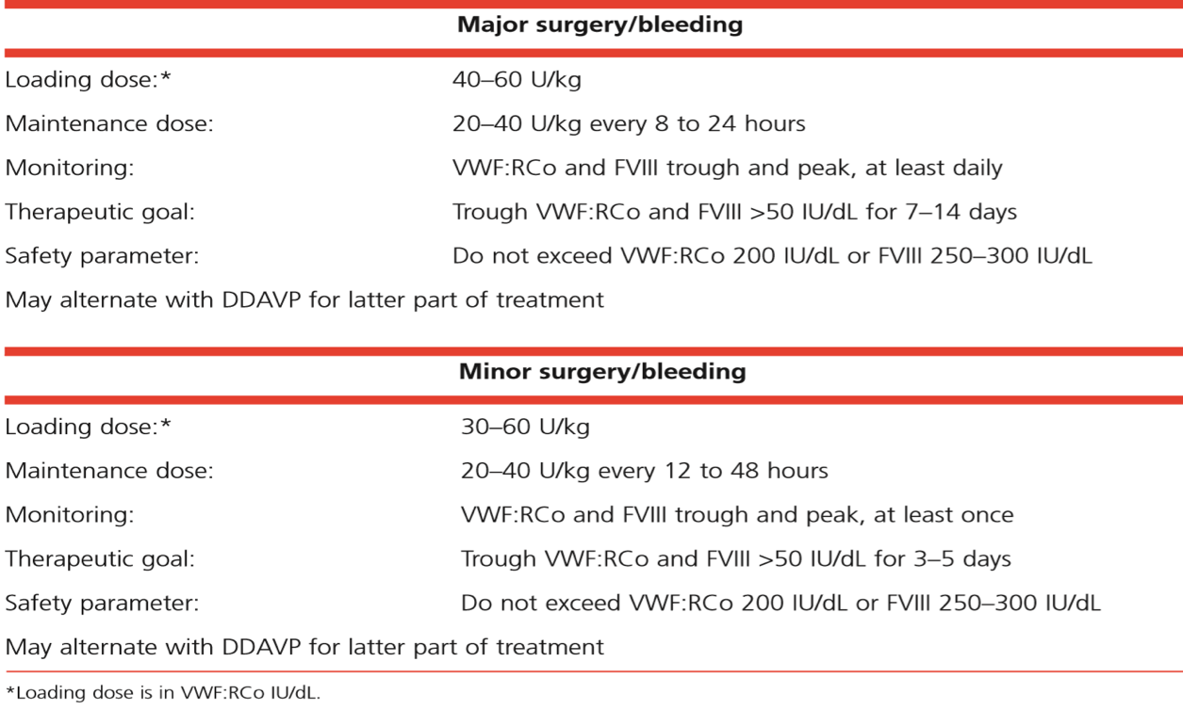
VWF Replacement Therapy
The National Heart, Lung and Blood Institute. The Diagnosis, Evaluation and Management of Von Willebrand Disease. Bethesda, MD: National Institutes of Health Publication
Notes:
The ultimate goal of surgical prophylaxis is to achieve a therapeutic level of 100 IU/dL VWF:RCo and 50 IU/dL VWF:RCo for the first 3-5 days postoperatively in minor surgeries and for 7-14 days in major surgeries.
For surgery, the recommended loading dose is 40-80 VWF:RCo IU/kg administered intravenously every 8 to 12 hours.

Slide 31
VWF Replacement Therapy
Humate-P®
Concentrate of purified VWF and FVIII.
Contains 50–100 IU/mL VWF:RCo and 20–40 IU/mL FVIII activity.
It has a half-life of 11 hours.
Alphanate SD/HT®
Concentrate of VWF and FVIII
Contains 20 IU/mL VWF:Rco and 40-180 IU/mL FVIII activity.
Notes:
Humate-P®, FDA approved lyophilized concentrate of purified VWF and FVIII, contains other plasma proteins including fibrinogen and albumin. VWF:RCo to FVIII ratio of 2.4 IU to 1 U FVIII. When reconstituted at the recommended volume, 1 ml Humate-P contains 50–100 IU/mL VWF:RCo and 20–40 IU/mL FVIII activity. It has a half-life of 11 hours.
Alphanate SD/HT® is FDA approved lyophilized concentrate of VWF and FVIII, and other plasma proteins. Upon reconstitution to the recommended volume, 1 ml of Alphanate contains 40-180 IU/mL FVIII activity, and 20 IU/mL VWF:RCo activity

Slide 32
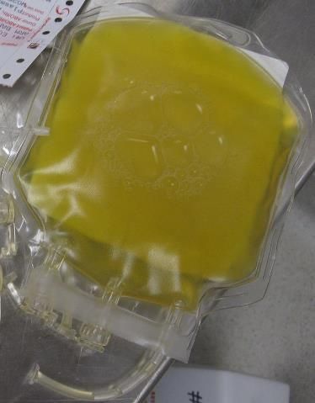
VWF Replacement Alternatives
Cryoprecipitate
80 U FVIII per standard donor unit
1 unit/6-10 kg q 12-24 hours
Risk of transmitting diseases
Notes:
Cryoprecipitate: In the past, Cryoprecipitate, has been used to treat hemophilia A and VWD.
Cryoprecipitate has on average at least 80 U FVIII per standard donor unit.
Dosage: 1 unit/6-10 kg q 12-24 hours, depending on the severity of the bleeding.
In developing countries, patients who have VWD may have no other options, but to use cryoprecipitate which poses a risk of transmitting disease because it is not subjected to viral inactivation procedures like concentrates.
Human platelets contain 10–15 percent of total blood VWF and platelet transfusions have been used successfully to treat bleeding in VWD patients. Platelet transfusion therapy should be considered as an adjunctive source of VWF, especially in patients with type 3 or platelet low VWF, to control bleeding that is non- or poorly responsive to replacement therapy with VWF concentrate

Slide 33
VWF Replacement Alternatives
Platelets
Type III VWD
Platelet low VWF
Poor response to replacement therapy with VWF concentrate
Notes:
Cryoprecipitate: In the past, Cryoprecipitate, has been used to treat hemophilia A and VWD.
Cryoprecipitate has on average at least 80 U FVIII per standard donor unit.
Dosage: 1 unit/6-10 kg q 12-24 hours, depending on the severity of the bleeding.
In developing countries, patients who have VWD may have no other options, but to use cryoprecipitate which poses a risk of transmitting disease because it is not subjected to viral inactivation procedures like concentrates.
Human platelets contain 10–15 percent of total blood VWF and platelet transfusions have been used successfully to treat bleeding in VWD patients. Platelet transfusion therapy should be considered as an adjunctive source of VWF, especially in patients with type 3 or platelet low VWF, to control bleeding that is non- or poorly responsive to replacement therapy with VWF concentrate

Slide 34
Clot Stabilizers Antifibrinolytics
Promotes clot stability by inhibiting the conversion of plasminogen to plasmin → inhibiting fibrinolysis
Adjunctive therapy in VWD and Hemophilia
Valuable in oral and dental surgery
Can cause nausea and vomiting
Contraindicated in patients treated with PCC
Notes:
Antifibrinolytic drugs like aminocaproic acid and tranexamic acid inhibit the conversion of plasminogen to plasmin, inhibiting fibrinolysis and thereby helping to stabilize clots that have formed.
These are important adjuvant agents for hemorrhage prevention and treatment especially during oral and dental surgeries because they act by inhibiting the fibrinolytic action of salivary enzymes.
Both drugs can cause nausea and vomiting
Both drugs are contraindicated in patients with factor VIII inhibitors being treated with prothrombin complex concentrate, due to the risk for thromboembolism.

Slide 35
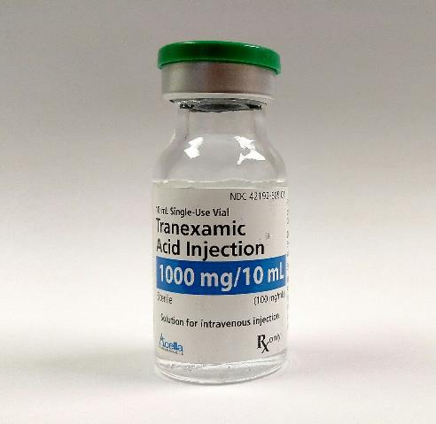
Clot Stabilizers: Antifibrinolytics
Tranexamic acid (TXA)
10 mg/kg IV q8h
25 mg/kg PO daily
Epsilon aminocaproic acid
50 mg/kg IV or PO
Shorter plasma half-life
Less potent than TXA
CC BY-SA 4.0
Notes:
Tranexamic acid (TXA) is given intravenously at a dose of 10 mg/kg every 8 hours or orally at 25 mg PO q daily.
Epsilon aminocaproic acid may be orally or intravenously administered @ 50 mg/kg. Lower doses (25 mg/kg) can be used when gastrointestinal side effects interfere with therapy. It has a shorter plasma half-life is lest potent than TXA.

Slide 36
Overview: VWD Treatment
Type | Treatment of Choice | Alternative Treatment
Type 1 | Desmopressin | VWF:FVIII concentrates
Type 2 | VWF:FVIII concentrates | Desmopressin
Type 3 | VWF:FVIII concentrates | Platelet concentrates Recombinant F VIIa
Notes:
A majority of patients with type 1 and some with type 2A and 2M can be successfully treated with only intravenous desmopressin acetate (DDAVP). Roughly 20% to 25% of patients may not respond.
Patients who have an inadequate response to DDAVP, such as in type 2B, 2N, or 3, will require the use of plasma-derived factor VIII concentrates that contain VWF.
Platelet transfusion therapy should be considered as an adjunctive source of VWF, especially in patients with type 3 to control bleeding that is non- or poorly responsive to replacement therapy with VWF concentrate.

Slide 37
Suggested Reading
Smith SA. The cell-based model of coagulation. J Vet Emerg Crit Care. 2009;19(1):3-10.
Leebeek FWG, Eikenboom J. Von Willebrand’s disease. N Engl J Med. 2016;375:2067-2080.
Yawn BP, Nichols WL, Rick ME. Diagnosis and management of von Willebrand disease: guidelines for primary care. Am Fam Physician. 2009;80(11):1261-1268.
Castaman G. Treatment of von Willebrand disease with FVIII/VWF concentrates. Blood Transfus. 2011;9 Suppl 2(Suppl 2):s9–s13.

