Slide 1
Bronchoscopy for Airway Foreign Body: Anesthetic Management
Saeedah Asaf, MD
Arkansas Children’s Hospital Little Rock, AR
The Children’s Hospital Lahore, Pakistan

Slide 2
Disclosures
No relevant financial relationships

Slide 3
Learning Objectives:
Presentation
Incidence of foreign body (FB) in the airway
Preoperative work up
Intraoperative management
Postoperative care

Slide 4
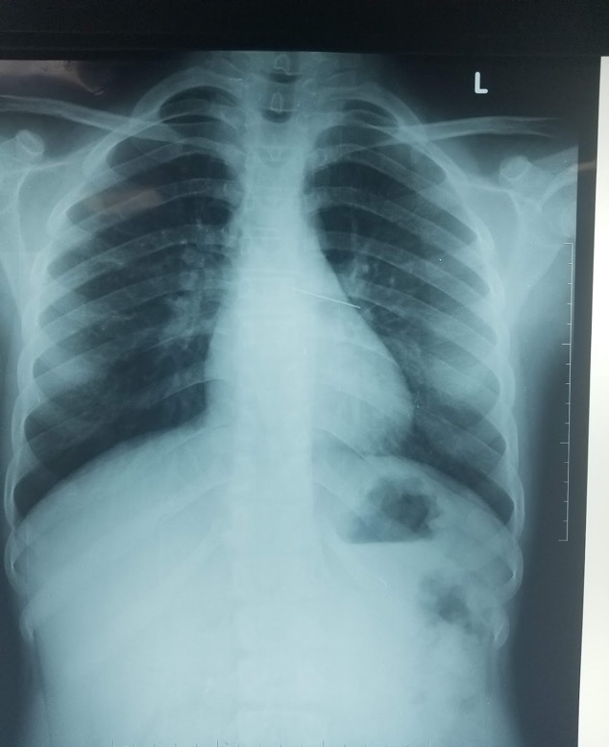
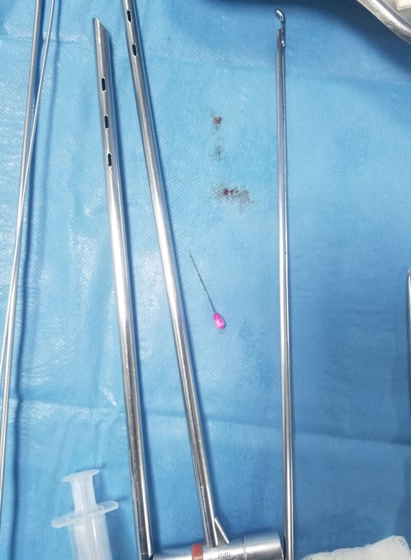
15 years old female inhaled scarf pin 6 hours earlier: Persistent Cough

Slide 5
Immediate Presentation
Immediate presentation: coughing, dyspnea, wheezing, cyanosis, or stridor
Witnessed choking- high predictability

Slide 6
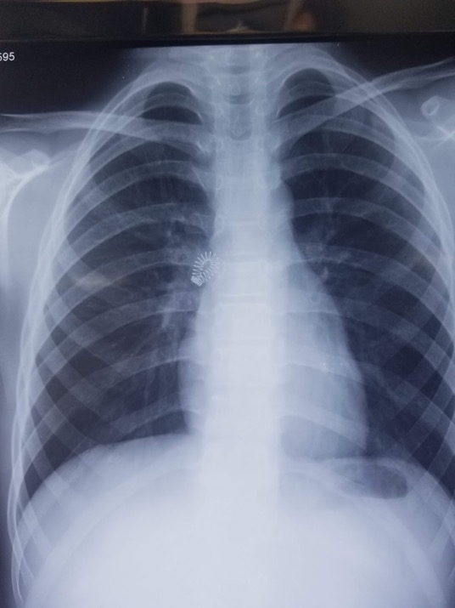
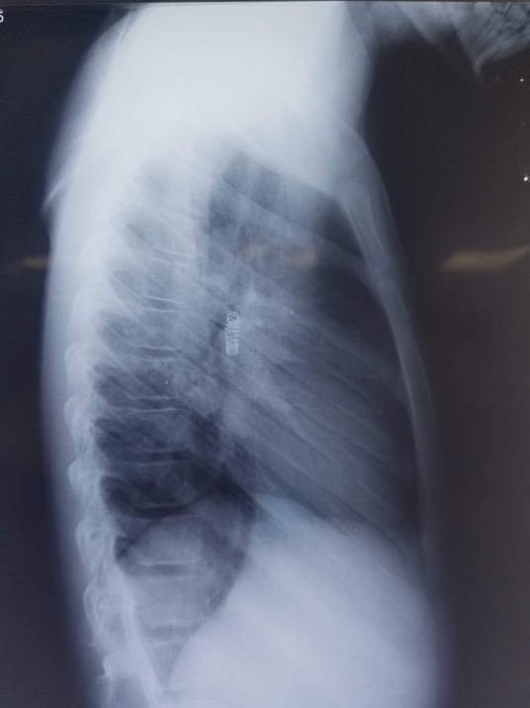
8 years old male with 1 year history of wheezing: Chest X-Ray shows spring from a pen in the right mainstem bronchus

Slide 7
Delayed Presentation
Unilateral decreased breath sounds and rhonchi
Recurrent or persistent pneumonia
May be misdiagnosed as asthma (persistent cough or wheezing)

Slide 8
Incidence of FB Inhalation
Leading cause of accidental death under 4 years of age
Majority are under 3 years of age
Organic foreign body are the most common (e.g. nuts, seeds)
Sharp objects (e. g. pins) are the most common in adolescents
Site: Bronchial tree 88%, Tracheal 12%
Right side 52%, Left 33%, Bilateral 15%

Slide 9
Findings on Chest X-ray
Majority of Foreign bodies are radiolucent (89%)
Normal CXR (17%)¹
Other findings:
Air trapping, atelectasis, localized hyperinflation
Infiltrate
Mediastinal shift
Pneumothorax

Slide 10
Additional Testing: CT Scans
Excellent correlation and can aid decision making
Can provide virtual bronchoscopy via 3D CT reconstruction ( 6th bronchial generation)
Disadvantages
Radiation exposure
Cost
Limited availability

Slide 11
Flexible vs Rigid Bronchoscopy
Rigid bronchoscopy- most often utilized
Allows ventilation & airway control through side port
Graspers through main port for FB removal
Flexible bronchoscopy
Diagnostic
Possibly therapeutic for small FB removal in distal airways
Notes:
The anaesthetic consideration of tracheobronchial foreign body aspiration in children
Pinar Kendigelen
Despite recent preference in some centers for using the fiber-optic bronchoscope, use of the rigid bronchoscope remains the gold standard (7,11,14,15). Although the fiber-optic bronchoscopy has the disadvantages of limited suction and instrumentation, and the lack of ventilatory capability and airway control, it has advantages in being less invasive, and in not requiring general anaesthesia. The flexible bronchoscope is also preferred for the removal of the foreign materials in distal airways of the upper lobe bronchi (8,16-18). It appears more useful with the paediatric patient as a diagnostic device to detect the foreign body, when there is insufficient historical, clinical, or radiologic findings for foreign body aspiration; whereas the rigid bronchoscope is used for its retrieval only (19,20). Presence of an optical forceps on the rigid ventilating bronchoscope simplifies the procedure as well as rendering it less hazardous. Skill is required for using the rigid bronchoscope in children who have small airways. An appropriately sized bronchoscope has to be selected to avoid the high incidence of bronchospasm in this age group of patients, as well as to prevent laryngeal oedema by not extending the time of the intervention

Slide 12
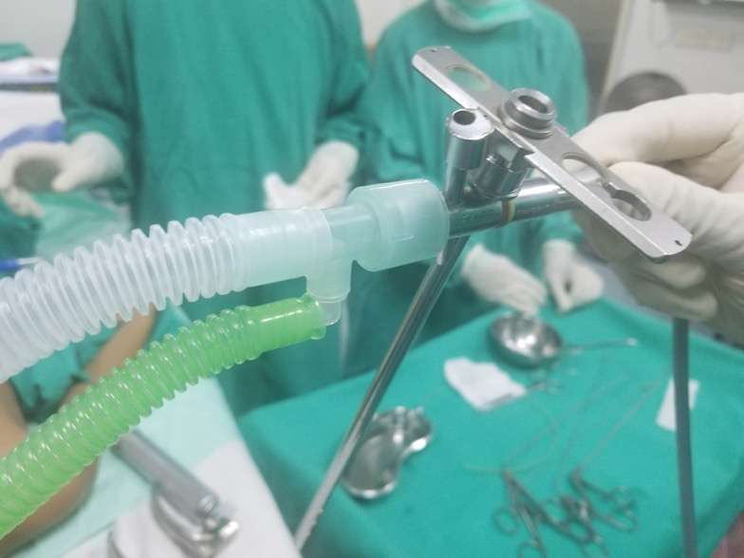
Rigid Bronchoscopy: Oxygenation and Ventilation through side port¹
Anesthesia circuit is attached to the side port of the rigid bronchoscope
Notes:
The Anesthetic Considerations of Tracheobronchial Foreign Bodies in Children: A Literature Review of 12,979 Cases
Christina W. Fidkowski, MD,* Hui Zheng, PhD,† and Paul G. Firth, MBChB*

Slide 13
Preoperative Assessment
Degree of distress → urgency of retrieval
Oxygen requirement
SPO₂ 94% or less
Tachypnea and retractions
NPO status
No distress: standard ASA guidelines
Distress: proceed as emergency, OG suction
Site of obstruction: tracheal vs bronchial
Unilateral wheeze, decreased breath sounds, CXR findings
Tracheal: usually emergent case

Slide 14
Preoperative Assessment
Nature of foreign body
Nuts: inflammation and airway edema
Time since inhalation
Recent: coughing, possible dislodgement
Remote: Airway edema and infection

Slide 15
Induction
IV induction is preferable
Inhalational induction possible if patient is in minimal respiratory distress
Consider lidocaine to vocal cords prior to instrumenting airway with bronchoscope: Max dose: 4mg/kg

Slide 16
Anesthetic Plan for Rigid Bronchoscopy
Spontaneous vs Controlled Ventilation:
Retrospective review of 94 pediatric cases noted no difference in adverse outcomes³
Meta-analysis (423 controlled ventilation and 441 spontaneous ventilation)⁴
No difference in desaturation
Lower incidence of laryngospasm and shorter operating time with controlled ventilation
Notes:
³Litman RS, Ponnuri J, Trogan I. Anesthesia for tracheal or bronchial foreign body removal in children: an analysis of ninety-four cases. Anesth Analg. 2000;91(6):1389-91.
This report is a description of the ventilation techniques used in 94 children undergoing general anesthesia for foreign body removal of the bronchus. No particular technique was found to be associated with a greater incidence of adverse outcomes.
⁴Liu Y, Chen L, Li S. Controlled ventilation or spontaneous respiration in anesthesia for tracheobronchial foreign body removal: a meta-analysis. Paediatr Anaesth. 2014;24(10):1023‐1030.
Results: From the included studies, 423 subjects received controlled ventilation, whereas 441 subjects received spontaneous respiration. There was no significant difference in the incidence of desaturation between controlled ventilation and spontaneous respiration (odds ratio, 0.70; 95% CI, 0.30-1.63). However, the incidence of laryngospasm was lower when controlled ventilation was performed (OR, 0.27; 95% CI, 0.10-0.76). The operation time (mean difference, -9.07 min; 95% CI, -14.03 to -4.12) was shorter in the controlled ventilation group.

Slide 17
Rigid Bronchoscopy: Spontaneous Ventilation
Advantages:
Avoids positive pressure ventilation which can theoretically push foreign body deeper into airway
No muscle relaxant and no reversal
Disadvantages:
Difficult to have patient deep enough to avoid coughing and movement and still ventilating adequately
Longer operative time

Slide 18
Rigid Bronchoscopy: Controlled Ventilation
Advantages:
Ensures immobility and prevents coughing, gagging or movement during the procedure
Shorter operative time
Disadvantages:
Need to monitor and reverse neuromuscular blockade
Need to carefully monitor positive pressure ventilation to prevent air trapping

Slide 19
Rigid Bronchoscopy: Spontaneous Ventilation
Preserve spontaneous ventilation
Induce with sevoflurane or propofol
Maintain anesthesia with TIVA:
Propofol infusion
Fentanyl bolus or remifentanil infusion
+/- dexmedetomidine
Lidocaine to vocal cords

Slide 20
Rigid Bronchoscopy: Controlled Ventilation
Induce with sevoflurane or propofol
Neuromuscular blockade with rocuronium and controlled ventilation via side arm of bronchoscope
Maintain anesthesia with TIVA:
Propofol infusion
Fentanyl bolus or remifentanil infusion
+/- dexmedetomidine

Slide 21
Anesthetic Plan for Rigid Bronchoscopy
Spontaneous vs Controlled Ventilation.
Personal preference of anesthesiologist and surgeon
TIVA is optimal approach as minimizes operative team’s exposure to volatile agents

Slide 22
Rigid Bronch: Intraop
Dexamethasone 0.5 mg/kg for airway edema prophylaxis to a maximum of 10 -16 mg
Albuterol to minimize/treat bronchospasm from foreign body removal and airway manipulation

Slide 23
Rigid Bronchoscopy: Challenges
Shared airway
Must coordinate ventilation with position of bronchoscope (e.g. smaller breaths when bronchoscope is more distal)
Difficult to monitor ETCO₂ when ventilating through side arm of bronchoscope
Risk of airway injury from rigid bronchoscope from coughing, bucking or movement

Slide 24
Bronchoscopy for FB: Common Intraop Problems
Hypoxia/hypercarbia during procedure
Difficult to monitor ETCO₂ when ventilating trough side-arm of rigid bronchoscope → Monitor chest rise
Significant circuit leak → Adjust ventilator, increase flows or ventilate by hand
Hypoxia and desaturation when bronchoscope is distal as only ventilating/oxygenating one lung or a fraction of one lung (shunt) → Communicate with surgeon to withdraw bronchoscope into trachea
Communication with surgeon is important!

Slide 25
Bronchoscopy for FB: Common Intraop Problems
Complete airway obstruction
Can occur when FB is retrieved into the trachea or lodges in larynx just below the vocal cords during retrieval attempt → Inability to ventilate or oxygenate
Management: Instruct surgeon to push FB back into bronchus to allow oxygenation/ventilation via one lung

Slide 26
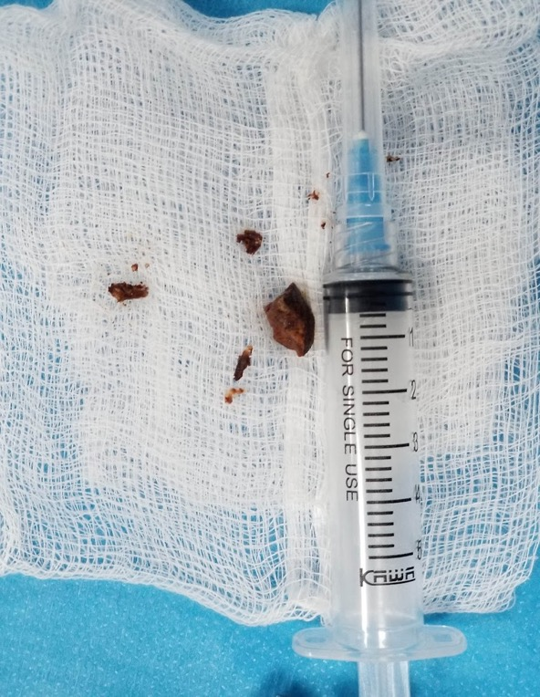
Bronchoscopy for FB: Common Intraop Problems
FB fragments during retrieval
Most commonly occurs with organic FBs (nuts or beans)
May require multiple retrievals and prolongs case → consider controlled ventilation
May require 2nd or 3rd bronchoscopy to remove all fragments → consider leaving patient intubated
Betel nut that fragmented during retrieval

Slide 27
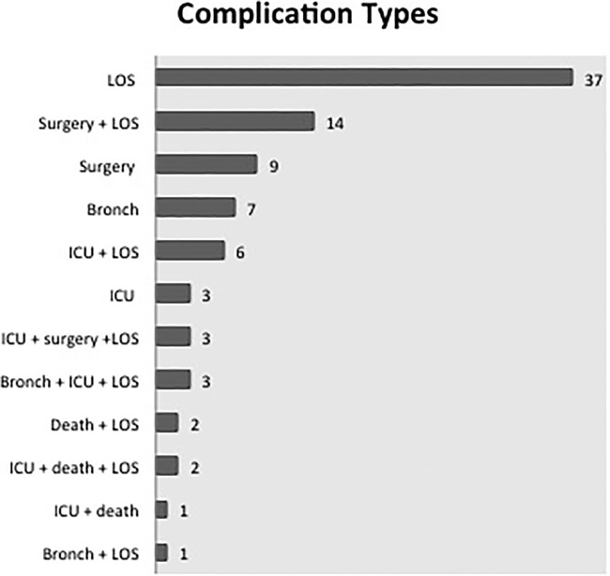
Complications from Airway FB Removal
Greater than one bronchoscopy required for foreign body extraction
ICU admission
Hospital length of stay greater than 24 hours
Time of surgery greater than 1 hour
Sjogren PP, Mills TJ, Pollak AD, Muntz HR, Meier JD, Grimmer JF. Predictors of complicated airway foreign body extraction. Laryngoscope. 2018;128(2):490‐495.
Notes:
Four hundred and fifty cases of airway foreign body extraction with a breakdown of complications. Bronch = greater than one bronchoscopy required for foreign body extraction; ICU = intensive care unit admission; LOS = hospital length of stay greater than 24 hours; surgery = time of surgery greater than 1 hour.
IF THIS IMAGE HAS BEEN PROVIDED BY OR IS OWNED BY A THIRD PARTY, AS INDICATED IN THE CAPTION LINE, THEN FURTHER PERMISSION MAY BE NEEDED BEFORE ANY FURTHER USE. PLEASE CONTACT WILEY'S PERMISSIONS DEPARTMENT ON PERMISSIONS@WILEY.COM OR USE THE RIGHTSLINK SERVICE BY CLICKING ON THE 'REQUEST PERMISSIONS' LINK ACCOMPANYING THIS ARTICLE. WILEY OR AUTHOR OWNED IMAGES MAY BE USED FOR NON-COMMERCIAL PURPOSES, SUBJECT TO PROPER CITATION OF THE ARTICLE, AUTHOR, AND PUBLISHER.

Slide 28
Predictors of Complicated Postoperative Course
Hyper-lucency on CXR
Unwitnessed aspiration
Inability to completely remove all of the fragments of a FB (e.g. peanut)

Slide 29
Initial Airway Management After FB removal
 | Face Mask or LMA | ETT
Airway Edema | - | +
FB Fragments still in Airway | - | +
Significant O₂ Requirement | - | +
Full Stomach | - | +

Slide 30
Postoperative Disposition
Majority are admitted a minimum of 4 hours for monitoring
Consider ICU admission
Prolonged duration of bronchoscopy
Significant airway edema or bleeding
Inability to remove all the FB fragments on initial bronchoscopy

Slide 31
Conclusions:
FB in airway – a major source of preventable accidental mortality & morbidity in children
Anticipate complications
Have a clear, shared airway plan
Communicate with surgical colleagues!

Slide 32
References:
Fidkowski CW, Zheng H, Firth PG. The Anesthetic Considerations of Tracheobronchial Foreign Bodies in Children. Anesthesia & Analgesia. 2010;111(4):1016–1025. doi: 10.1213/ANE.0b013e3181ef3e9c.
Sjogren, P.P., Mills, T.J., Pollak, A.D., Muntz, H.R., Meier, J.D. and Grimmer, J.F. (2018), Predictors of complicated airway foreign body extraction. The Laryngoscope, 128: 490-495. doi:10.1002/lary.26814
Litman RS, Ponnuri J, Trogan I. Anesthesia for tracheal or bronchial foreign body removal in children: an analysis of ninety-four cases. Anesth Analg. 2000;91(6):1389-91.
Liu, Y., Chen, L. and Li, S. (2014), Controlled ventilation or spontaneous respiration in anesthesia for tracheobronchial foreign body removal: a meta‐analysis. Paediatr Anaesth, 24: 1023-1030. doi:10.1111/pan.12469
Foltran, F., Ballali, S., Rodriguez, H., (Sebastian) van As, A.B., Passali, D., Gulati, A. and Gregori, D. (2013), Inhaled foreign bodies in children: A global perspective on their epidemiological, clinical, and preventive aspects. Pediatr. Pulmonol., 48: 344-351. doi:10.1002/ppul.22701
Kendigelen, Pinar .The anaesthetic consideration of tracheobronchial foreign body aspiration in children. Journal of thoracic disease 2016; (2072-1439), 8 (12), p. 3803.
Baram, Aram .Scarf pin-related hijab syndrome: A new name for an unusual type of foreign body aspiration.2017. Journal of international medical research (0300-0605), 45 (6), p. 2078.
P.S.N. Murthy, V.S. Ingle, Edicula George, S. Ramakrishna, Fahim A. Shah.Sharp foreign bodies in the tracheobronchial tree. 2001.American Journal of Otolaryngology, Volume 22, Issue 2,pages 154-156,ISSN 0196-0709
Divisi, D. "Foreign bodies aspirated in children: role of bronchoscopy.". The Thoracic and cardiovascular surgeon 2007.(0171-6425), 55 (4), p. 249.
TOMASKE, M., GERBER, A.C. and WEISS, M. Anesthesia and periinterventional morbidity of rigid bronchoscopy for tracheobronchial foreign body diagnosis and removal. Pediatric Anesthesia, (2006), 16: 123-129. doi:10.1111/j.1460-9592.2005.01714.x
https://www.cdc.gov/injury/wisqars/pdf/leading_causes_of_injury_deaths_highlighting_unintentional_injury_2011-a.pdf

